Slide 1
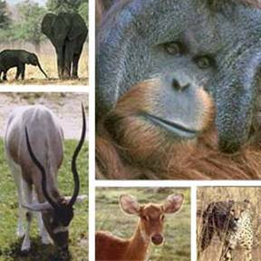
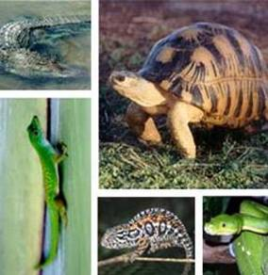
CITES Secretariat
Roles and tasks of the Scientific Authority

Slide 2
Roles of the Scientific Authority
The Scientific Authority has an important role that is essential for the effective implementation of CITES, namely to advise the Management Authority whether export of specimens would be detrimental to the survival of the species in the wild
The Scientific Authority also advises the Management Authority on other scientific matters

Slide 3
Tasks of the Scientific Authority
Tasks specifically imposed by the text of the Convention (1):
Determination that the export of specimens of species included in Appendices I and II is not detrimental to their survival
Article III, paragraph 2.(a) Article IV, paragraph 2.(a)
Determination that the purpose of the import of specimens of a species included in Appendix I is not detrimental to its survival
Article III, paragraph 3.(a)

Slide 4
Tasks of the Scientific Authority
Tasks specifically imposed by the text of the Convention (2):
Determination whether the intended recipient of live Appendix-I specimens is suitably equipped to house and care for them
Article III, paragraph 3.(b)
Determination whether introduction from the sea would be detrimental to the survival of the species involved
Article III, paragraph 5.(a) Article IV, paragraph 6.(a)

Slide 5
Tasks of the Scientific Authority
Tasks specifically imposed by the text of the Convention (3):
Monitor export permits granted and actual exports to ensure that the species is maintained at a level consistent with its role in the ecosystems in which it occurs, and to avoid an Appendix-I listing
Article IV, paragraph 3
This task is frequently ignored!!

Slide 6
Tasks of the Scientific Authority
Tasks of the Scientific Authority included in Resolution Conf. 10.3
Provide advice as to whether or not scientific institutions seeking registration meet the criteria established in Resolution Conf. 11.15 (Rev. CoP12)
Review applications submitted under Article VII, paragraphs 4 or 5 (is the facility capable of captive breeding or artificial propagation?) - also in Resolution Conf. 12.10 (Rev. CoP15)
Gather and analyze information on the biological status of species affected by trade to assist in the preparation of proposals to amend the Appendices
Review proposals to amend the appendices submitted by other Parties

Slide 7
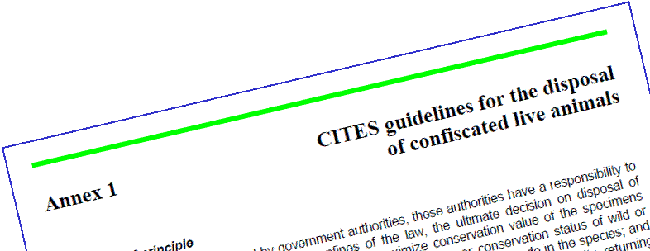
Tasks of the Scientific Authority
Tasks of the Scientific Authority included in Resolution Conf. 10.7 (Rev. CoP15)
Before making a decision on the disposal of confiscated live specimens, the Management Authority must consult with and obtain advice of its own Scientific Authority
The Scientific Authority, in preparing its advice, must follow the guidelines in the two Annexes to Resolution Conf. 10.7 (Rev. CoP15)

Slide 8
Tasks of the Scientific Authority
Tasks of the Scientific Authority included in Resolution Conf. 12.11 (Rev. CoP16)
Interpretation of listings
Consultation with the Animals or Plant Committees as appropriate
Identification of nomenclatural issues that may warrant further review by the appropriate CITES committee and preparation of proposals to amend the Appendices if appropriate
Support and cooperation in the development and maintenance of checklists

Slide 9
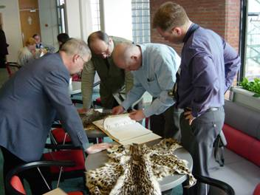
Tasks of the Scientific Authority
Tasks related to implementation at the national level
Identification of specimens
Determining the national status of CITES species
Working with the Animals and Plants Committees of CITES

Slide 10
Structure of Scientific Authorities
The Scientific Authority may exist under various structures:
Government agencies
Scientific institutions
Committees
Individuals
Management Authority is also the Scientific Authority (however, Resolution Conf. 10.3 recommends that: all Parties designate Scientific Authorities independent from Management Authorities)
Supra-national Scientific Authority

Slide 11
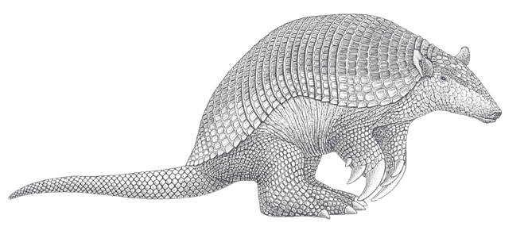
Responsibilities of the Party
Every Party should ensure that when a Scientific Authority is designated, it is in a position to carry out all of its tasks
Every Party should provide logistical and financial support to enable its Scientific Authorities to do their work

Slide 12
CITES Secretariat Geneva

