Slide 1
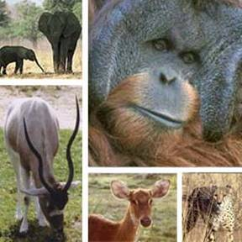
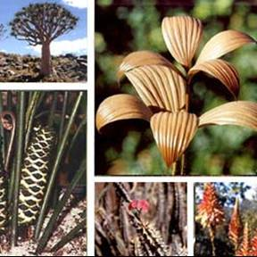
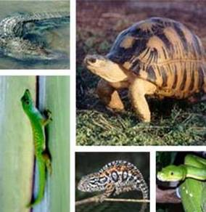
CITES Secretariat
Permits and Certificates

Slide 2
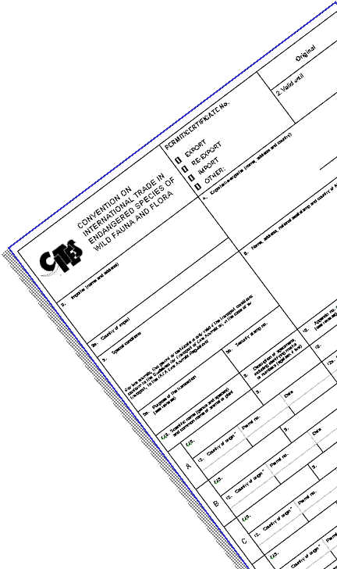
Overview
Permits and certificates
Normal procedures

Slide 3
Permits and certificates

Slide 4
CITES permits and certificates
CITES regulates international trade in specimens of species of wild fauna and flora listed in its Appendices on the basis of a system of permits and certificates which are issued only when certain conditions are met, and which must be presented when leaving and entering a country
For Appendix-II and –III listed species, international trade is permitted but regulated
For Appendix-I listed species, international trade is generally prohibited

Slide 5
CITES permits and certificates
What is a permit?
A conditional authorization
A tangible product, a result of decision-making
A means to deliver information
A record of trade
A conservation tool (the permit system)
A bureaucratic headache

Slide 6
CITES permits and certificates
The permit system
Export permit
Import permit (Appendix I only)
Introduction from the Sea certificate
--------------------------------------------------------------------------------
Export permit (Appendix III)
Re-export certificate
Certificate of Origin (Appendix III)
Pre-Convention certificate
Captive-breeding certificate (for animals)
Artificial propagation certificate (for plants)
Management Authority and Scientific Authority
Management Authority

Slide 7
Normal procedures
Appendix I import
For trade in specimens of Appendix I-listed species, an import permit must be issued before an export permit may be issued
This is to ensure that both the importing and exporting Parties agree on the proposed trade before it occurs, and that particular conditions, only to be determined by the importing country, have been met
This can be considered as a form of ‘prior informed consent’

Slide 8
Normal procedures
Appendix I import
In every case, the import permit may be issued only if:
The purpose of the import will not be detrimental to the survival of the species
The proposed recipient is suitably equipped to house and care for any live specimen
The specimen is not to be used for primarily commercial purposes

Slide 9
Normal procedures
The determination whether trade in Appendix-I specimens is for ‘primarily commercial purposes’ ONLY has to be made for imports
Consequently, the purpose of the export can still be commercial
Examples of primarily commercial purposes are:
profitable scientific or biomedical research
commercial captive breeding
professional traders
circuses
Examples of non-commercial purposes are:
non-profit scientific or medical research
bona-fide captive breeding programmes
non-profit teaching & training
personal hunting trophies
non-profit exhibitions
non-profit zoological gardens

Slide 10
Normal procedures
Appendix I export
Once an import permit is obtained from the Management Authority of the country of import, only then may an export permit be issued by the Management Authority of the country of export
In every case, the export permit may be issued only upon presentation of the import permit, and only if:
the export will not be detrimental to the survival of the species
the specimen was acquired in accordance with national wildlife protection laws
any live specimen will be shipped in a manner which will minimize the risk of injury, damage to health or cruel treatment

Slide 11
Normal procedures
Appendix I re-export
The re-export certificate may be issued only if the specimen was imported in accordance with the Convention
In the case of live specimens:
the preparation and shipment will minimize the risk of injury, damage to health or cruel treatment
a valid import permit was granted by the country of destination

Slide 12
Normal procedures
Appendix II export
For export of Appendix II specimens, the Convention requires an export permit only
The Convention does not require an import permit, and any requirement by a Party for an import permit for Appendix II specimens is a stricter domestic measure, allowed under the provisions of Article XIV
In every case, an export permit may be issued only if:
The export will not be detrimental to the survival of the species
The specimen was acquired in accordance with the national wildlife legislation
Any live specimen will be shipped in a manner which will minimize the risk of injury, damage to health or cruel treatment

Slide 13
Normal procedures
Appendix II re-export
A re-export certificate may be issued only if:
The Management Authority of the country of re-export is satisfied that the specimen was imported in accordance with the Convention
Any live specimen will be shipped in a manner which will minimize the risk of injury, damage to health or cruel treatment

Slide 14
Normal procedures
Appendix III export
For export from the country that included the species in Appendix III, an export permit is required and may be issued only if:
The Management Authority is satisfied that the specimen was acquired in accordance with national wildlife laws
Any live specimen will be shipped in a manner which will minimize the risk of injury, damage to health or cruel treatment
For export from countries that did not include the species in Appendix III a certificate of origin is required
This may only be issued by a Management Authority of the country of origin

Slide 15
Normal procedures
Appendix III re-export
A re-export certificate may be issued only if:
The Management Authority is in possession of the valid original of the export permit or certificate of origin, or the previous re-export certificate
The import was in accordance with the Convention
The re-export certificate must clearly indicate whether the specimen was processed in the State which is issuing the document

Slide 16
Normal procedures
Introduction from the sea
The introduction from the sea of any specimen of a species included in Appendix I shall require the prior grant of a certificate from a Management Authority of the State of introduction
A certificate shall only be granted when the following conditions have been met:
a Scientific Authority of the State of introduction advises that the introduction will not be detrimental to the survival of the species involved;
a Management Authority of the State of introduction is satisfied that the proposed recipient of a living specimen is suitably equipped to house and care for it; and
a Management Authority of the State of introduction is satisfied that the specimen is not to be used for primarily commercial purposes.

Slide 17
Normal procedures
Introduction from the sea
The introduction from the sea of any specimen of a species included in Appendix II shall require the prior grant of a certificate from a Management Authority of the State of introduction
A certificate shall only be granted when the following conditions have been met:
a Scientific Authority of the State of introduction advises that the introduction will not be detrimental to the survival of the species involved; and
a Management Authority of the State of introduction is satisfied that any living specimen will be so handled as to minimize the risk of injury, damage to health or cruel treatment.

Slide 18
Normal procedures
Introduction from the sea
Introduction from the sea certificates may be granted on the advice of a Scientific Authority, in consultation with other national scientific authorities or, when appropriate, international scientific authorities, in respect of periods not exceeding one year for total numbers of specimens to be introduced in such periods

Slide 19
Normal procedures
Introduction from the sea
"Introduction from the sea" means transportation into a State of specimens of any species which were taken in the marine environment not under the jurisdiction of any State
Article I of the Convention
The Conference of the Parties to the Convention AGREES that ‘the marine environment not under the jurisdiction of any State’ means those marine areas beyond the areas subject to the sovereignty or sovereign rights of a State consistent with international law, as reflected in the United Nations Convention on the Law of the Sea
Resolution Conf. 14.6 (Rev. CoP-16), Introduction from the sea

Slide 20
Normal procedures
Introduction from the sea
The term “Transportation into a State” still needs to be defined by the Parties

Slide 21
CITES Secretariat Geneva www.cites.org

