Slide 1




CITES Secretariat
Role of the
Management Authority

Slide 2

Overview
In this session we will review the functions (roles and tasks) of designated CITES Management Authorities

Slide 3
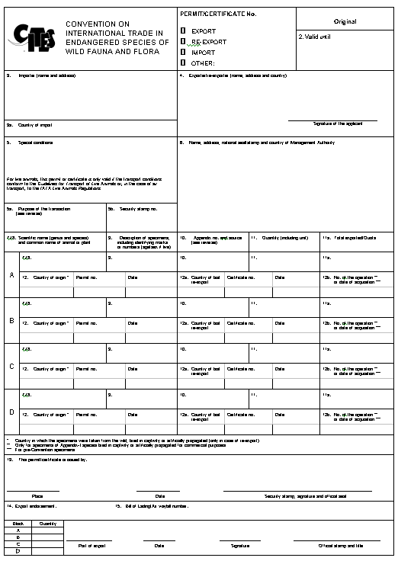
Roles of the Management Authority
The Management Authority has two of the most basic roles:
  granting permits and certificates under the terms of the Convention
  communicating with the CITES Secretariat and other Parties

Slide 4
Tasks of the Management Authority
Tasks specifically imposed by the text of the Convention:
    Articles III, IV and V – permit issuance and acceptance provisions
    Article VI - retaining and cancelling the export permit or re-export certificate and any corresponding import permit presented with imports; marking specimens
    Article VII – determining the applicability of exemptions
    Article VIII – responsibility for confiscated live specimens
    Article IX – communication with the Secretariat and other Parties

Slide 5
Tasks of the Management Authority
Preparation and circulation of official information on CITES
Representing the Party
Education and Information
Training
Co-ordination with other government departments
Enforcement
Communication with traders,
NGOs and the public
Co-ordination with the CITES Secretariat
Co-ordination with the National Central Bureau of Interpol
Preparation of Annual and Biennial Reports
Issuance of permits and
certificates
Communication with the Scientific Authority
Preparation of proposals for the Conference of the Parties

Slide 6

Tasks of the Management Authority
The Management Authority also prepares and circulates official information on CITES to:
  Customs
  Other Border Authorities
  Police
  Authorities in charge of
  internal control
  Health authorities
  Other ministries

Slide 7
Responsibilities of the
Management Authority with respect to the Scientific Authority
The Management Authority MUST consult the Scientific Authority before issuing an export permit for specimens of species in Appendices I & II)
The Management Authority must make sure that it keeps the Scientific Authority informed about all relevant CITES issues

Slide 8
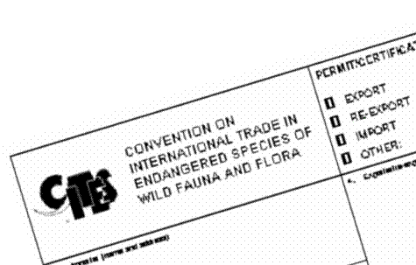
Responsibilities of the
Management Authority with respect to the Scientific Authority
“NOTING that issuance of permits by a Management Authority without appropriate Scientific Authority findings constitutes a lack of compliance with the provisions of the Convention and seriously undermines species conservation”
Resolution Conf. 10.3

Slide 9







CITES Secretariat
Geneva

