Slide 1
Reptiles Working Group – progress report
Group membership: AC Nomenclature Specialist, Austria, Benin, Center for Biological Diversity, Ghana, Germany, Japan, Malaysia, Togo
Considered the Decision Tree methodology useful, but not specific for reptiles, will not be developed by the group
Discussion of terminology and additions to Glossary to be provided to IUCN
Links for Online Tools relevant to creation of NDFs for reptiles were identified
Factors that may be relevant for performing NDFs for reptiles were added to Module 9 (i.e. elusive lifestyle, seasonality, dispersal ability); language was modified in this section in a way to indicate utility rather than requirement of all the factors

Slide 2
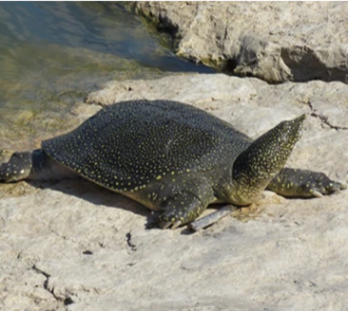
Reptiles Working Group – progress report
Presentation of and discussion on NDF for Varanus salvator and Malayopython reticulatus in Malaysia as case example
Rapid Assessment and Comprehensive Assessment case study were completed and discussed in detail on Trionyx trianguis from Ghana
Broad agreement that rapid NDF template is useful and that there is no need or specific further guidance, noting that scoring will remain subjective
Scoring system was considered very precautionary in case of reptiles
Discussion on ways to conclude on a positive rapid NDF with score ≥ 5
Flowcharts (Fig. 2F and 2G in module2): useful to include an additional column for inserting evaluation of risk/ impact; consolidation of both assessments should be considered

Slide 3
Factor | Assessment may consider | Evaluation for Trionyx triunguis Ghana (Taking into account the source of the specimens)
Species’ biology and life-history characteristics | Intrinsic vulnerability of species or population (reproductive capacity, niche width) | MEDIUM
Species’ range (historical and current) | Distribution and trends | LOW
Population structure, status and trends | Population size / structure/ density and trends (harvest area and nationally) | LOW
Conservation status | Status and trends (global, national, and local scales) | MEDIUM
Threats | Other threats and threat trends | LOW
Harvest overview | Levels and trends in harvest of the species/ types of specimens | LOW
Trade trends | Levels and trends/ types of specimens in trade. | LOW
Benefits to local livelihoods | Do benefits to local people provide an incentive for using the species sustainably | LOW
Factor | Assessment may consider | Evaluation for Trionyx triunguis Ghana
Harvest impacts | Impact of harvest on harvest area, national population and internationally. Consider total volume of harvest (both for domestic and export) and legal and illegal harvest | LOW
Trade impacts | Impact of trade on harvest area, national population and internationally. Consider total volume of trade (domestic and export) trade (known, inferred, projected, estimated). | LOW
Population monitoring | Is a monitoring program in place? Frequently of monitoring depending on species characteristics. Methods for monitoring. | HIGH
Management measures in place/proposed including adaptive management | Harvest management/ compliance / land tenure | LOW
In conclusion, the overall level of risk is LOW and given current circumstances as described above the NDF is POSITIVE.

