Slide 1
Module 1 - progress
Re-worded to make clear the text is non-binding and to avoid use of mandatory terms (needs to be reflected across all modules)
Suggestions made to use ‘offtake’ in preference to ‘harvest’ & to refer to total ‘mortality’ (Note included in module 2 with reference to total offtake).
Note that RC16.7 and Annex 6 of RC9.24 both refer to ‘harvest’ and neither use offtake. Propose sticking with ‘harvest’ with definition in glossary
Terminology changed to ‘NDFs with conditions’ – text added re low confidence in data
Revisions to s4.5 on extinction/threat assessment to expand beyond reference to IUCN Red List only & incorporate other regional and national assessments

Slide 2
Module 1 - progress
Role of spp in ecosystems – amended text & reference to assessing ecosystem services if Parties wish (but beyond strict requirements of Article IV.3)
New section 4.8 on other socio-economic & political risks – including rapidly changes in demand for species
New section (7.3) on data management, storage and analysis – still to complete
More emphasis on importance of monitoring for adaptive management (note existing text in s9.5) with text to add on different sources of monitoring (local communities etc)
Reflect that SAs rarely responsible for AM & will provide a glossary definition for adaptive management
Numerous other edits (some still to complete) – audit table

Slide 3


Questions?

Slide 4
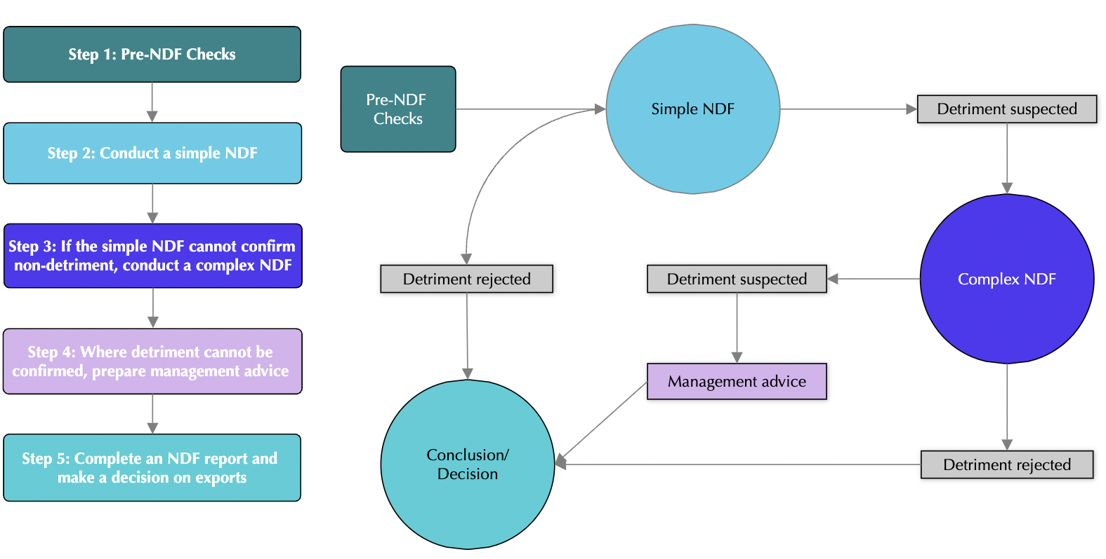
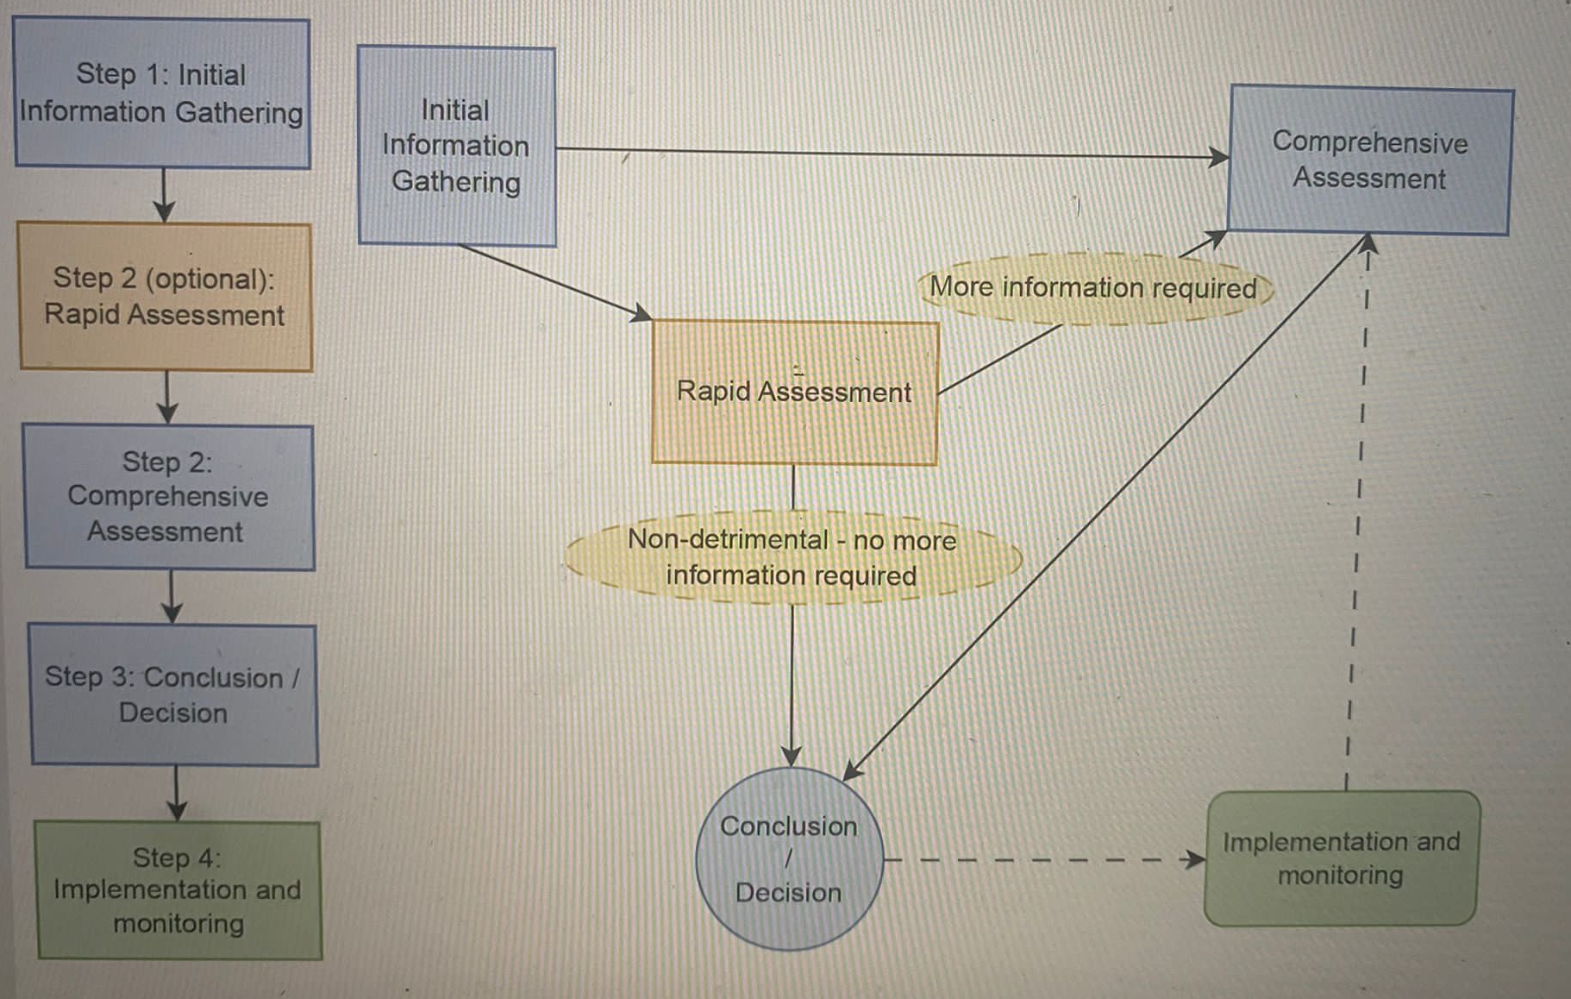
Module 2 - progress

Slide 5
Module 2 - progress

Slide 6
Module 2 - progress

Slide 7
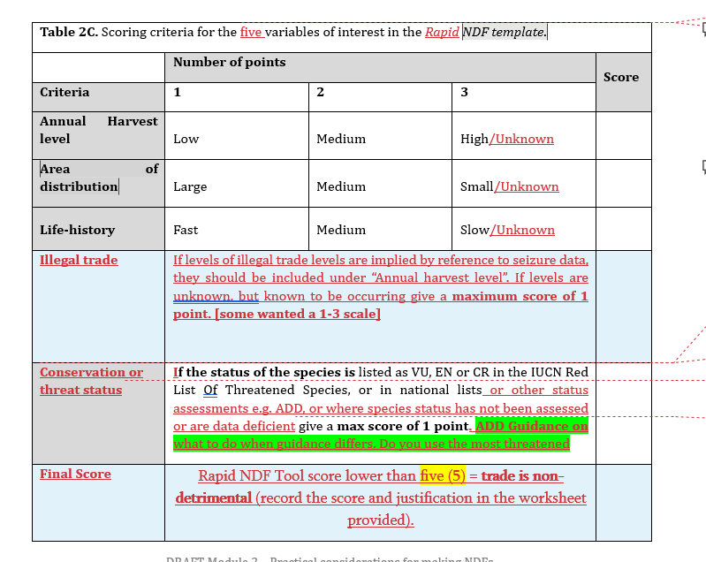
Module 2 - progress
Other variables have been suggested including
Populations density and distribution.
Adaptability to habitat degradation.
Consider connectivity and fragmentation - additional scores / guidance on how to incorporate species with large home ranges. Particularly an issue for migratory species.

Slide 8
Module 2 – Section 6 - Comprehensive
Risk Evaluation
  consider duplication of some factors e.g. harvest and trade in risk and consolidate in Impact.
  Remove Benefits to Livelihoods.
Impact [and management] Evaluation
  Amalgamate ecosystem and role in ecosystem
  ? Include evaluation of decision on livelihoods?

Slide 9
Module 2 – Overall and outstanding
Some overall comments that still need addressing/checking in terms of language and definitions (e.g. harvest to ensure clear that all offtake is included, reduction)
Modules 0 and 2 (possibly 1) still require text to clarify that this is non-binding guidance and that other approaches being effectively applied by Parties remain valid.
Some areas that need further consideration are
Inclusion of additional factors in Rapid Assessment.
Inclusion of Benefits to livelihoods either as a risk factor or in terms of impact evaluation. More comments related to the later but with no consensus on whether or not to include these.
Some guidance figures (would suggest not using the term thresholds) may require further discussion and revision, although in many case the suggestion was to remove these.
Maintaining throughout range and deliberate extirpation in parts of range.
Introductory and explanatory text around Rapid Assessment, including defining areas to consider (when whole country not relevant) and frequency etc. Text needs review to ensure equally applicable to other life forms.
Where better guidance figures have been developed from module discussions, these should be included, but there were some comments that Rapid is not recommended for some taxa.
Wording around source code Y
How to score or incorporate uncertainty or reliability of information used.

Slide 10
Questions?

Slide 11
Module 2 – Mandate part 1!
The working group shall:
1) Consider the draft generic NDF guidance (Modules 1 & 2, including the simple evaluation template), as well as other relevant materials and:
a) Draft improved wording for Module 1 section 4.7 on Governance, policy and management (“M-risk”) as one type of risk to be considered in making NDFs;
b) Review indicators and fields in templates contained in Module 2, ensure coherence with Module 1, and ensure these are sufficiently generic to adapt to any species group;
c) Ensure appropriate representation of NDFs for all relevant trade situations (export, introduction from the sea) in Module 2;
d) Condense the number of steps for each phase of adaptive management (Module 2 section 2.4) to a manageable number (ca. 5 steps per phase);
e) Consider any improvements to the flow diagram for the overall NDF process (Module 2 figure 2A);
f) Consider including checks for any existing trade suspensions in the pre-NDF checks (Module 2, Section 4 and Figure 2B);
g) Consider whether the guidance should retain Option 3 for making NDFs in situations whether species-specific identification is not possible (section 4.1 of Module 2);
h) Insert examples of conversion factors into section 4.5 of Module 2;
i) Consider the risk evaluation phase of making more complex NDFs (Module 2 figure 2F) and the simple NDF template (Module 2, table 2C and figure 2C) and make recommendations on whether and how these two approaches should be reconciled or kept as sequential steps;
j) Add a footnote in Module 2 in relation to the paragraph 1 of section 6.3.5 to caution that the Parties to CITES and CBD differ, and amend the section on benefits of wildlife trade for local livelihoods to impacts of wildlife trade on livelihoods;
k) Consider whether impacts on / benefits to local livelihoods should be maintained as one aspect of the risk assessment phase (Figure 2F and section 6.2.8 of Module 2), or whether these would be better placed as an aspect relevant for species management during impact evaluation (Figure 2G and section 6.3.5);
l) Decide whether section 6.3.5 and Figure 2G (Module 2) should retain a differentiation between harvest impacts and impacts on the role of species in their ecosystems, noting that both concepts would apparently be measured with the same set of guiding questions;
m) Discuss whether paragraph 1 of section 6.3.5 (Module 2) should be retained, noting that it suggests that all CITES listed species can be assumed to currently fulfil all their roles in all their ecosystems;
n) Consider, and if appropriate, develop an evaluation template for steps 6 and 7 of Module 2;
o) Make other improvements to Modules 1 & 2, as appropriate; and
p) Submit revised draft guidance to the Secretariat and IUCN.

Slide 12
Module 2 – Mandate part 2!
The working group shall:
2) Identify a list of definitions for any relevant specialist terms contained in Module 1 & 2 that are not yet contained in the glossary on the CITES website to assist users with applying the NDF guidance, and submit to IUCN.
3) Submit a list of relevant online tools in relation to Modules 1 & 2 to IUCN, for inclusion to Module 12.
4) By Wednesday, 6 December, 3pm, submit a progress report to the Secretariat for plenary review (with 1-2 slides, as appropriate), and by Thursday evening (7 December), submit a presentation of revised draft guidance to the Secretariat for plenary discussion.
5) By Thursday, 7 December, 5pm, submit recommendations to the Secretariat for a feedback mechanism for Parties and the wider CITES community to share experiences with using NDF guidance, and to review and update the NDF materials as may be needed.

