Slide 1
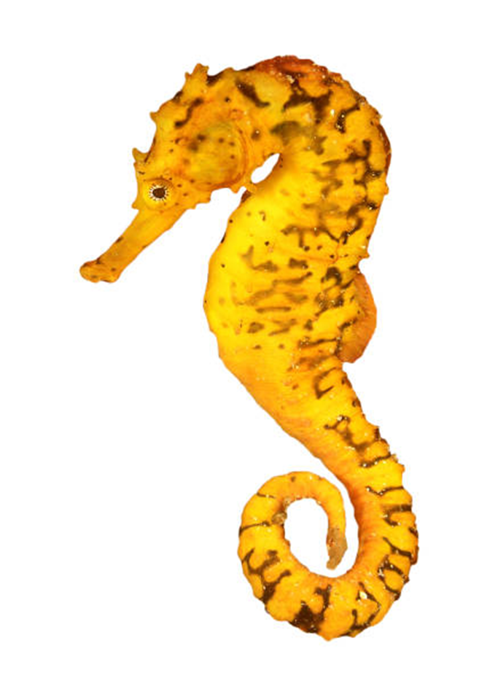
Module 5 Aquatic species – plenary update
As stated in plenary, we are not aiming to rewrite the module, just refine it.
Harmonious and constructive discussions took place, and it was acknowledged having translation contributed to effective operation of the Aquatic Species Working Group.
Several elements of the mandate were identified and agreed to be addressed outside the Working Group, including amendments to Module 5 and alignment to language in Modules 1 and 2.
Additionally, it was agreed that transhipment would be more appropriately discussed at the upcoming workshop on non-detriment findings for specimens of Appendix-II species taken from areas beyond national jurisdiction, and discussions around source code ‘R’ (ranching) were already being considered more widely by Parties.
The WG recognised that there is a significant amount of existing guidance available for aquatic species (e.g. for sharks, seahorses) being used, much adapted for different taxa - a queen conch example (based on timber’s 9 steps) was presented to the group and the eNDF was adapted for sea cucumber NDFs. It was agreed that the Module 5 document serves both as one-stop compendium of resources, and as a useful standalone document that considers key NDF considerations relevant to aquatic species.
Currently, the revised draft is being finalised for circulation and subsequent review by the group tomorrow morning, which the WG will discuss in the afternoon, ahead of presenting to the document to plenary.

Slide 2
Module 5 mandate
Review Module 2, and identify any additional fields that are as a general rule applicable to marine and aquatic species, and that should complement/be considered in addition to those of the Module 2; Reviewed and addressed, see revised document.
Review the simple NDF template (Module 2, table 2C) and consider elaborating taxon-specific thresholds for the criteria within the Simple NDF template for aquatic species in international trade;
  We noted that there is existing guidance and templates that are used, or adapted for use.
Elaborate 1 case study for an aquatic species, using the simple and complex generic NDF approaches as proposed in modules 1 and 2; Queen conch example presented, examples given of NDFs using existing/adapted guidance (sea cucumbers, seahorses)
Propose an option for transforming module 5 from a compendium-style document to an operational tool to support SAs in making NDFs – e.g. consider the usefulness of a decision tree approach similar to module 7 on Terrestrial invertebrates; Report under review, table of key considerations added.
Consider merging section 2.1 CITES NDF website/database and 2.2 eNDF platform into Module 12 and update section on sea cucumber eNDF to include relevant information; Addressed outside the group.
Consider Section 2.3 Simplified guidance documents section to decide if elements should be incorporated into Module 2; a Consider Figure 2 and its explanation in Section 3.1 Use of risk assessments as the starting point of NDFs to decide if elements should be included in Module 2; Mexico has provided a document.
Consider paragraph on stakeholders in Section 3.0 How do address low/poor data situations and Section 3.1.3 Use of Local Ecological Knowledge to decide if any parts should be merged into Module 3 on Local and traditional knowledge; Language aligned

Slide 3
Module 5 mandate: (continued)
Consider module 5, as well as any other relevant materials, to:
j) Formulate improvements to Section 3.1.2 Strategies to improve linkages between fisheries departments and CITES Authorities” in alignment with Res. Conf. 10.3 on the Designation and role of the Scientific Authorities; Discussed and accounted for in revised document.
k) Consider shortening Section 3.4 on How to account for other sources of mortality of listed species to retain key points and formulate recommendations on how to consider other sources of mortality when making NDFs; Not considered necessary, ghost fishing added.
l) Consider merging Section 3.5 Monitoring to inform NDFs for adaptive management (including its subsections) with Module 2 and only retain information related to aquatic species; Addressed outside the group.
m) Condense Section 3.6.3 Trans-shipment and formulate recommendations, if possible; Addressed outside the group.
n) Consider merging Section 3.6 Shared stocks, IFS and the role of Regional Fisheries Bodies in making NDFs and Sub sections of Section 3.10 Geographic scale of NDFs into a single heading and include recommendations on role of RFMO/Bs; Considered but kept separate. Linkage referenced in the text.
o) Consider Section 3.9.1 Ranched species – source code R and identify guidelines for application of source code R for marine species; Addressed elsewhere.
p) Recommend three take-away lessons for SAs for each section of module 5; Could not extract three messages more important than others, uncertainty why three?
Consider draft guidance on queen conch, if available; and Considered
Make other improvements to module 5, as appropriate. Undertaken, revised draft to be presented.

