Slide 1



CITES NDF Workshop
Nairobi, 4 – 8 December 2023
Notes:
Good morning everyone…
Thank you for inviting us today to present this exciting new project on the livelihood implication of reptile trade in Indonesia
My name is Dan Natusch – I’m an ecologist, and managing Director of EPIC Biodiversity, a small consultancy company that works on sustainable development projects and applied research with the aim of safeguarding biodiversity.
We are going to be splitting our presentation today between the two of us, so I will let Jess introduce herself now……...
JESS
Hello my name is Jessica Lyons
I am a principal scientist with EPIC Biodiversity … and the lead researcher on this project
Some background information on myself …I am a member of the IUCN Boa and Python Specialist Group … and the Monitor Lizard Specialist Group … and i have conducted research on reptiles and other species in several countries … but mainly in South-east Asia and Oceania
I completed my Masters in Indonesia on the trade of reptiles in Papua and West Papua
I have also undertaken several livelihoods studies … similar to this one … in Malaysia, Viet Nam and Thailand
I will pass you back to Dan now ….
At EPIC we collaborate with the luxury industry to work on strategic and sustainable material sourcing for a range of products – from reptile skins, cashmere, wool, cotton, bovine and ovine leather, coloured gemstones, mined minerals and so on.
But our major passion is wildlife. And in this capacity we do a lot of work with IUCN – as individuals we are members of several IUCN Specialist Groups – and have written policy documents on the implementation of CITES and conduct numerous capacity development exercises teaching government regulators how to implement wildlife trade regulations.
In our experience, trying to do biodiversity conservation and make lasting change on the ground… understanding the needs and motivations of local people, and then designing intervention that WORK for people, is the most critical aspect of any conservation program.
Hence the importance of the project we are about to present.

Slide 2

PROPOSED GUIDANCE STRUCTURE
MAIN (GENERIC) NDF GUIDANCE
SPECIFIC APPENDICES
Module 3: Local and Traditional Knowledge
Module 0: General NDF Introduction
Module 4: Appendix I Imports
Module 5: Aquatic Species
Module 1: NDF Principles and Concepts
Module 2: NDFs in Practice
Module 6: Migratory Species
Module 7: Terrestrial Invertebrates
Module 8: Birds
Module 9: Reptiles
Module 10: Timber
Module 11: Plants
Module 12: Certifications and Online Tools
CASE STUDIES

Slide 3
Online Workstream Personnel
Original workstream | Workstream Lead Consultant | Output
WG-1: Generic | Thomasina Oldfield | Module 1: Principles and Concepts Module 2: NDFs in Practice
WG-2: Adaptive management | Vin Fleming | Module 1: Principles and Concepts Module 2: NDFs in Practice
WG-3: Traditional Knowledge | Dilys Roe | Module 3: Traditional knowledge
WG-4: Appendix I Imports | Ron Orenstein | Module 4: Appendix I Imports
WG-5: Aquatic species | Matthew Gollock | Module 5: Aquatic species
WG-6: Migratory species | Adrian Lombard | Module 6: Migratory species
WG-7: Terrestrial invertebrates | Ernest Cooper | Module 7: Terrestrial invertebrates
WG-8: Birds | Amy McDougall | Module 8: Birds
WG-9: Reptiles | Lee Fitzgerald | Module 9: Reptiles
WG-10: Timbers | Sara Oldfield | Module 10: Timbers
WG-11: Plants | Danna Leaman (Oliver Tallowin) | Module 11: Plants
WG-1: Generic | Thomasina Oldfield + IUCN | Module 12: Online tools and certification
IUCN Core Team
Dr. Daniel Natusch (present)
Dr. Oliver Tallowin (present)
Dr. Richard Jenkins (not present)

Slide 4
SUMMARY OF ONLINE WORKSTREAMS
KEY FACTS
At least two online meetings per workstream (some groups held > 5 meetings in varying capacities)
Workstream’s focused on what they considered to be (a) the largest gaps in NDF guidance, and (b) information most important for simplification and explanation.
The diversity in materials produced by each workstream reflects the diversity of organisms dealt with by CITES, as well as the diversity of ways to undertake NDFs
IUCN and the CITES Secretariat edited the submitted guidance documents

Slide 5
CORE NDFs: MODULES 1 + 2 OVERVIEW
Module 1 – Principles of NDFs
Module 0: General NDF Introduction
Guidance material focused on overarching theory and principles.
Includes all sections on Role of the species in the ecosystem, Risk, Precaution, uncertainty, adaptive management, etc
Module 1: NDF Principles and Concepts
Module 2: NDFs in Practice
Module 2 – Practical considerations for making NDFs
Practical steps for completing an NDF, separated into:
  Pre-NDF checks
  Simple NDF
  Complex NDF (risk and impact evaluation)
  Conclusion/Decision

Slide 6
APPENDICES: MODULES 3 – 12
SPECIFIC APPENDICES
Module 3: Local and Traditional Knowledge
Module 4: Appendix I Imports
Module 5: Aquatic Species
Module 6: Migratory Species
Module 7: Terrestrial Invertebrates
Module 8: Birds
Module 9: Reptiles
Module 10: Timber
Module 11: Plants
Module 12: Certifications and Online Tools

Slide 7
MODULE 3 – TRADITIONAL KNOWLEDGE
The workstream recognised and included in the draft guidance the wide variety of terms and understandings of "local knowledge" "indigenous knowledge" "traditional knowledge" etc. For the purposes of the guidance, we settled on the term ‘local and traditional knowledge’ as per CITES Decision 18.300
The workstream included a focus on participatory monitoring as a key mechanism for collecting and utilising local and traditional knowledge
The workstream summarised how local and traditional knowledge has been incorporated into a range of global and national level scientific assessments as well as into existing NDFs
A key focus was on the different opportunities and challenges associated with incorporating local and traditional knowledge - recognising it is not always appropriate, not always available, and can be methodologically challenging to collect
A key conclusion was that when it is available and accessible local and traditional knowledge can be relevant at all stages of the NDF process – from scoping to remedial actions.

Slide 8
MODULE 4 – APPENDIX I IMPORTS
Lack of guidance on the assessment to be done as required in terms of Article III 3. a) a Scientific Authority of the State of import has advised that the import will be for purposes which are not detrimental to the survival of the species involved.
Key issues the workstream discussed were:
  Specific aspects that require clarification during discussions – with some members of the workstream of the view that detailed examination of the purpose of import is not useful.
  The SA in the importing country should make its own finding / independent finding, taking into consideration various sources of information, including information from exporting Parties such as the NDF (if available).
  Although the Scientific Authority prepares the NDF, guidance should also address the Management Authority’s determination as to whether an NDF was required (e.g., if a stricter domestic measure prohibited import, or if an Article VII exemption applied.
  The WG decided to present our guidance in the form of a tabular decision tree with explanatory notes, based in part on a risk assessment approach.
  **The material produced by this workstream underwent additional consideration and was adapted by the CITES Secretariat and several Parties after the workstream concluded.

Slide 9
MODULE 5 – AQUATIC SPECIES
The workstream discussed an expanded list of key themes and species for which NDF materials existed and were needed, and this was populated with relevant links and case studies.
There was a particular focus on how to address limited resource and/or capacity, for example, use of simplified guidance documents or automated systems, such as the shark eNDF platform.
Identifying where information may already exist was a key theme in the document, and this may be about creating connections between government departments overseeing CITES and those managing fisheries, or utilising Local and Traditional Knowledge.
Accounting for mortality other than targeted harvest, whether this is by-catch or non-fisheries impacts, was examined.
Developing NDFs beyond just domestic waters, either in ABNJ and/or in the context of developing regional NDFs for migratory species were considered.

Slide 10
MODULE 6 – MIGRATORY SPECIES
The workstream considered the following key points to be of importance when undertaking NDFs and targeted their guidance accordingly:
  The complexity of NDFs relating to Migratory and Transboundary Species is increased as populations are shared across two or more national jurisdictions. Similarly, other legislation, apart from CITES, must be considered, including other MEAs and regional agreements or legislation.
  Harmonization and collaboration between national Scientific Authorities, with the support of the CITES Secretariat, should be encouraged.
  Considerations were discussed around point of harvest and monitoring of offtake, and broader evaluation of scientific methodology for establishing and monitoring harvests.
  Correct understanding and application of the Precautionary Approach, to manage, not prevent, harvests was discuss and guidance provided.
  The “function” of Migratory and Transboundary species within ecosystems, including human-modified ecosystems, is disproportionate to that of other species, and requires evaluation. Several examples and considerations were provided.

Slide 11
MODULE 7 – TERRESTRIAL INVERTEBRATES
Out of approximately 8 million species that may be considered terrestrial invertebrates—80% of multicellular life on earth—only approximately 200 species have been listed on the CITES Appendices.
The listed species represent four separate classes from three different phyla and vary significantly in biology. Guidance for completing NDFs applicable to all terrestrial invertebrates will therefore be generic in nature.
The vast majority of CITES-listed terrestrial invertebrates in trade are captive-bred, simplifying the NDF process. The exception are scorpions in the genus Pandinus, which are traded almost exclusively as wild-caught specimens. This highlights the need for a taxonomic revision of the genus, and prioritization of field studies on Pandinus.
Identification of the species being traded is critical to the NDF process. Identification of living specimens of terrestrial invertebrates may be especially challenging as specimens are typically live, and may involve large numbers of specimens of mixed species of tiny newly hatched juveniles which may be extremely challenging to identify.
The guidance developed by the group for completing NDFs for wild specimens focused on assessing the risk posed by the species geographic distribution, population size and distribution, habitat and food specificity, reproductive output and adult longevity.
Two cases studies were created.

Slide 12
MODULE 8 – BIRDS
The workstream utilized the NDF flow that has now been inserted into the Generic Guidance, showing the NDF process.
A process of pre-NDF checks, Simple NDF, followed by Complex NDFs was followed – with taxon-specific considerations provided at each step in the NDF-making process.
The guidance included a number of considerations that were generic in nature (i.e., not specific to birds). Several of these were moved to Modules 1 or 2, where appropriate.
The group included a range of species-specific methods for surveying and monitoring birds.

Slide 13
MODULE 9 – REPTILES
The overarching objective of the Reptiles Workstream was to develop general guidelines for NDFs that would be applicable to the broad spectrum of scenarios for reptiles in trade, ranging from small numbers of an un-studied species to long-term, high volume trades in crocodilians, lizards, turtles, and snakes.
The WG developed guiding principles focusing on Life History Traits, Geographic Range and Distribution, and Volume of Trade.
Much of the group’s original work was transferred into the Module 1 on Principles
Based on the guiding principles, a Simple NDF Template was developed. The simple NDF template allows some species to be “ruled out”, allowing Parties to focus energy and resources on species that are in genuine need of more detailed NDFs. The simple NDF template includes the provision of scores for four basic criteria, scored 1 to 3: Annual harvest Level; Life history traits; Area of Occupancy; Illegal trade and Threat status.
Guidance on the types of additional information that can be used for complex NDFs is provided.
Methods for surveying for and monitoring reptiles was summarised
A large number of case studies were produced using the Simple NDF Template

Slide 14
MODULE 10 – TIMBERS
There is already a wealth of experience in NDF development for timbers with background materials available. The workstream provided further case studies.
Standard silvicultural and forest management practices are widely in place to inform NDFs and technical guidance on sustainable forest management is generally available.
Collecting species inventory data can be resource intensive and is a limiting factor in NDF development – the workstream suggested a focus on areas of current exploitation.
Forest Management Units generally recommended as basis for NDF formulation.
The workstream discussed that it would be inappropriate to set thresholds for determining sustainable levels of timber in relation to developing an NDF.
NDFs should be based on quantitative considerations and also take into account the rigour and validity of the forest management provisions.

Slide 15
MODULE 11 – PLANTS
The plant workstream decided early-on that there was not a need to ‘re-invent the wheel’, and that the 9-Steps Guidance for Plants was a robust framework on which to base NDFs.
For the above reason, the workstream focused on recommendations to strengthen that existing guidance.
In particular, the workstream developed a draft matrix related to the biological risk of wild harvest for different plant parts (e.g., branches, roots, etc) and the life-form from which they came (e.g., perennial, annual, tree, etc).

Slide 16
MODULE 12 – ONLINE TOOLS AND CERTIFICATIONS
This module includes information originally created as part of Workstream 1 on Generic Guidance, which was moved into a separated module because of its continuously-evolving nature.
Focused on two areas:
  Online tools such as the shark e-NDF tool, 9 steps website, guidance and tools, etc, and
  The usefulness of existing certification schemes, the data generated by them, and their utility for assisting with the making of NDFs.

Slide 17
Questions?

Slide 18
MODULE 1&2: Deep dive

Slide 19
MODULE 1

Slide 20
MODULE 1 – PRINCIPLES AND CONCEPTS:
NDF & role of species in ecosystems
Provides guidance on what constitutes a Non-Detriment Finding
Considers how the provisions of Article IV.3 – the role of the species in its ecosystems – might be implemented.
Notes that whilst this is a separate assessment from that of an NDF it is still required (even if it is often overlooked) & is integrated in the guidance as part of the impact evaluation
Examples provided of different roles & functions of species in their ecosystems – note excludes any assessment of ecosystem services – and of the geographical extent for consideration & which parameters an SA might assess.
In the absence of better information, impacts might have to be assumed – the need for better information might be linked to the degree of risk (see later)

Slide 21
MODULE 1 – risks & uncertainty
NDFs are often considered as risk assessments. The module addresses how risk & uncertainty can be assessed, differentiated & applied when making NDFs
Risks can be linked inter alia to life history traits, extinction rates, levels of harvest, governance, policy & management.
Risks are issues / events that can be anticipated with confidence, sometimes on known time and spatial scales, & their probability and impact can be predicted; steps can then be put in place to mitigate them.
Uncertainties, by contrast, are typically novel or unexpected ‘wildcard’ events that can’t be anticipated nor mitigation planned in advance
Biological variables tend to be better known & identified as risks; uncertainties more likely to be social, economic, political & legal variables

Slide 22
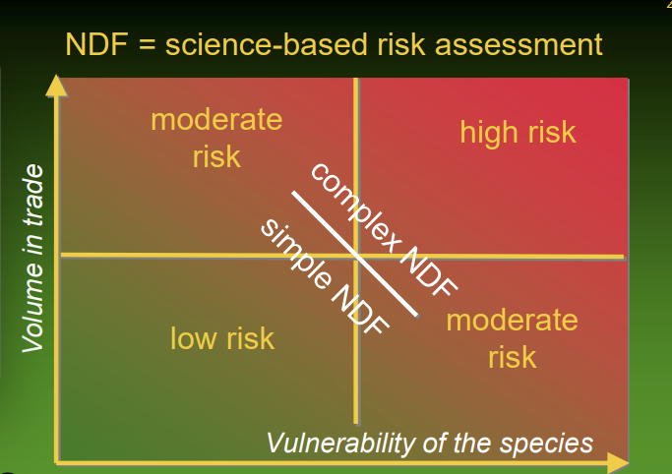
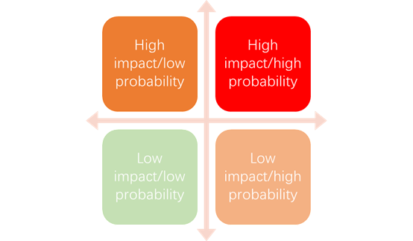
MODULE 1 – risks & uncertainty

Slide 23
MODULE 1 – precaution
Precaution is a means to respond to and mitigate risks (& uncertainty) – so an analysis of these is necessary
The precautionary approach was developed in the 1990s and has been applied widely in many MEAs. No explicit reference in CITES but arguably implicit in Articles II, III & IV & reference in Res Conf 9.24 & 16.7
Using the interpretation in CITES, we suggest here that precautionary measures should be proportionate to the risks to the species and be in the best interest of the species
Taking a precautionary approach does not mean that if any risks are identified, a positive NDF cannot be made or that trade or harvests need to be halted – precautionary measures can be adapted in proportion to the risk

Slide 24
MODULE 1 – conditional NDFs
This term is often used when an NDF has been made subject to (precautionary) conditions by the exporting Scientific Authority – these conditions are to mitigate risks & increase probability a harvest is sustainable
Examples of such safeguards & conditions are provided (with pros and cons) including quotas, size limits, spatial-temporal closures, limiting effort etc.
Notes that most NDFs are made under conditions of limited quantity & quality of data (and of limited capacity) – gaps in knowledge are inevitable & full knowledge is never achievable
Recall Res Conf 16.7 – data requirements proportionate to vulnerability (or risks) to species concerned. If a low risk NDF, don’t need exhaustive information
Means to improve SA capacity & data availability suggested – adaptive management one way to achieve the latter

Slide 25
MODULE 1 – adaptive management
Or ‘learning by doing’ – adaptive management (AM) takes a structured iterative approach to making the best decisions possible, despite risks, uncertainty and imperfect knowledge, whilst simultaneously accruing critical new information to inform, test and improve future management
The intention of AM is to achieve desired objectives whilst accounting for known risks & learning, through monitoring, about the significance of each risk.
A feedback loop based on monitoring, is integral to the dynamic approach implemented
Need for AM depends on risk – might be no need for a full AM approach for a low risk NDF.
Ability to respond rapidly to changing circumstances is an essential element of AM

Slide 26
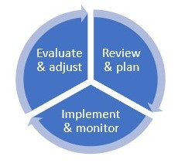
MODULE 1 – adaptive management
Three discrete steps – elaborated in module 2 – in feedback loop
1 Review & plan – assess current knowledge & risks, set goals & objectives, agree management & monitoring plan
2 Implement & monitor
3 Evaluate & adjust – take results from monitoring to review & revise the plan to move towards objectives with greater confidence

Slide 27
MODULE 2

Slide 28
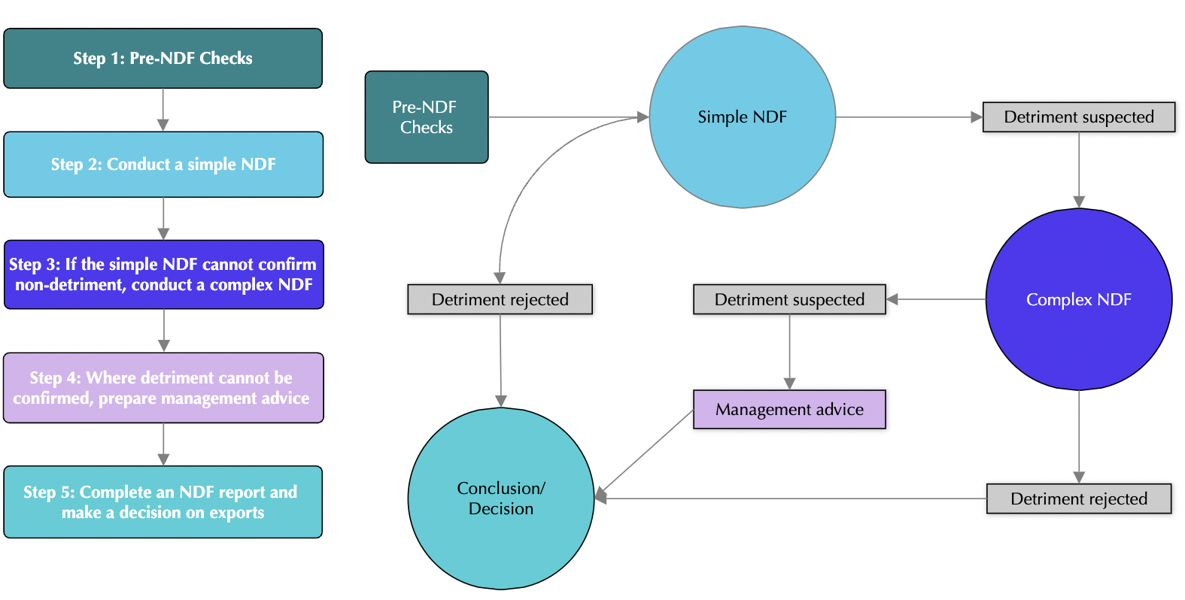
MODULE 2 – NDF 5-STEP PROCESS

Slide 29
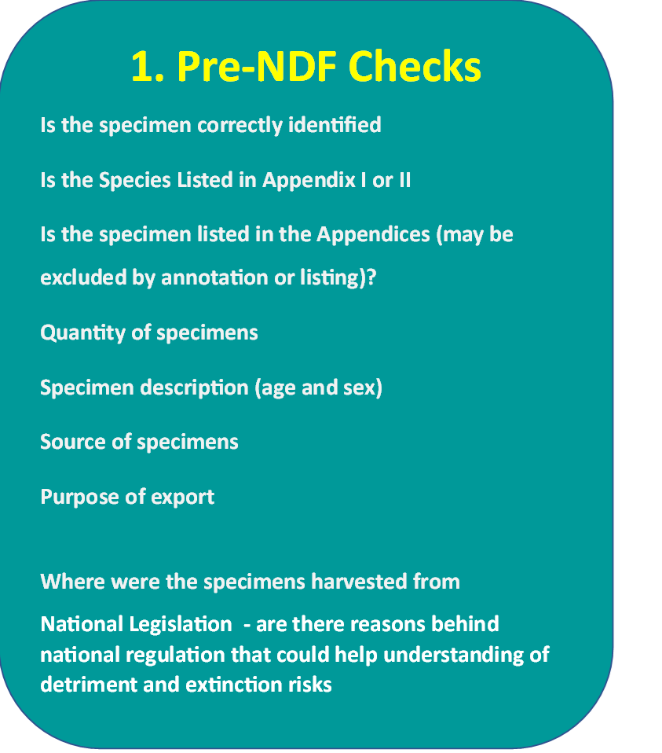
STEP 1 – PRE-NDF CHECKS

Slide 31
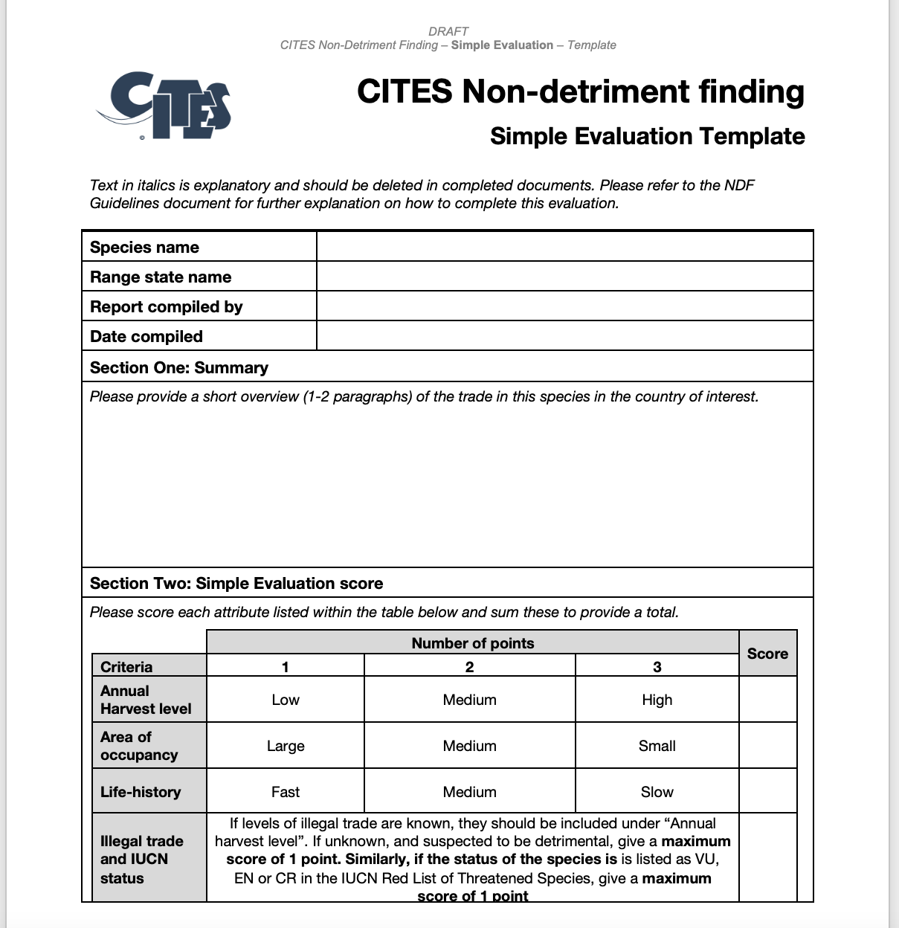
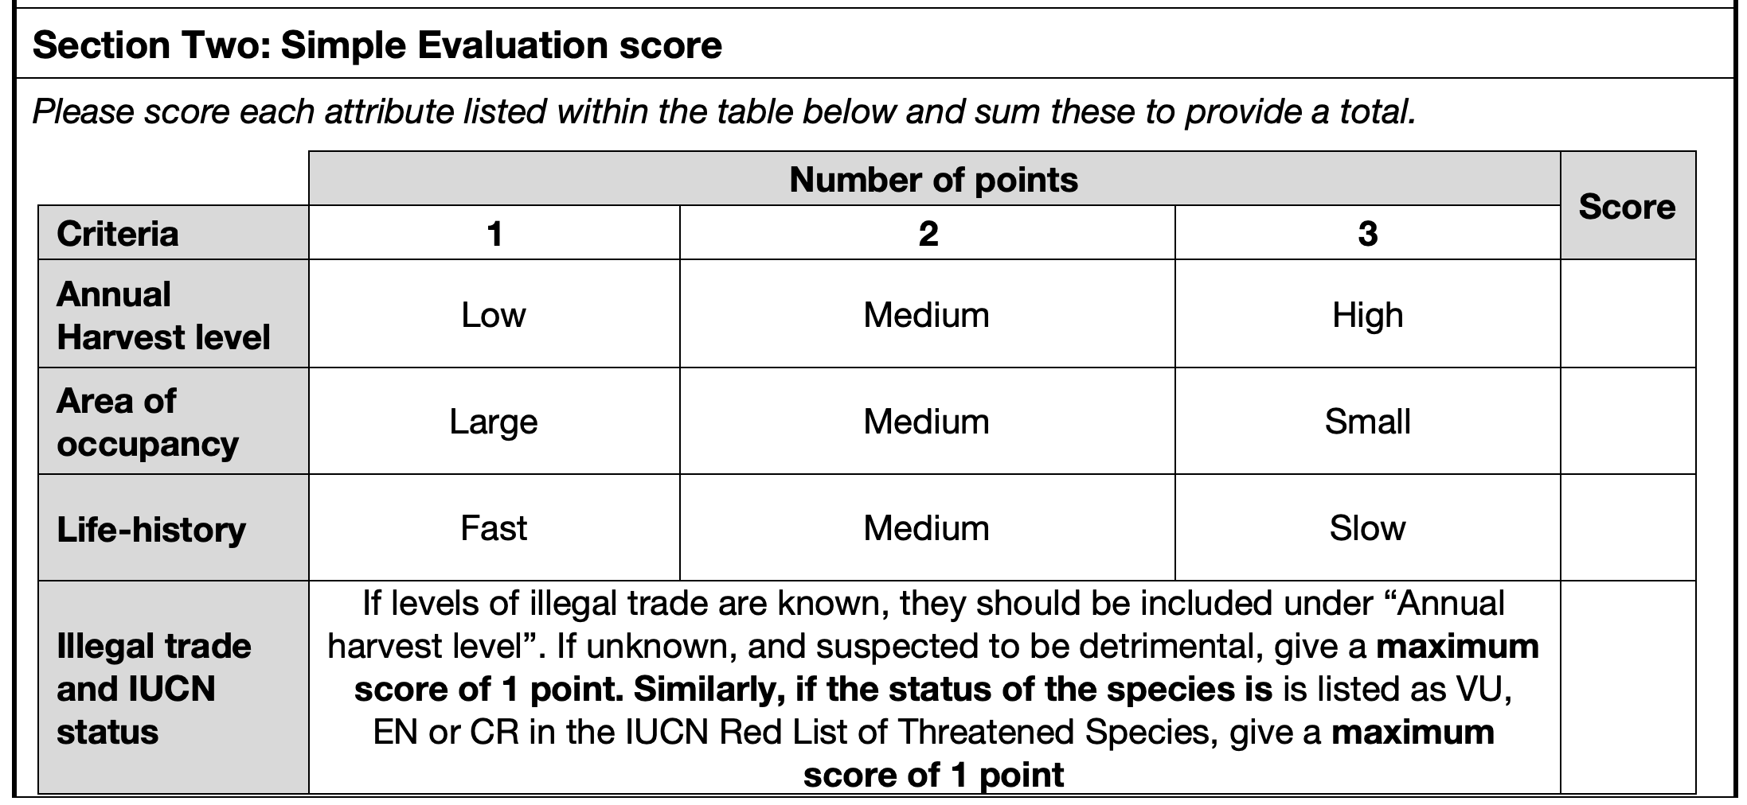
STEP 2 – SIMPLE NDF

Slide 32
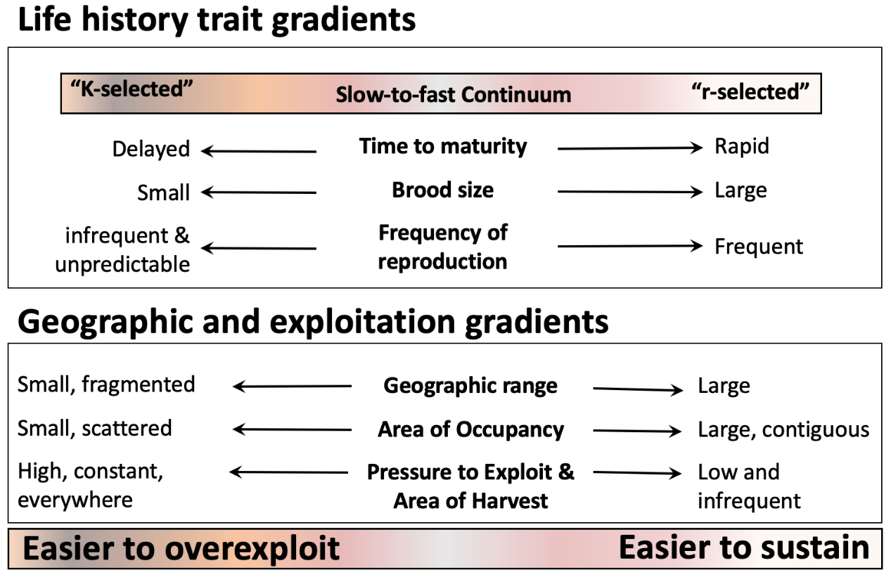
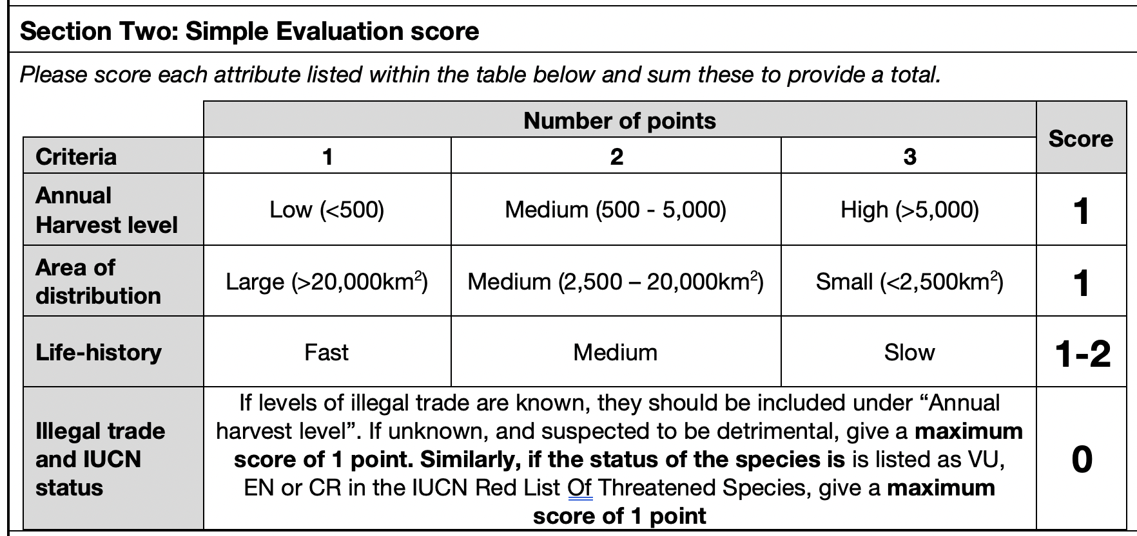
STEP 2 – SIMPLE NDF
KEY FACTS
- Inherently conservative
- Threshold values should be specific to the species groups of interest
- The task of writing a justification for each of the scores given is critical to the process
- Scores of 5 or more require a more complex NDF to be undertaken

Slide 33
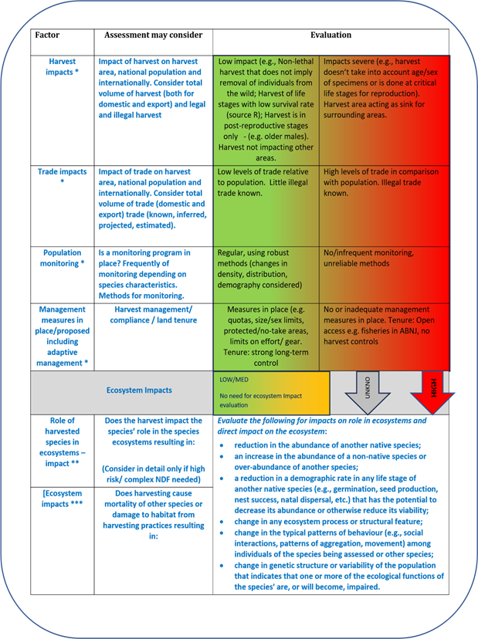
MODULE 2 – NDF PROCESS COMPLEX

Slide 34
STEP 3A – RISK EVALUATION

Slide 35
STEP 3A – RISK EVALUATION

Slide 36
STEP 3B – IMPACT EVALUATION

Slide 37
STEP 3B – IMPACT EVALUATION

Slide 38
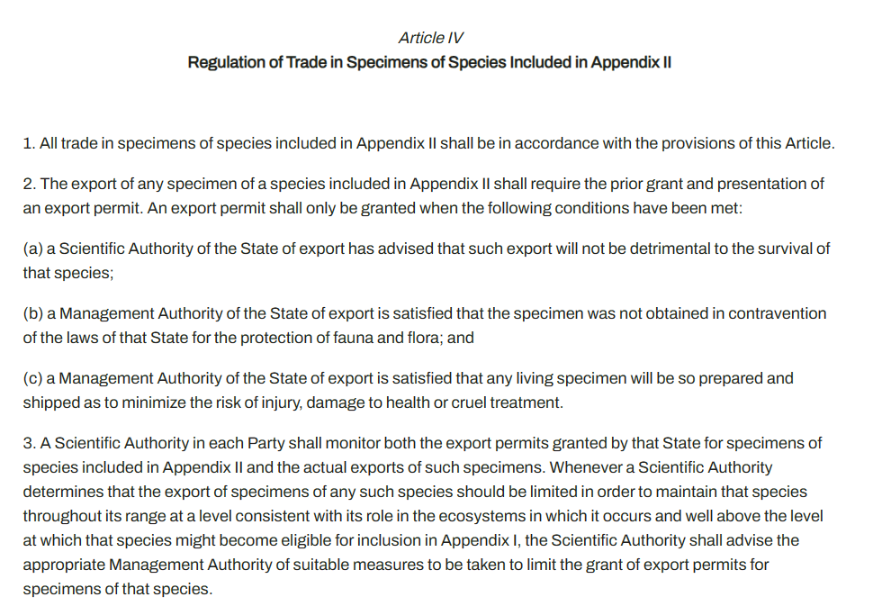
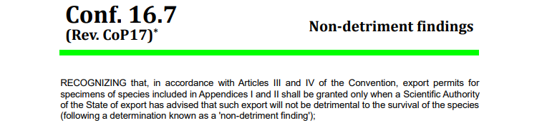
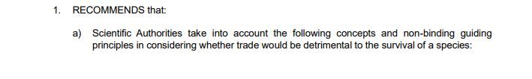
IMPACT EVALUATION –ROLE in Ecosystems
assume if there is a viable population (of the species distributed over as much of its range as possible and it is being sustainably harvested, this is a good enough proxy to accept that the species is maintaining its roles in the ecosystem(s).
in higher risk situations (as evaluated as part of the NDF process) further consideration/more rigorous assessment could be made.

Slide 39
STEP 4+5 – MANAGEMENT ADVICE AND FINAL DECISION
Ø Positive; meaning that export will be non-detrimental and the Scientific Authority advises the Management Authority as such;
Ø Negative; meaning exports may be detrimental, or more information is required, and thus should not be approved; or
Conditions or Remedial Actions
meaning a positive NDF is made subject to certain conditions being in place, which are intended to mitigate defined risks and ensure sustainability of harvests, or
changes that would be necessary before a positive NDF is given.

Slide 40
MODULE 2 – OTHER GENERAL GUIDANCE
Geographic focus of assessment
primarily on the harvest site but considered in relation to species and its harvest nationally and internationally.
some SAs make whole country NDFs often resulting in National Annual Quotas.
NDFs for harvest of migratory species should ensure that harvest from the area in question does not impact negatively on other parts of the species’ range, including in other jurisdictions.
Frequency
Case by case basis when permits are submitted, or on annual or even less frequent basis (but exports should be tracked to ensure that harvest is not being exceeded).
For AP or CB one off NDF of the acquisition of the founder stock for a facility is necessary, unless further wild harvest augments the breeding stock, in which case NDFs for the stock introduced from the wild will be necessary. Monitoring needed to ensure no laundering.
Relationship with export quotas
guidance made on relationship between quotas and NDFs. A quota should be based on a robust scientific NDF.

Slide 41
Questions?

