Slide 1
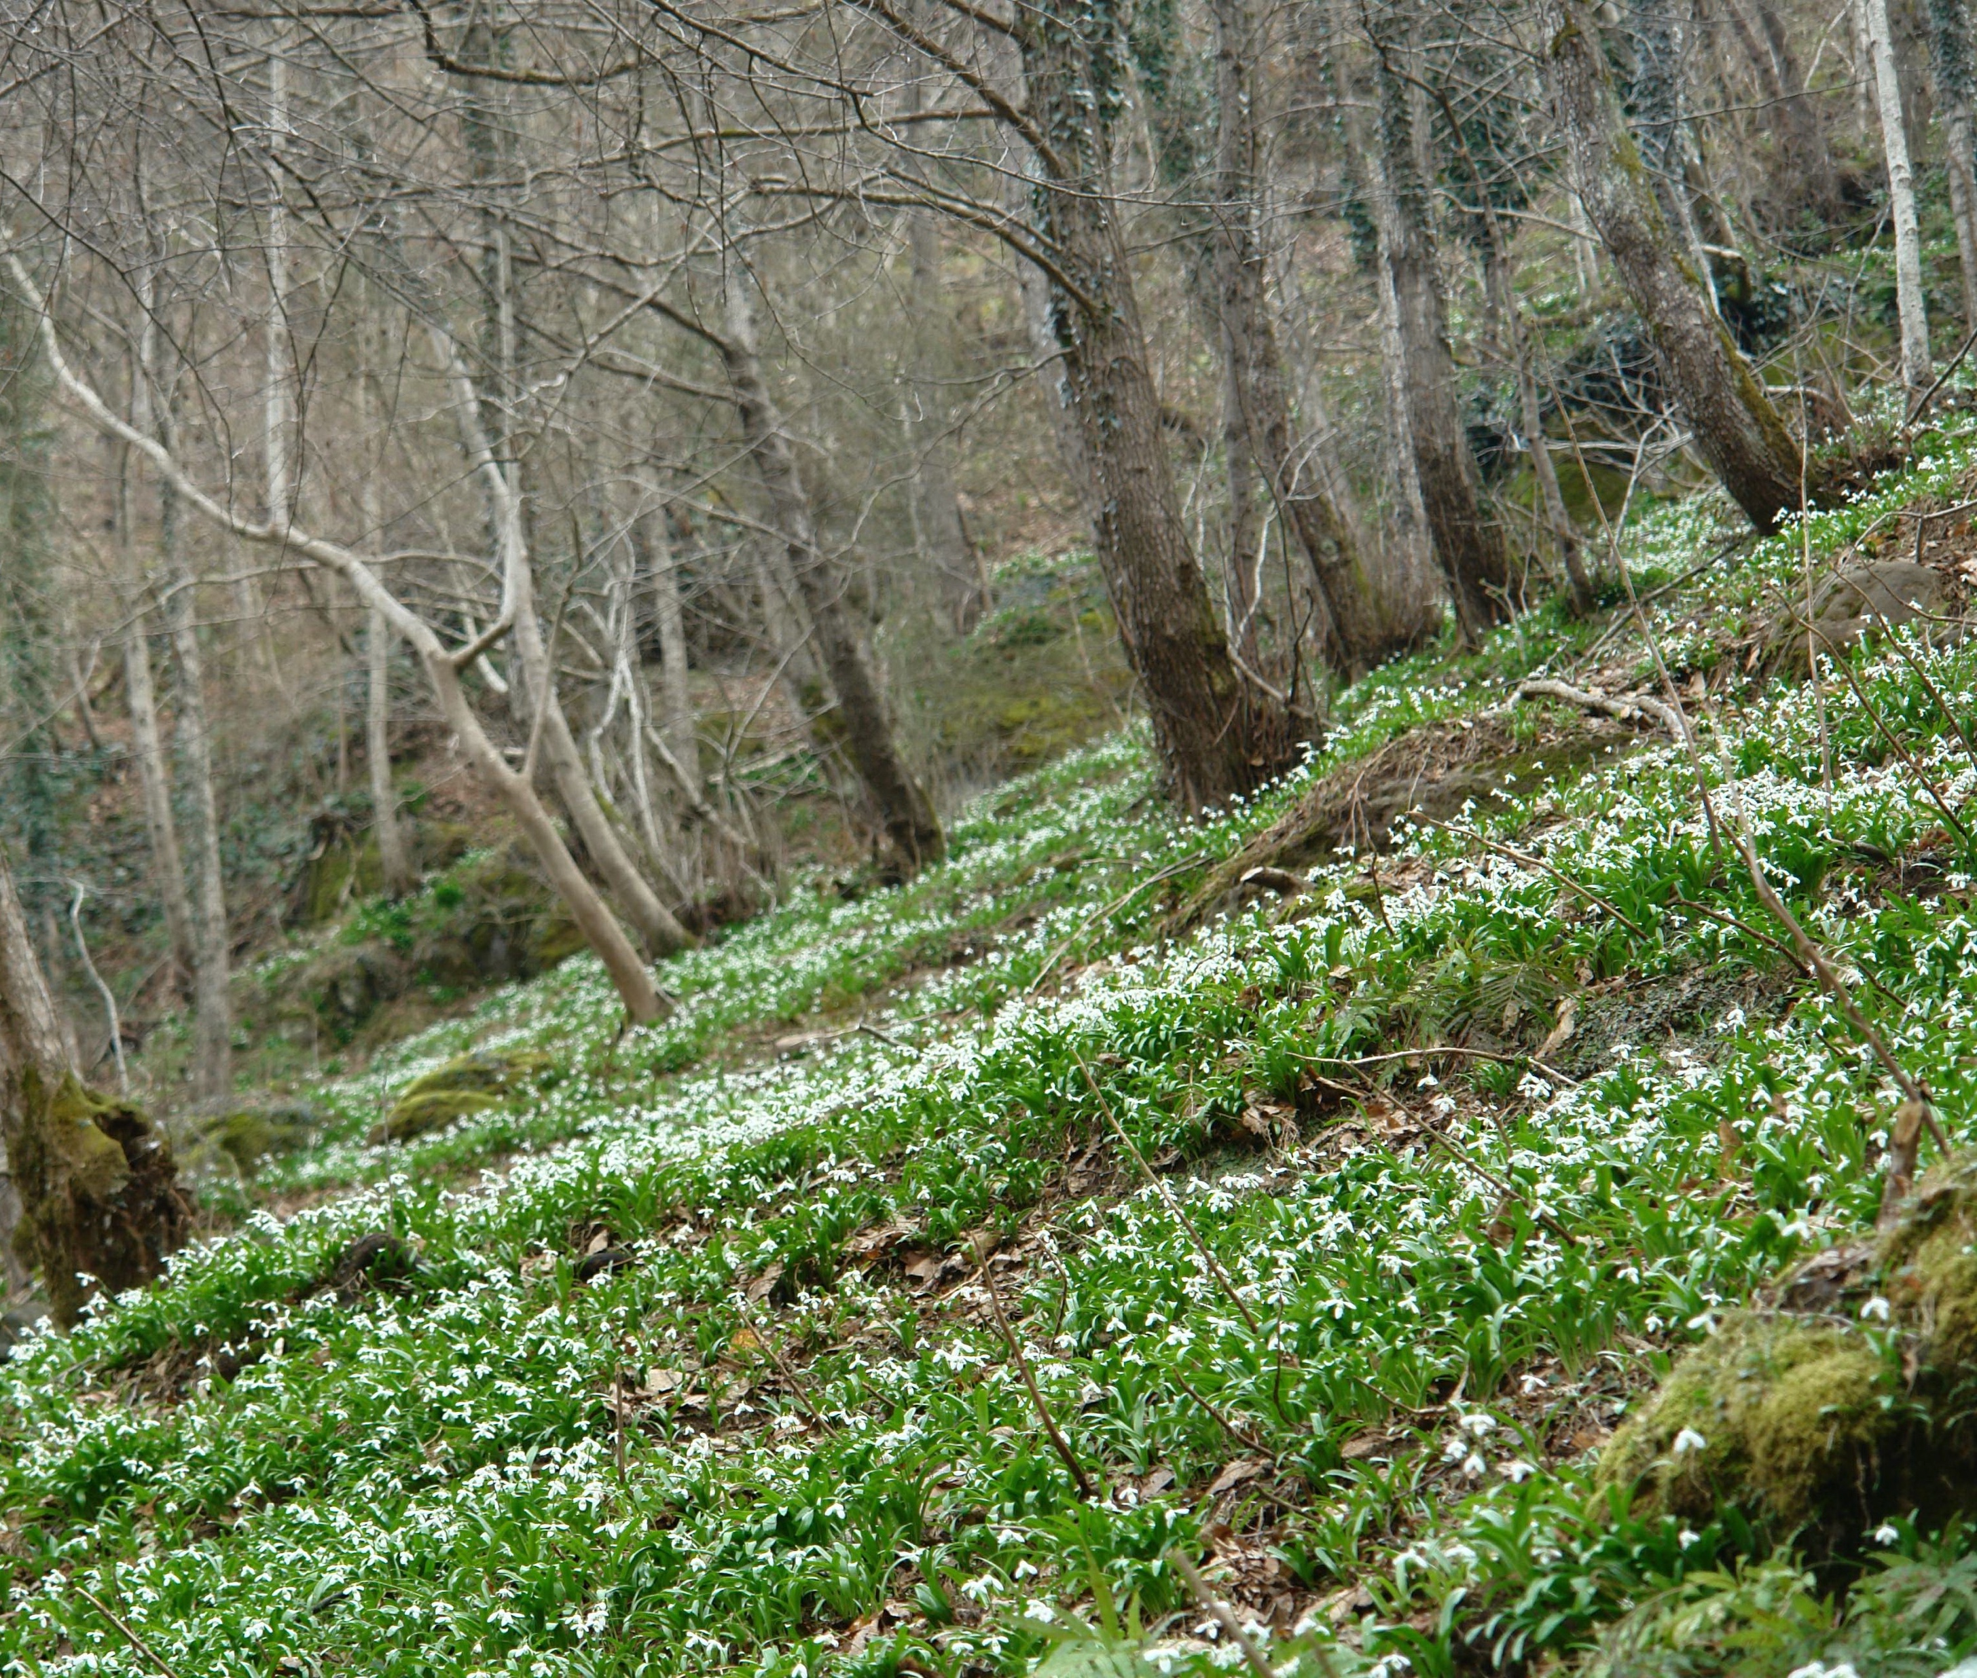
The Harvest and Export of Galanthus woronowii From W to A to Y in Georgia
Noel McGough (Consultant to Georgian CITES Authorities) &
David Kikodze (CITES Scientific Authority of Georgia)
December 2023

Slide 2
“How long will the story take Arkady? I have to be back in Tbilisi tonight”
Story Teller: “Its actually 2 Stories, a few hours.
Couldn’t you make it shorter?
Story Teller: No”
Brecht – The Caucasian Chalk Circle

Slide 3
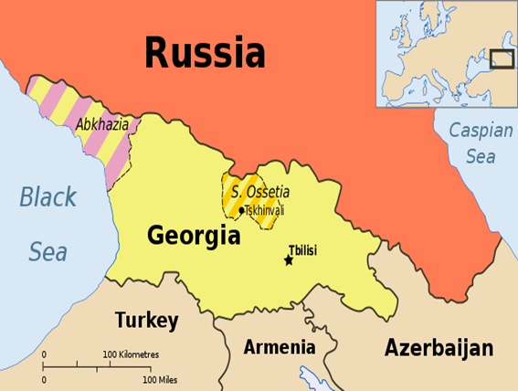
1991 Independence – Population 4.3 million
1997 Georgia, as an independent country, starts exporting bulbs

Slide 4
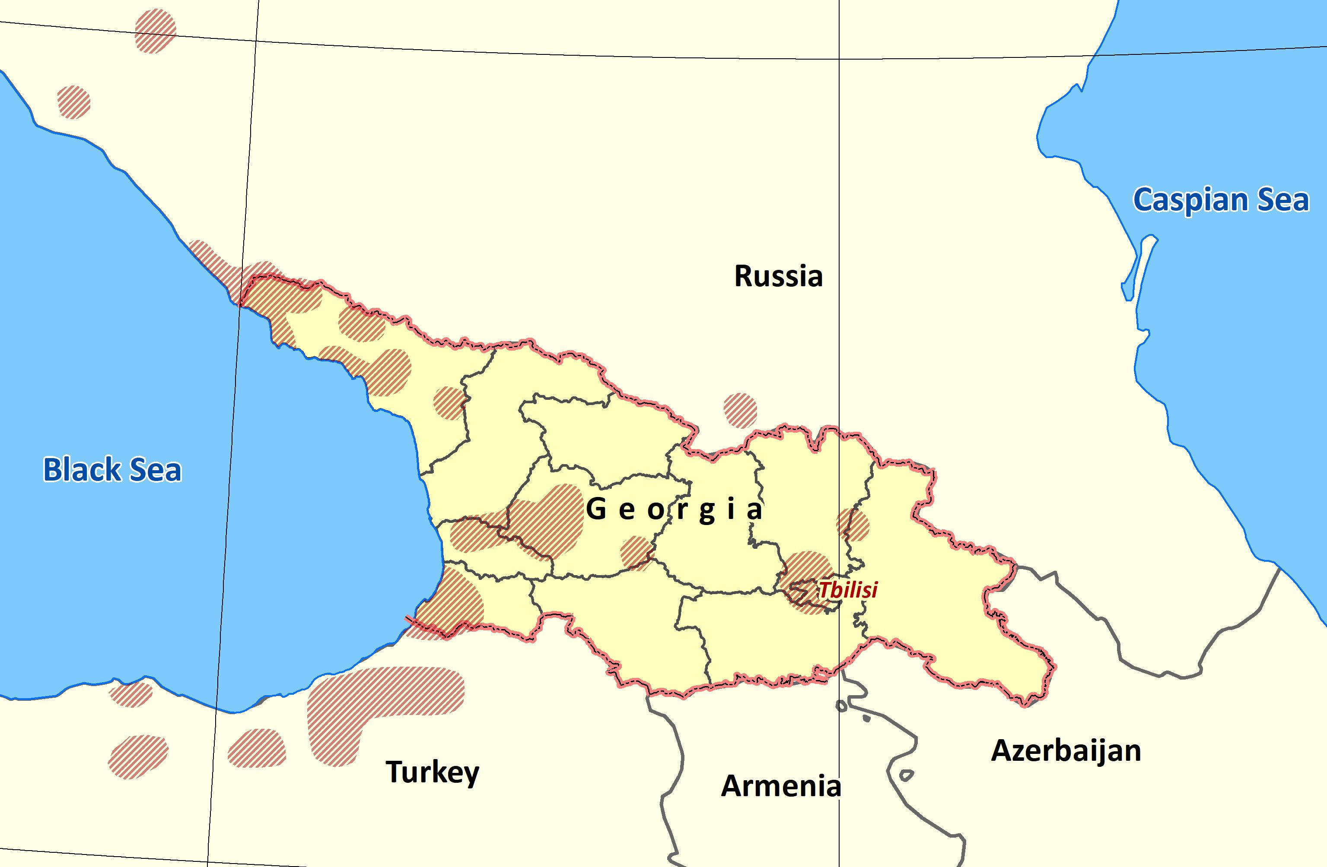
Distribution of Galanthus woronowii

Slide 5
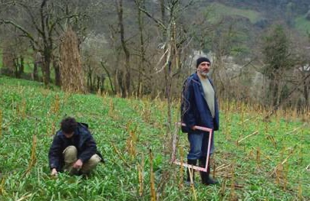
Some History
Georgia, as an independent country, has been exporting
Galanthus woronowii since 1997 starting at 10 million and rose
to 18 million in 2007
Significant Trade Project carried out in 2008-2009 – partners, Tbilisi
Central Botanical Garden & Institute of Botany, Batumi Botanic
Garden, RBG Kew, UK & Microsoft Research, Cambridge UK.
Found large wild populations and cultivation fields
Survey results – 41 wild pops surveyed – estimated to have
166 million harvestable bulbs. 12 cultivation sites of 6.5 hectare
had 2.2 million harvestable bulbs.

Slide 6
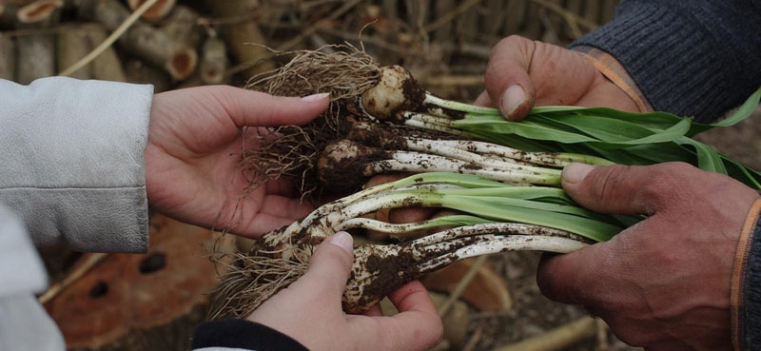
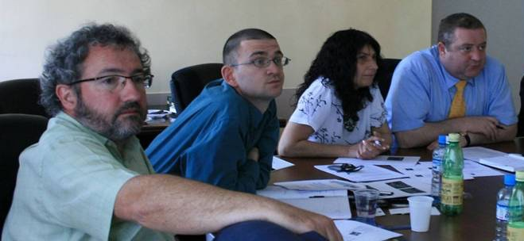
Significant Trade Survey 2009
Population modelling by Dr Matt Smith of Microsoft led to a precautionary estimate of a standing stock 0f 300 million bulbs wild and cultivated in some 820 hectares.
An Export Quota of 15 million bulbs was set.
No sites considered to be producing Artificially Propagated bulbs at that time – to CITES Standard.

Slide 7
Auctioning Wild Quota
The early 2000’s were turbulent times in Georgia
CITES Authorities were under-resourced and under pressure to issue permits as traders became aware of new opportunities
2008 the Government decided to auction access rights to the wild quota for a period of 10 years
Annual quota set on an independent basis by CITES Scientific Authority
4 legal entities were awarded 10-year licenses to harvest & export Galanthus – subject to quota
Licenses were subject to conditions laid down by CITES Authorities.

Slide 8
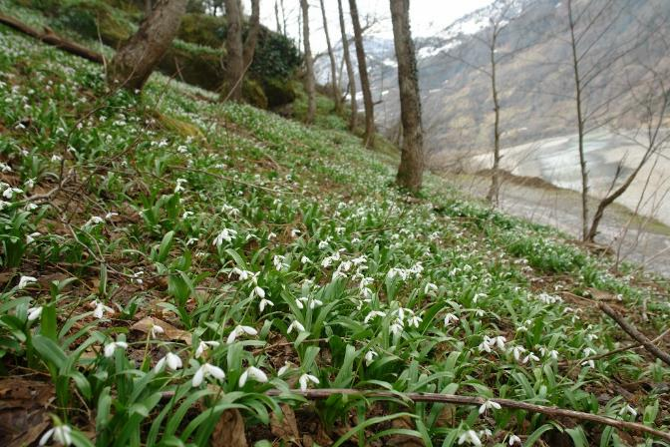
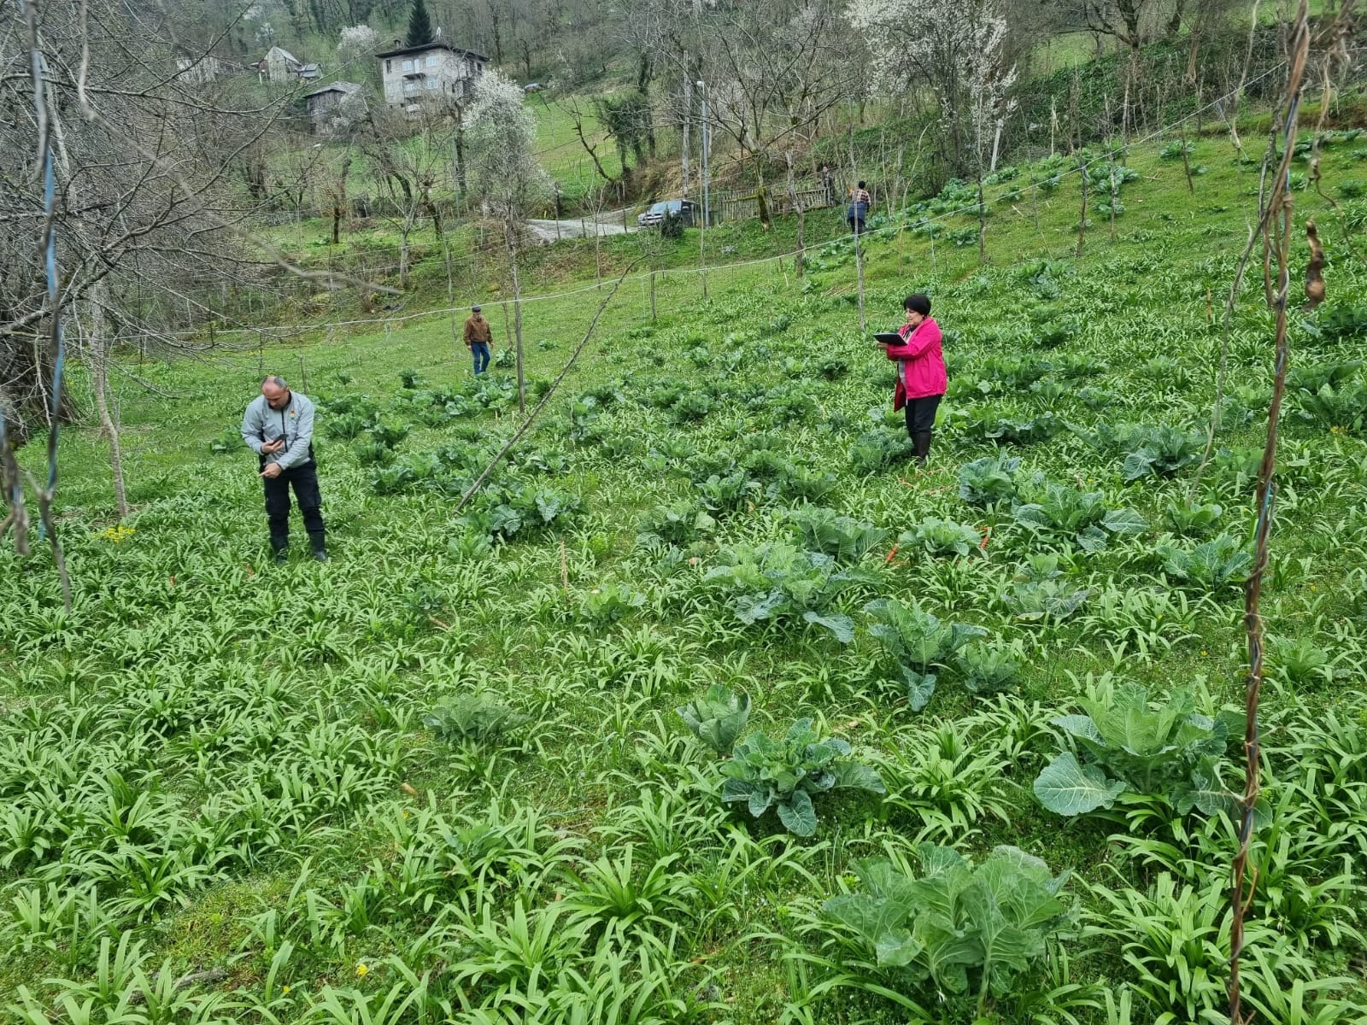
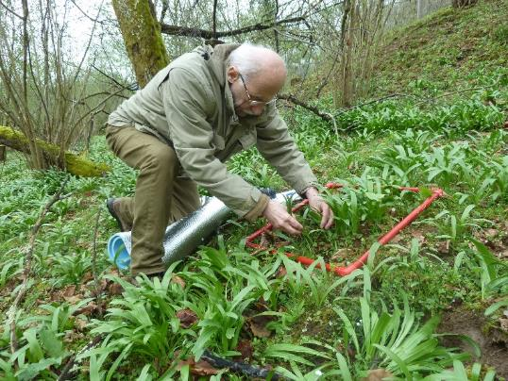
Field Survey Programme
Surveys carried out in 2009, 2010, 2011, 2012, 2014, 2018, 2019, 2020, 2023
Bold & Bigger = Most extensive surveys

Slide 9
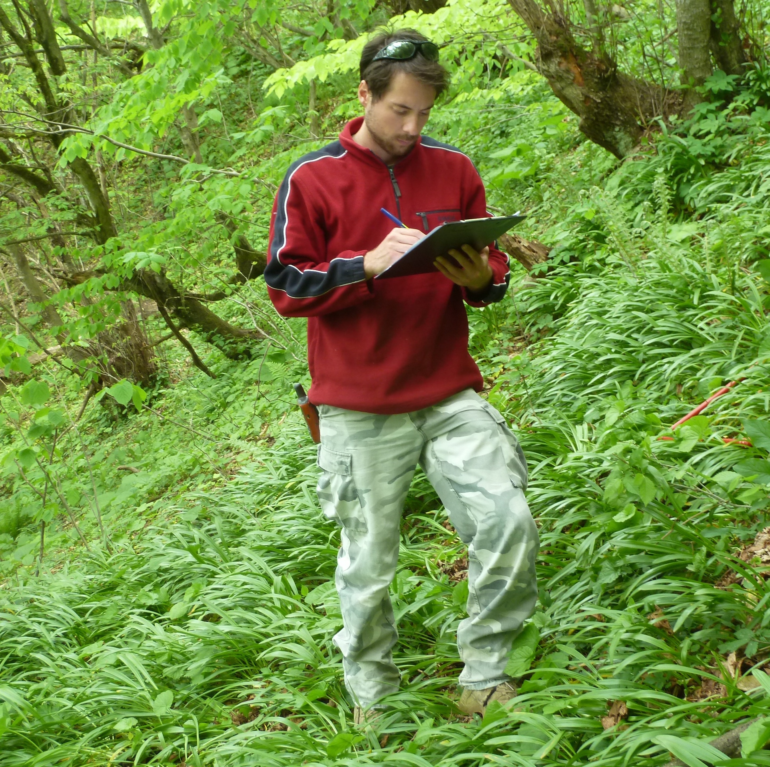
2023 Survey Results
58 wild harvest sites – total population of 1.3 billion export sized bulbs in 1056 hectares. Survey estimated to be 25% of wild population excluding Abkhazia.
53 cultivated sites surveyed-18 million bulbs. 13 million export size. No detailed data on total stock of cultivated bulbs in Georgia but SA estimate it @ 50-70 million.
9-Step NDFs carried for W & Y and quotas recommended

Slide 10
Distribution of Galanthus woronowii

Slide 11
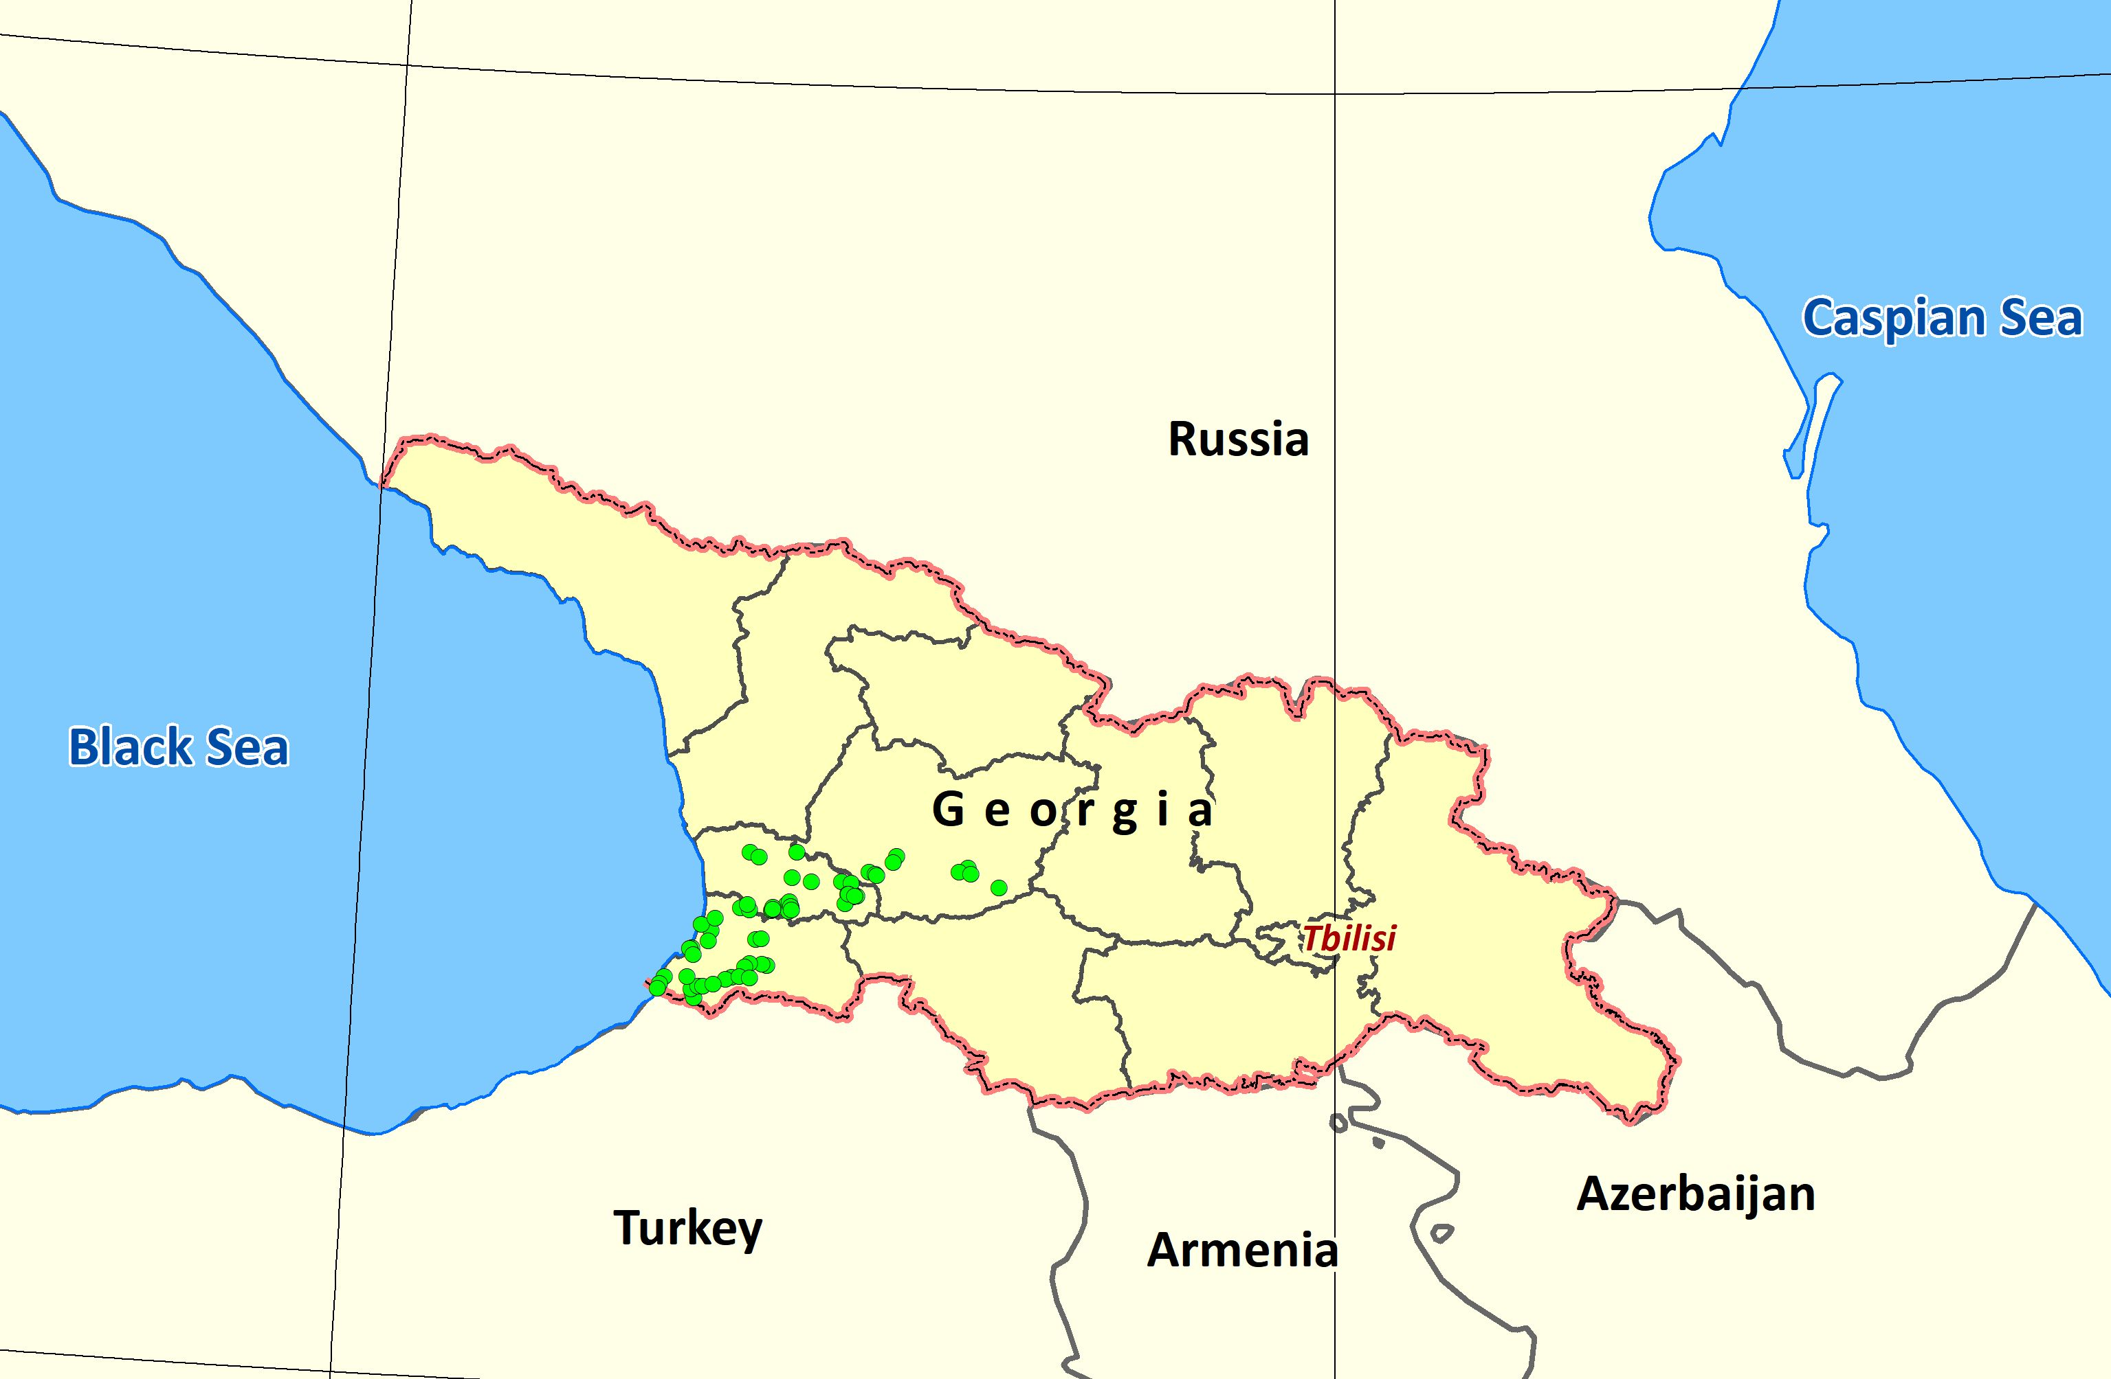
Wild populations of Galanthus woronowii
sampled in 2023

Slide 12
Cultivated Sites of Galanthus woronowii
sampled in 2023

Slide 13
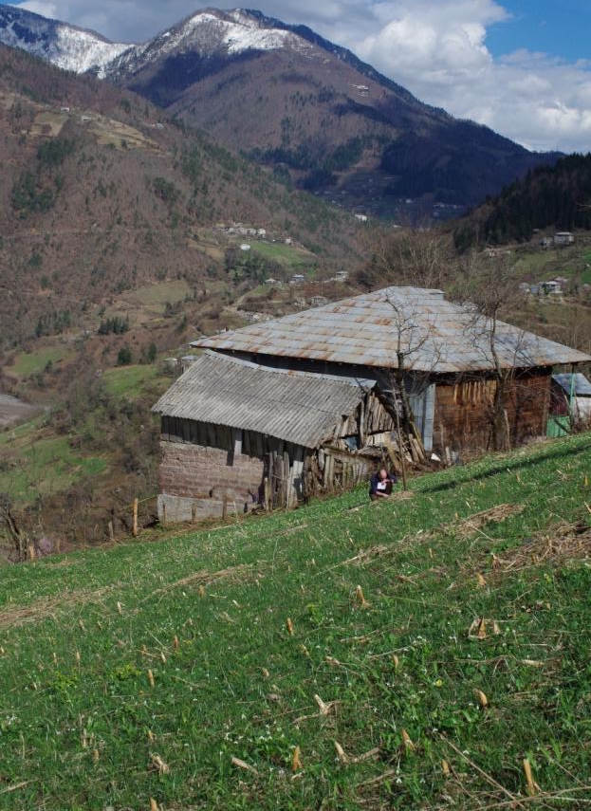
The Origins of Cultivation
No definitive information on exact origin
Possible first cultivation occurred through underplanting in cornfields and orchards. Locals also took advantage of overflow of natural populations into private land managed by smallholders
First formal cultivation reported to start in Adjara in 1993 aided by Turkish traders.

Slide 14
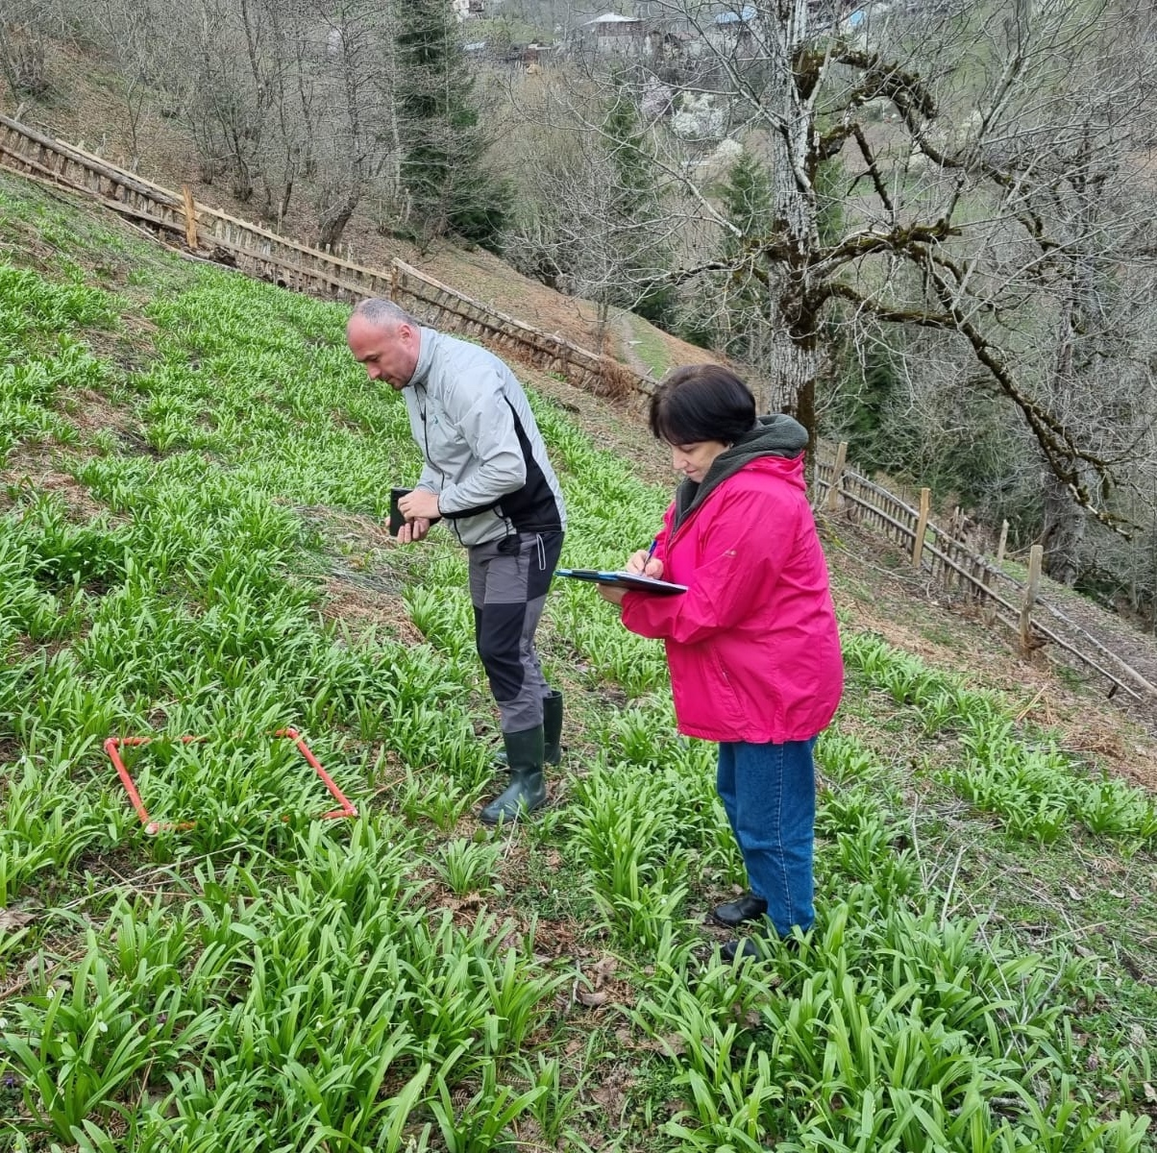
The Development of Artificial Propagation
In 2010 cultivation site holders approached MA with a request for a registration process to facilitate cultivation to progress to production of CITES Source Code A bulbs
Detailed registration system developed, and legislation approved by Parliament
Following inspections first Source A bulbs exported in 2012 & continued to 2019
System burdensome & resource intensive.

Slide 15
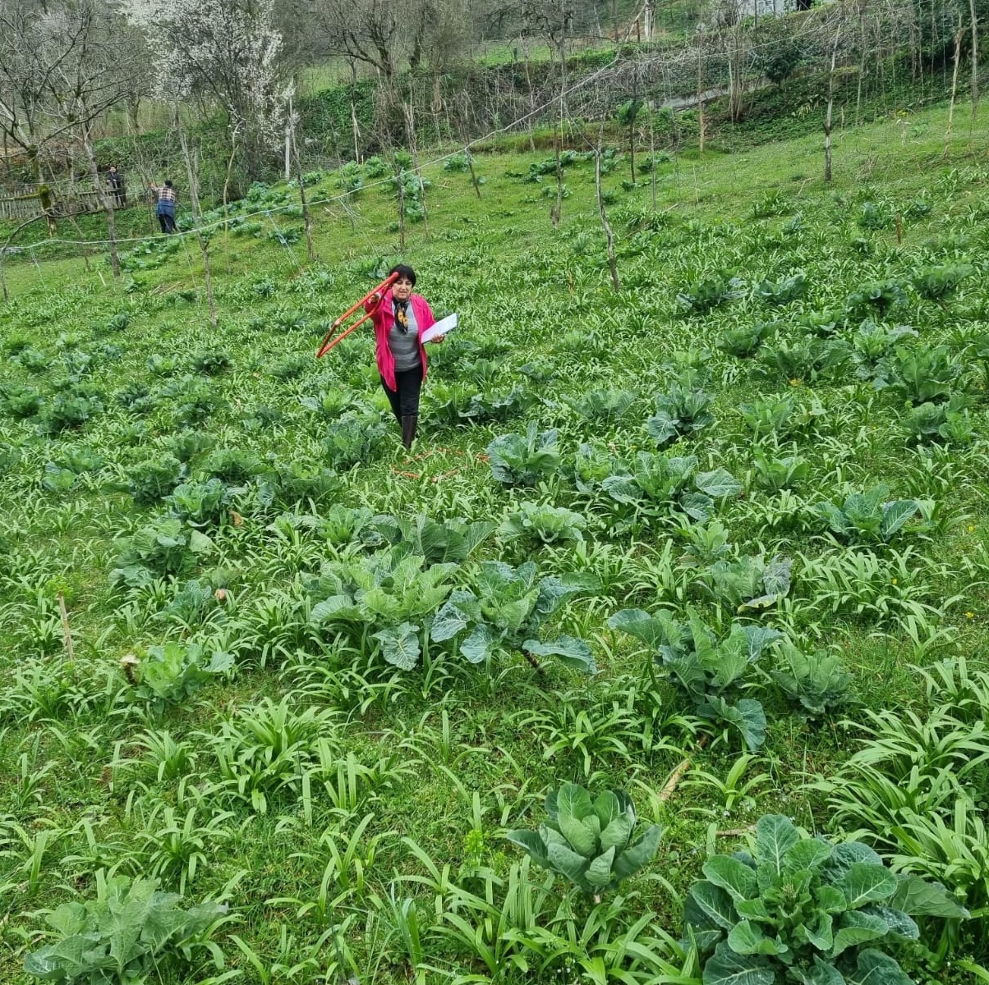
The use of Source Code Y
9-Step NDF in 2018 revealed weakness that traders sometimes used material from cultivation sites to fulfill wild quota – more convenient & cheaper!
Concern = source of unregulated harvest but no impact on wild population. Precautionary W quota maintained
Georgia commenced export of Y from cultivation sites in 2020 – many from old Source A plots

Slide 16
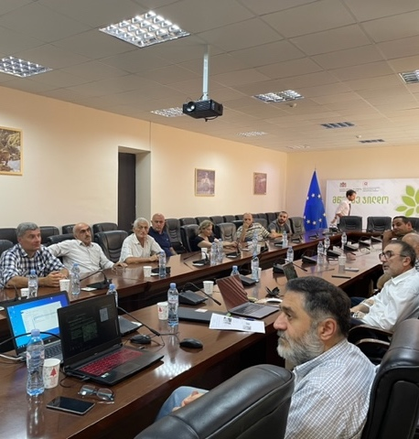
Source Code Y Implementation
Enabling legislation for Registration System put to Parliament in 2019 – delayed part of large package of conservation law – planned adoption 2024
2023 projected surveyed 53 cultivation sites – 13 million bulbs of export size. 9-Step NDF carried out for Y and quota for 2024 recommended @ 4 million bulbs
Simpler registration system designed for Y and will implement formally when legislation allows
Currently implementing an ad hoc system with traders linking to the National Environment Agency (NEA) for site inspection and reporting by NEA to the CITES Authorities.
Meeting with traders in Tbilisi, Summer 2023

