Slide 1
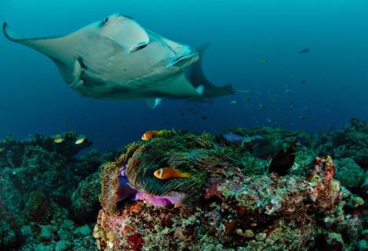
An introduction to…
LEGAL ACQUISITION FINDINGS
Wendy Jackson
NZ Ministry of Foreign Affairs and Trade

Slide 2
2
CITES priorities / requirements
Legality
Sustainability
Traceability
Notes:
2

Slide 3
Appendix II – legal acquisition
Article IV, para 2 : An export permit shall only be granted when the following conditions have been met:
…
(b)a Management Authority of the State of export is satisfied that the specimen was not obtained in contravention of the laws of that State for the protection of fauna and flora.

Slide 4
Note: legal acquisition and IFS
One-state transaction (Article IV, para 6)
MA of the State of Introduction does not require a legal acquisition finding.
However, Resolution Conf. 14.6 (Rev.CoP16) seeks to ensure consistency with RFMO and other measures and to prevent IUU fishing.
Two-state transaction (Article IV, paras 2, 3 and 4)
Appropriate legal acquisition findings are required.

Slide 5
Legality = “Legal acquisition finding”
WHERE IS IT FROM
ORIGIN??
WILD??
AQUACULTURE??
TRACEABILITY??
SOURCE
IDENTIFICATION???
PURPOSE???

Slide 6
Legal acquisition
A legal acquisition finding determines whether the specimen and its parental stock were:
Obtained in accordance with the provisions of national laws for the protection of wildlife and plants;
If previously traded, traded internationally in accordance with the provisions of CITES.
[US Code of Federal Regulations for Wildlife and Fisheries, 2011]

Slide 7
Who: shared responsibility
Exporter’s responsibility:
Commercial exporters should know and be able to verify the origin of the specimens they have purchased.
MAs are responsible for verifying the legal acquisition before issuing an export permit
MA can review provided information and require additional information
Importer's responsibility:
Resolution Conf. 12.3 (Rev.CoP16) recommends that ‘Parties not authorize the import of any specimen if they have reason to believe that it was not legally acquired in the country of origin’.

Slide 8
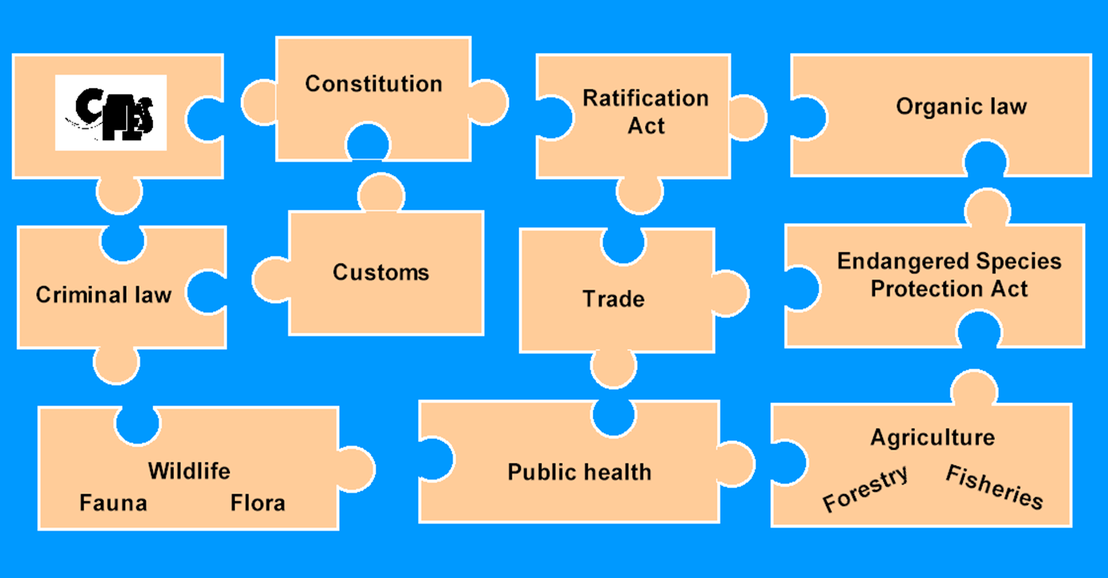
What: “…laws of that State…”

Slide 9
Process (US example)
A finding that a specimen was legally acquired may require that:
Sufficient information is provided (evidence);
All available information is considered;
Review of information is based on specific criteria;
As necessary, foreign Management and Scientific Authorities, CITES Secretariat and other relevant agencies are consulted.

Slide 10
The chain of responsibility
What kind of proof satisfies the MA of the State of export that the specimen was not obtained in contravention of the laws of that State for the protection of fauna and flora?
Reference to applicable legislation for harvesting/production
Valid written authorization to harvest from the wild or to artificially propagate/cultivate in a particular place
Proper equipment or method used to harvest or produce specimens
Proof of assigned quota and harvest/production within quota
Documentation showing lawful transport from place of harvest to place of storage and/or export (e.g. transport guides)
Records kept by registered artificial propagation or cultivation operation; periodic government inspections
Other

Slide 11
Traceability - permits
Opacity vs. transparency
Traceability systems facilitate the work of enforcement authorities (better equipped to confirm legal shipments and identify fraudulent suppliers)
Help consumers to distinguish between legal and illegal products by creating a higher level of reliability and precision of the CITES permit system
More importantly, a robust system will increase species conservation efforts and local livelihoods and reward law-abiding companies

Slide 12
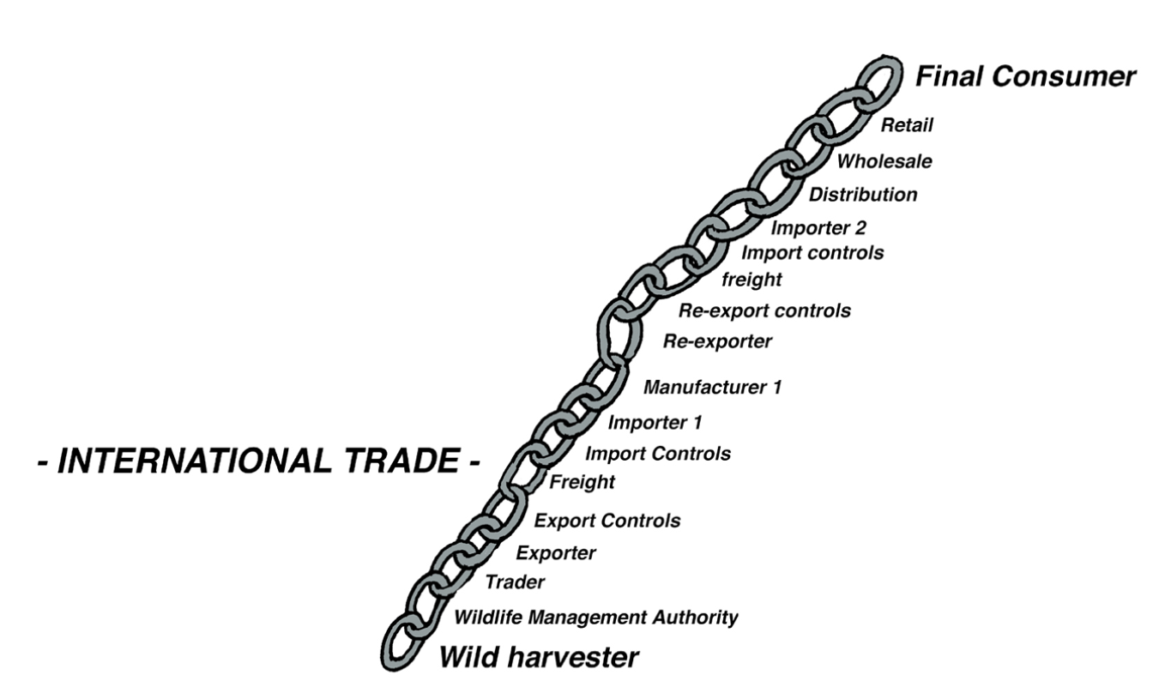

Slide 13
Defined Forest Area
Mill
Certified Logs
Retailer
Certified Lumber

Slide 14
Harmonised Customs Codes
Proposal: to insert shark fins and fish heads, tails, maws and other edible fish offal in fresh or chilled and frozen forms, with a major emphasis on shark fins, and to introduce shark fins in prepared and preserved form.
HS 2012 Structure
0302.90 -- Livers and roes
HS 2017 Proposed Structure
- Fish fins, heads, tails, maws and other edible fish offal :
0305.73 -- Dried, whether or not salted, fins of hammerhead sharks (Sphyrnidae), with skin and cartilage
0305.74 -- Dried, whether or not salted, fins of oceanic whitetip shark (Carcharhinus longimanus), with skin and cartilage
0305.75 -- Dried, whether or not salted, fins of blue shark (Prionace glauca), with skin and cartilage
0305.76 -- Dried, whether or not salted, fins of porbeagle shark (Lamna nasus), with skin and cartilage
0305.77 -- Other shark fins

Slide 15
Conclusion
The capacity of range States to implement the shark and manta ray listings strongly depends on their ability to verify the origin of specimens in trade and establish reliable legal acquisition findings.
Applicants for an export permit are required to provide sufficient information regarding how the specimens were first acquired.
CITES Management Authorities of Range States are entitled to scrutinize applications prior to issuing export permits.
Controls should add value not the contrary (non-intrusive).

