Slide 1
An introduction to…
INTRODUCTION FROM THE SEA
Wendy Jackson
NZ Ministry of Foreign Affairs and Trade

Slide 2
Four types of CITES trade
Import
Export
Re-export
Introduction from the sea
Notes:
Under CITES, there are four types of trade: import, export, re-export and introduction from the sea.

Slide 3
CITES provisions relating to IFS
Article I – Definition
Article III – Regulation of trade in Appendix-I specimens
Article IV – Regulation of trade in Appendix-II specimens
Article XIV – Effect on domestic legislation and international conventions
Notes:
RECALLING that ‘introduction from the sea’ is defined in Article I, paragraph e), of the Convention as "transportation into a State of specimens of any species which were taken in the marine environment not under the jurisdiction of any State";
RECALLING ALSO that Article III, paragraph 5, and Article IV, paragraphs 6 and 7, of the Convention, provide a framework to regulate the introduction from the sea of specimens of species included in Appendices I and II, respectively;
NOTING that ‘State of introduction’ is not defined in the Convention and that Article III, paragraph 5, Article IV, paragraph 6, and Article XIV, paragraph 5, place certain obligations on the State of introduction;

Slide 4
Definition – Article I
Introduction from the sea:
“Transportation into a State of specimens of any species which were taken in the marine environment not under the jurisdiction of any State”

Slide 6
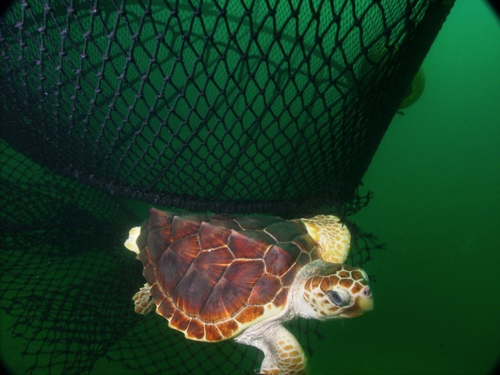
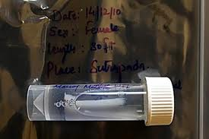
Article III – trade in Appendix-I species
Conditions before an IFS certificate is granted
Non-detriment finding
Suitably equipped to house and care (living specimens)
Not for primary commercial purposes
All done by the State of Introduction

Slide 7
Notes:
Specimens of Appendix-I species that have been taken off the high seas (cetaceans taken by Japan)

Slide 8
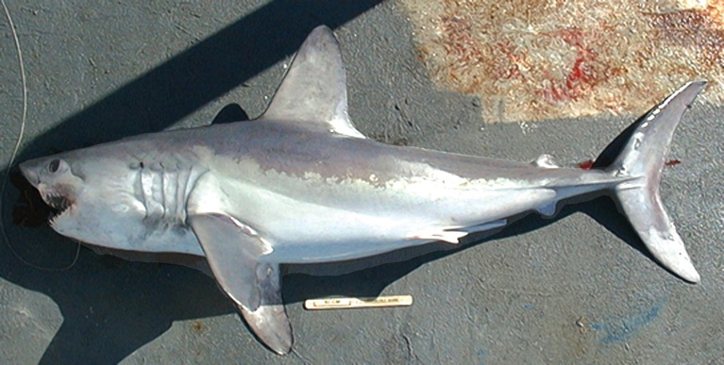
Article IV – trade in Appendix-II species
Conditions before an IFS certificate is granted
Non-detriment finding
Suitably equipped to house and care (living specimens)
All done by the State of Introduction

Slide 9
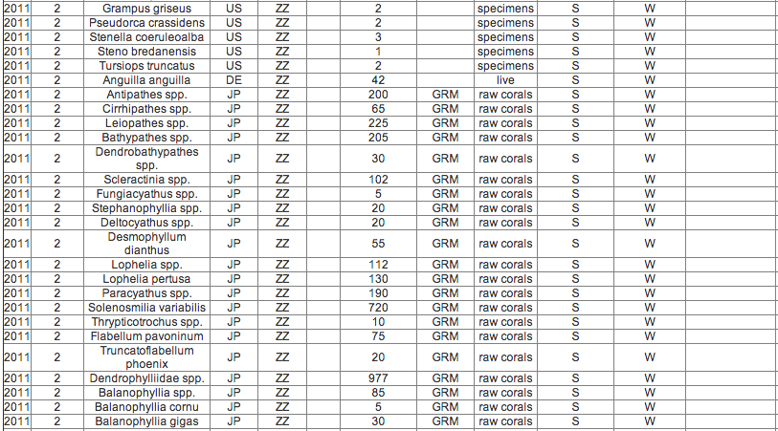
Notes:
Specimens of Appendix-II species taken off the high seas – cetaceans and corals taken by Japan.

Slide 10
Note: Introduction from the sea does not apply to Appendix-III species

Slide 11
Article XIV – Effect on domestic legislation and international conventions
Other international treaties, conventions, or international agreements that afford protection to marine species included in Appendix II
UN Convention on the Law of the Sea

Slide 12
Resolution Conf. 14.6 (Rev.CoP16)
Provides important definitions
Clarifies when something is an IFS transaction, and when it is not
Provides guidance on chartering situations
Takes into account other considerations (e.g. other agreements, etc.)

Slide 13
IFS: Definitions
Introduction from the sea: “transportation into a State of specimens of any species which were taken in the marine environment not under the jurisdiction of any State”
Marine environment not under the jurisdiction of any State: “those marine areas beyond the areas subject to the sovereignty or sovereign rights of a State consistent with international law, as reflected in the United Nations Convention on the Law of the Sea”

Slide 14
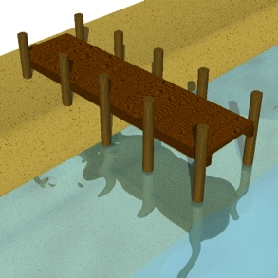
Transaction – Scenario 1
SCENARIO 1: Vessel and port = same state (i.e. one-state transaction)
“whenever any specimen of a species included in Appendix I or II is taken in the marine environment not under the jurisdiction of any State by a vessel registered in one State and is transported into that same State…

Slide 15
One-state transaction (IFS)
…the provisions of Article III, paragraph 5, or Article IV, paragraphs 6 and 7, respectively, should be applied; with that State being the State of introduction”

Slide 16
One-state transaction
One-state transaction = IFS certificate

Slide 17
Transaction – Scenario 2
SCENARIO 2: Vessel and port = different states (i.e. two-state transaction)
“whenever any specimen of a species included in Appendix I or II is taken in the marine environment not under the jurisdiction of any State by a vessel registered in one State and is transported into a different State…

Slide 18
Two-state transaction (export/import)
…the provisions of Article III, paragraphs 2 and 3, or Article IV, paragraphs 2, 3 and 4, respectively, should be applied, with the State in which the vessel that took the specimen is registered being the State of export and the State into which the specimen is transported being the State of import”
STATE OF EXPORT
STATE OF IMPORT

Slide 19
Two-state transaction
Article III, paras 2 and 3
(Appendix I)
Export requirements – prior grant and presentation of export permit
Import requirements – prior grant and presentation of import permit and export or re-export permit
Article IV, paras 2, 3 and 4
(Appendix II)
Export requirements – prior grant and presentation of export permit
Limits on exports (SA)
Import requirements – prior grant and presentation of export or re-export permit
Notes:
These are the export/import provisions that apply when it is a two-state transaction.

Slide 20
Two-state transaction
Two-state transaction = export or import documents

Slide 21
Chartering scenarios
SCENARIO 3: Vessel registration state and chartering state = different states

Slide 22
Chartering provisions
Apply when:
(i) the operation is under a written agreement between the State where the vessel is registered and the chartering State, consistent with the framework on chartering operations of a relevant RFMO/A
(ii) the CITES Secretariat has been informed of this arrangement in advance of its entry into effect and that the CITES Secretariat makes this arrangement available to all Parties and to any relevant RFMO/A

Slide 23
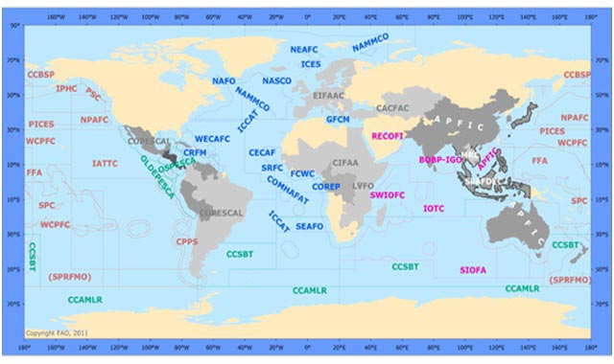
Notes:
Not all listed on here are RFMOs, but just to give an indication of those RFMOs that might be relevant.

Slide 24
Chartering - documentation
SCENARIO 3a: Vessel registration state A and charter state B and port state B

Slide 25
Chartering – scenario 3a
-could be either IFS or ‘export’ scenario, depending on agreement
STATE OF EXPORT*
*as mutually agreed
STATE OF INTRODUCTION*
*as mutually agreed

Slide 26
IF agreement is that charter state issues documents
IF agreed that flag state issues documents
STATE OF EXPORT*
*as mutually agreed
STATE OF INTRODUCTION*
*as mutually agreed
THEN
THEN
Issues export documentation
Issues IFS certificate
Notes:
Note that in the situation on the right where the flag state issues the documents, the charter state has no control over what is produced – this might be an issue.

Slide 27
Chartering – Scenario 3b
SCENARIO 3b: Vessel registration A and charter state B and port state C

Slide 28
Vessel/charter/port states differ
Article IV, paras 2, 3 and 4
(Appendix II)
Export requirements – prior grant and presentation of export permit
Limits on exports (SA)
Import requirements – prior grant and presentation of export or re-export permit
STATE OF EXPORT*
*by default; based on prior consultation and agreement of chartering state
(can be state of export and issue documents if authorised in written arrangement)
STATE OF IMPORT
Notes:
The default position is that the flag state issues the documents. However the chartering state can be the state of export and issue documents if authorised in the written agreement.

Slide 29
Other considerations
The CoP has recommended that the State of introduction, State of export or State of import, in satisfying itself that the provisions of the Convention have been met:
take into account whether or not the specimen was or will be acquired and landed:
in a manner consistent with applicable measures under international law for the conservation and management of living marine resources, including those of any other treaty, convention or agreement with conservation and management measures for the marine species in question; and
through any illegal, unreported or unregulated (IUU) fishing activity.

Slide 30
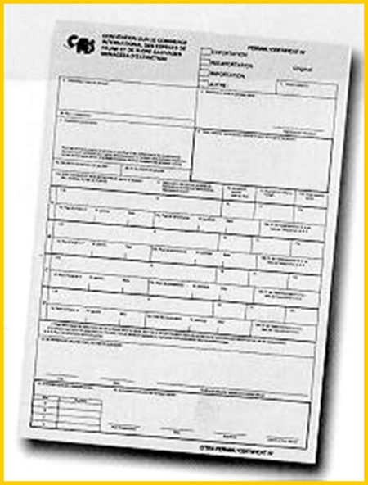
Source code – new one for IFS
Source code ‘X’ be used to indicate specimens taken in “the marine environment not under the jurisdiction of any State”
(from Resolution Conf. 12.3 (Rev.CoP16)

Slide 31
CoP16 decisions on IFS - chartering
The Secretariat shall report to the CITES Standing Committee on the implementation of the Convention by Parties concerned in relation to the provision on chartering arrangements provided for in Resolution Conf. 14.6 (Rev. CoP16)
The report should focus on the conditions under which non-detriment findings are made and permits and certificates are issued and assess the capacity of chartering States and States in which the vessels are registered to control compliance with the provisions of the CITES Convention.
On the basis of the assessment of the Standing Committee and any other relevant information, the Parties should review at CoP17 (2016) the provisions on chartering provided for in Resolution Conf. 14.6 (Rev. CoP16).

Slide 32
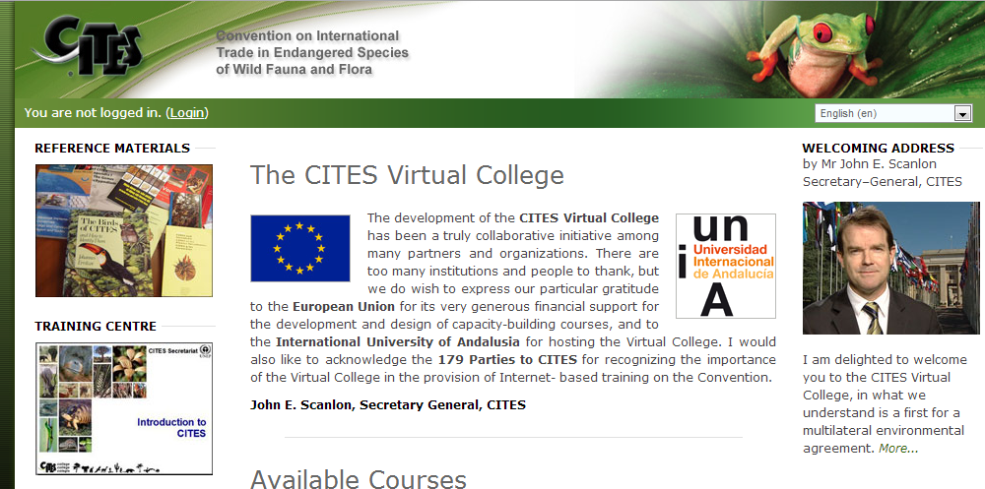
CoP16 decision on IFS - Capacity building
The Secretariat shall:
Develop capacity-building tools and materials for use by Parties (e.g., a module in the CITES Virtual College) related to the implementation of the Convention for specimens taken from the marine environment not under the jurisdiction of any State.

Slide 33
So what does it all mean?

Slide 34
What to consider…
Does your country fish for CITES shark species?
Are they fished in the EEZ or on the high seas?
Are specimens that come off the high seas exported?
Are charter vessels active in shark fisheries?

