Slide 2

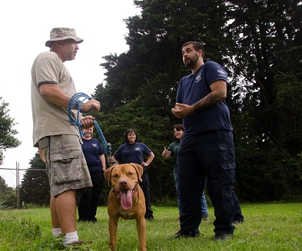
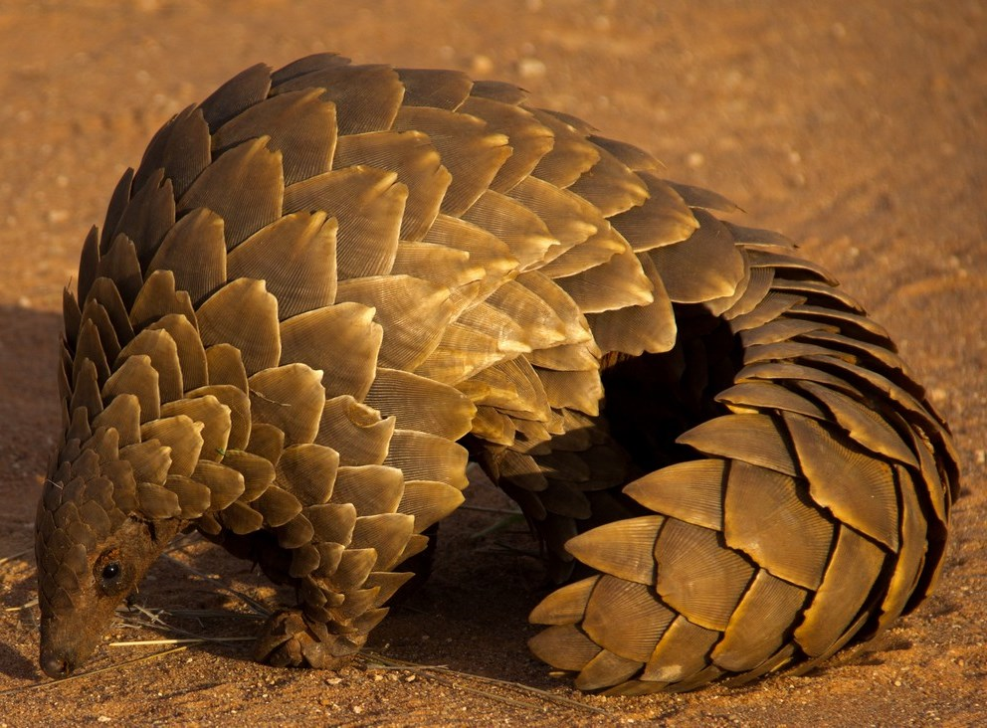
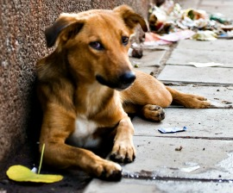
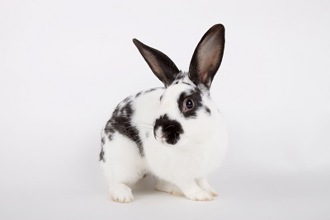
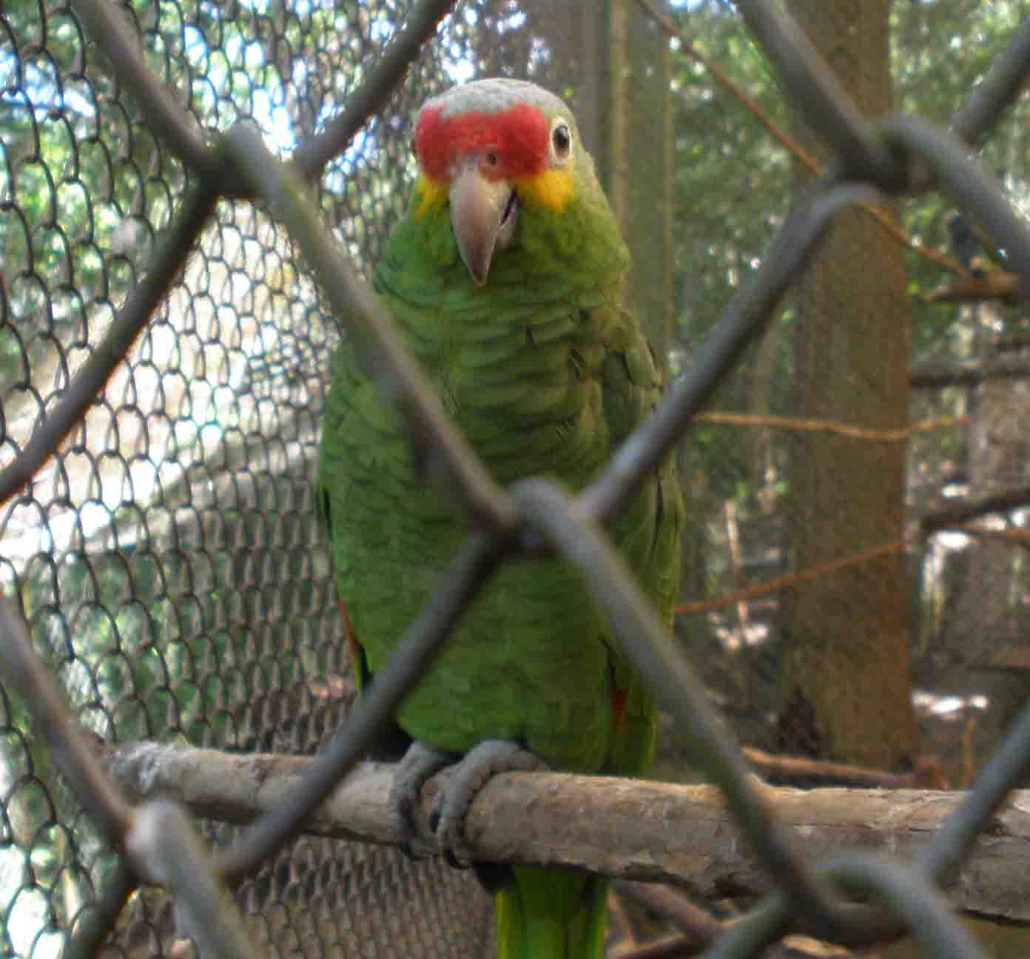
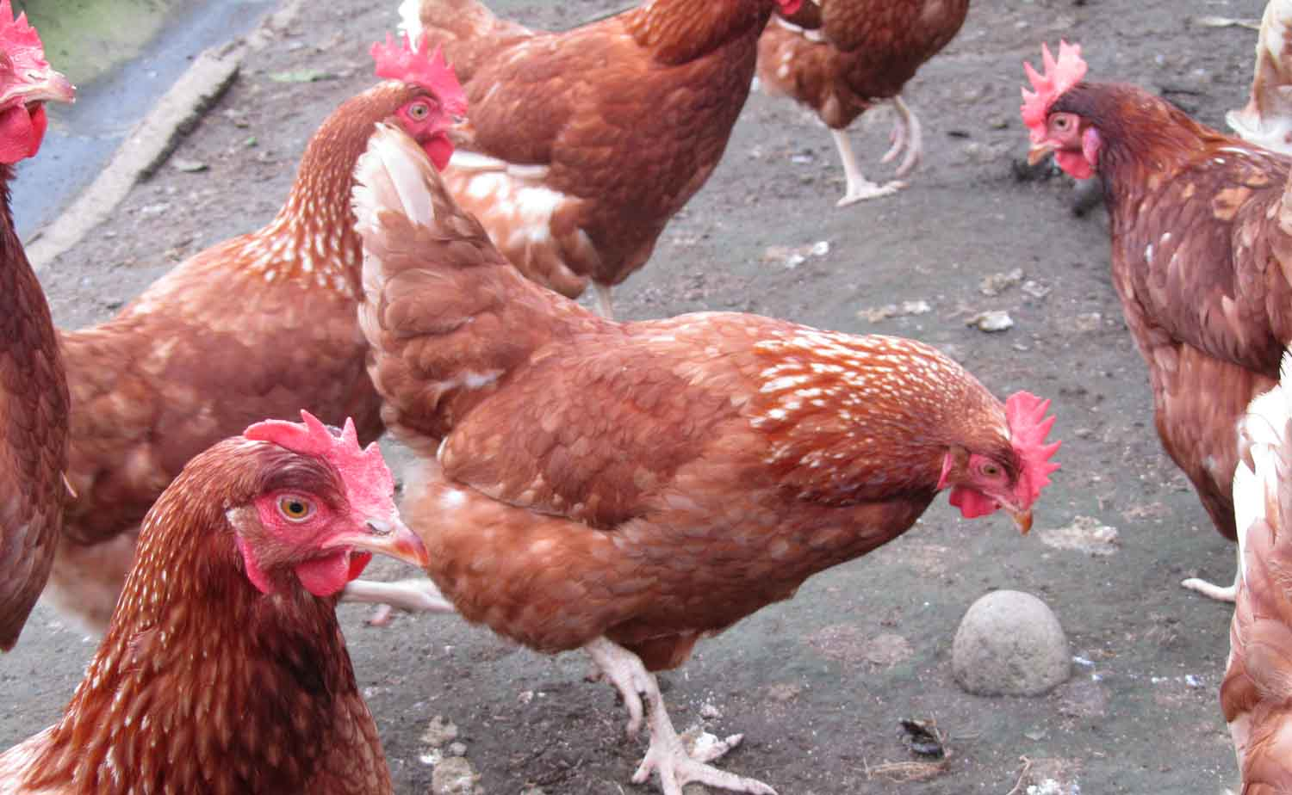
Quiénes somos
Metas de HSI
Mejorar el bienestar animal en los animales callejeros
Detener el abuso hacia animales silvestres
Proteger animales de granja
Acabar con la experimentación animal
Confrontar la crueldad

Slide 3
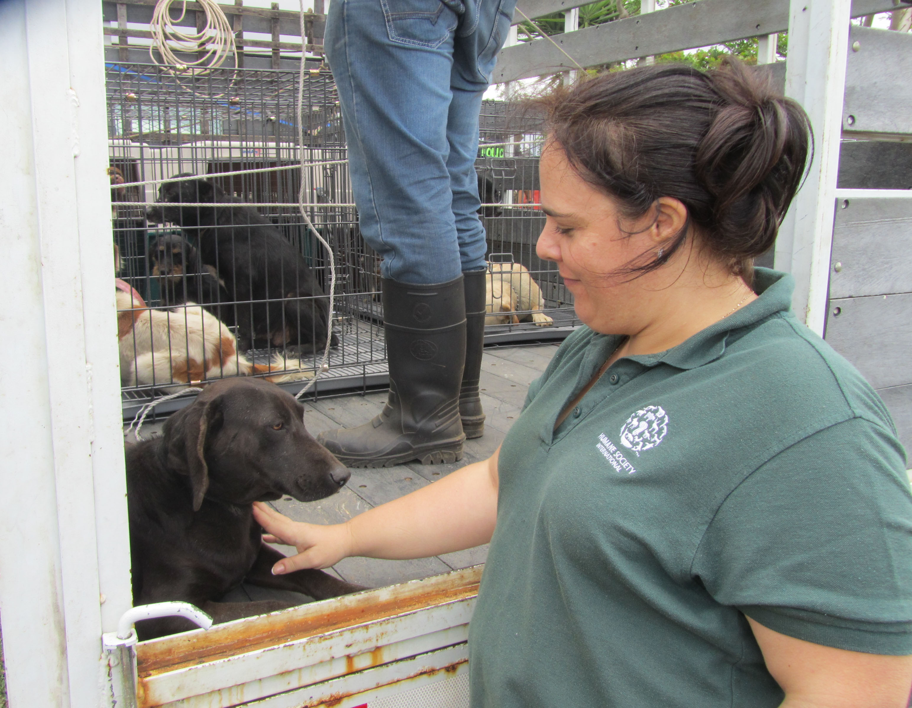
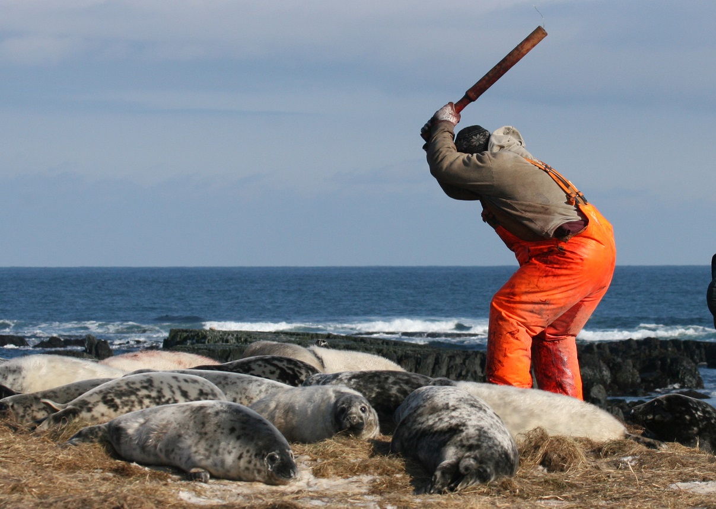
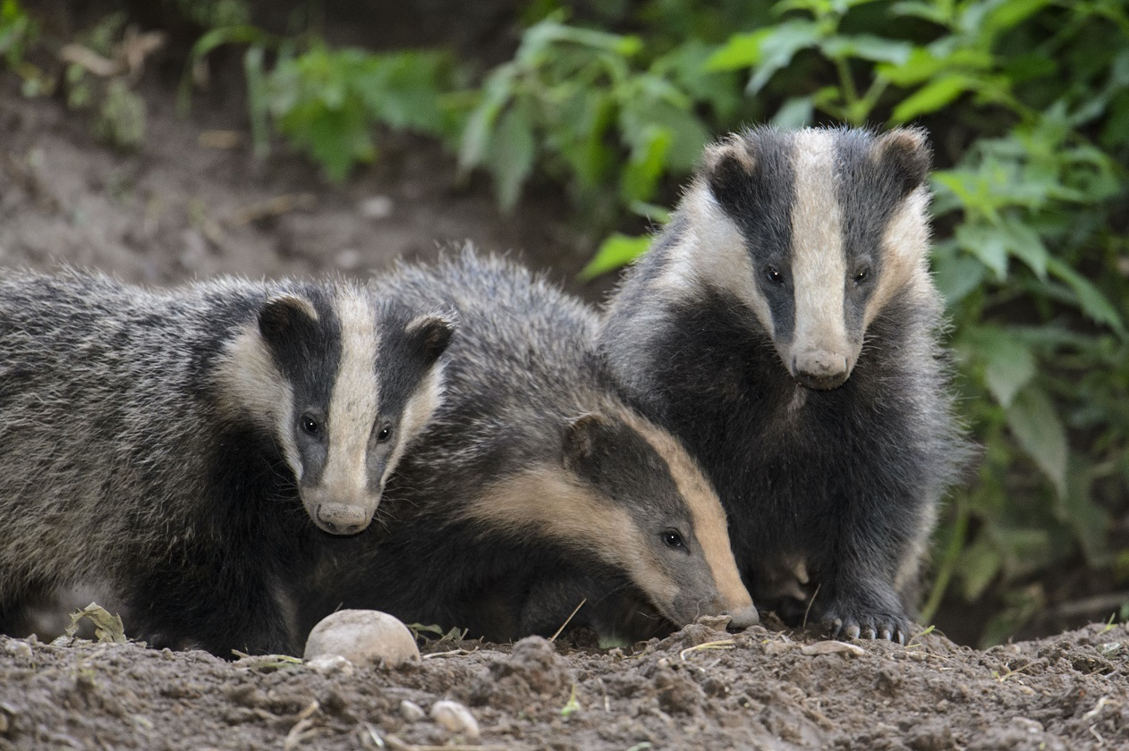
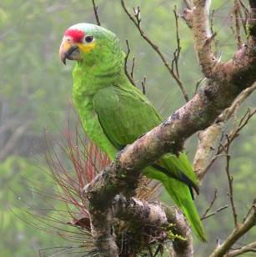
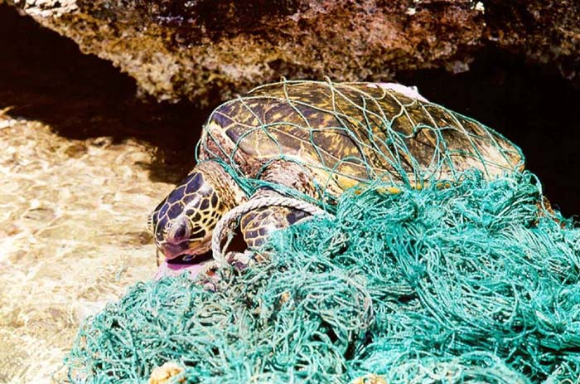
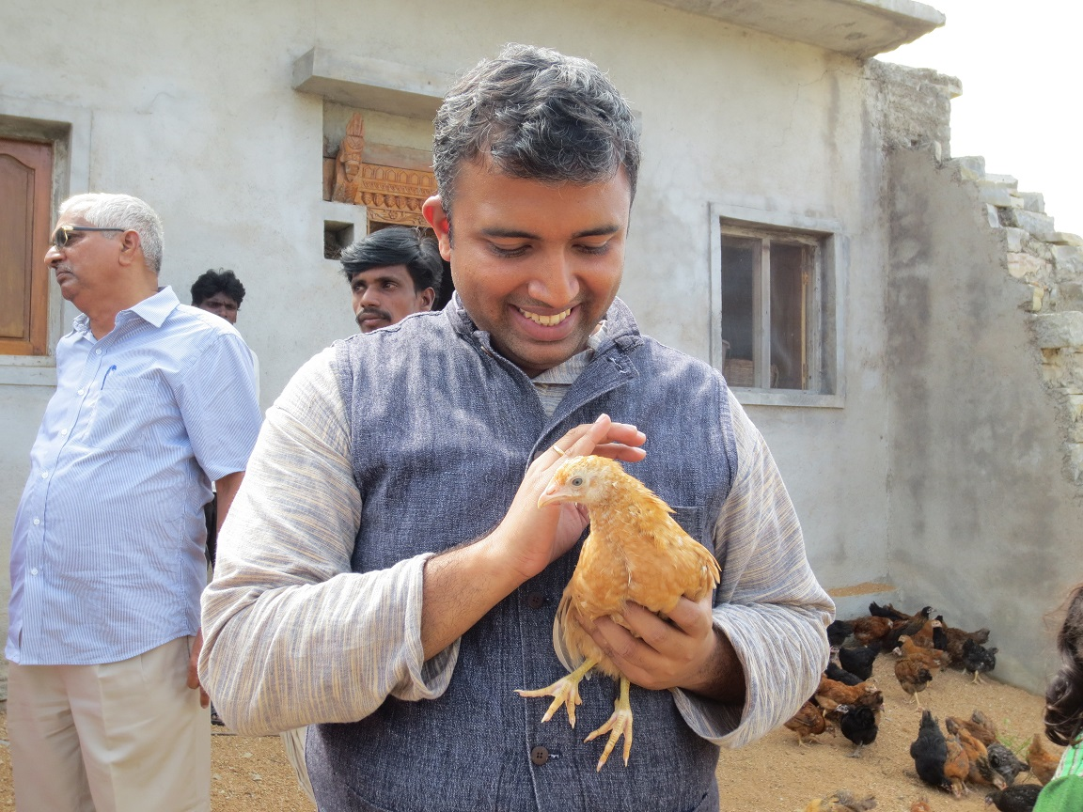
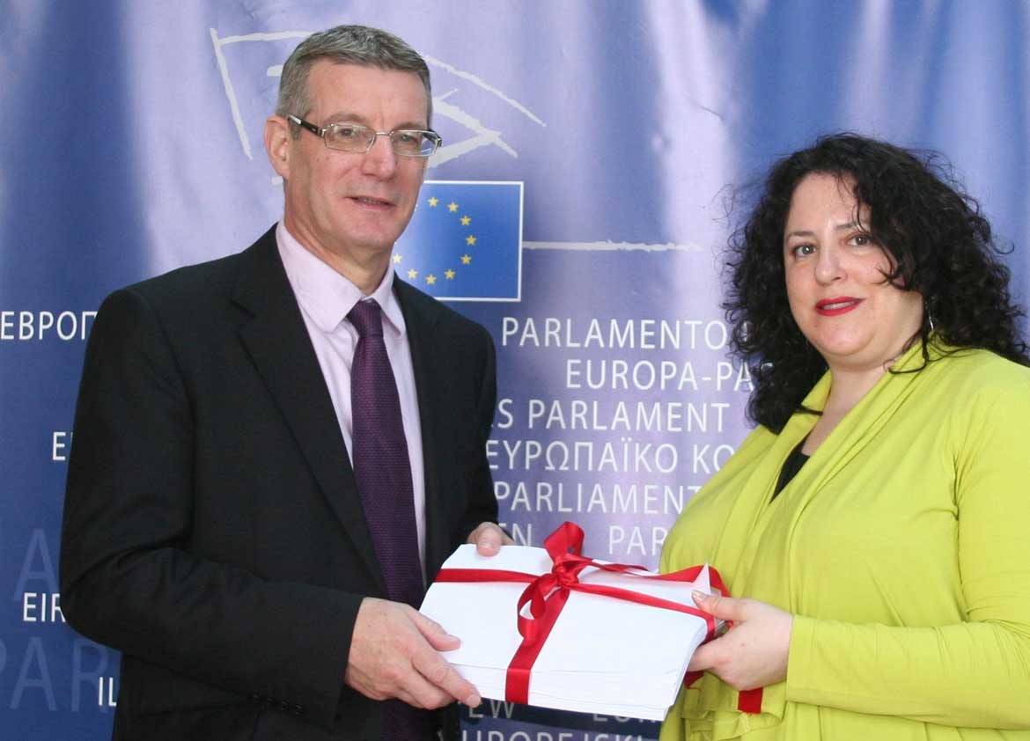
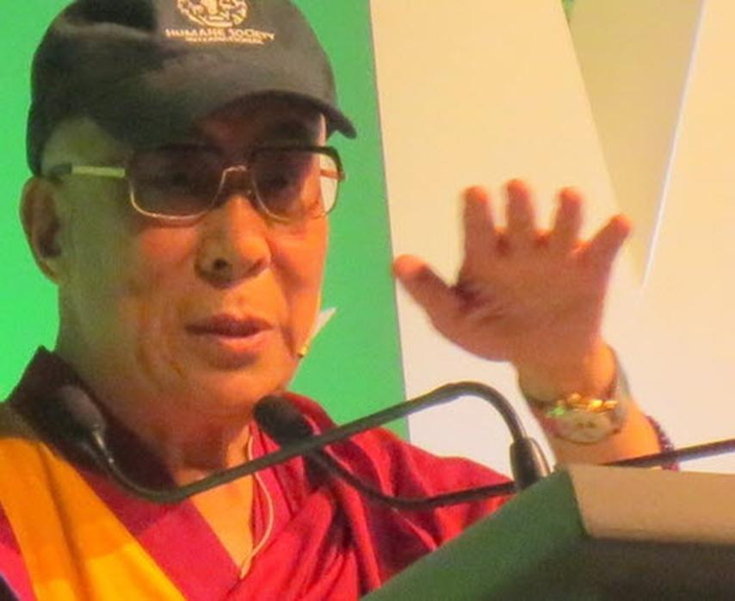
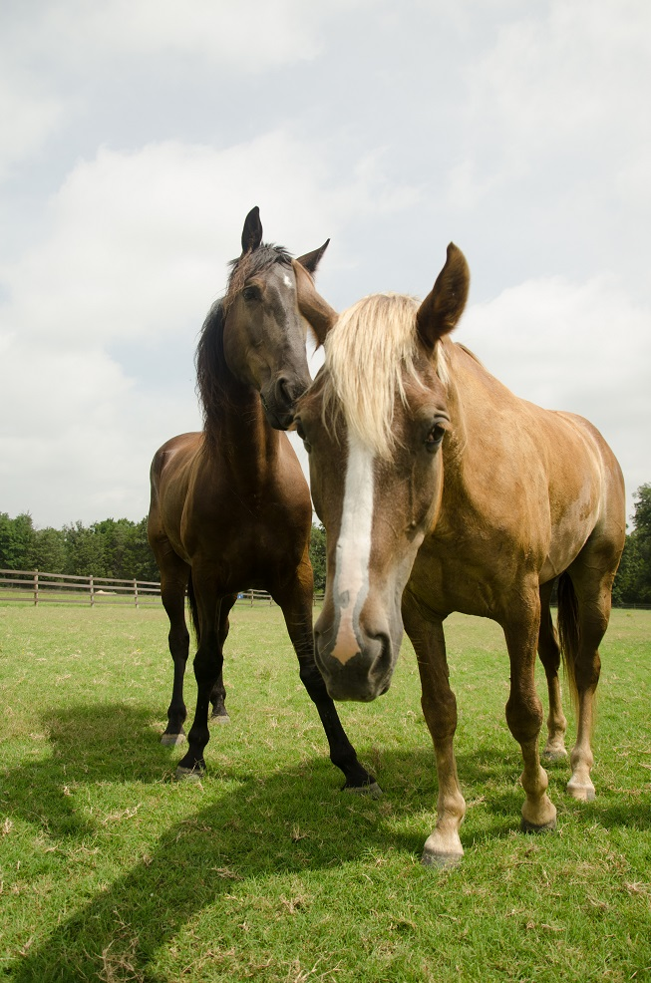

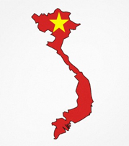
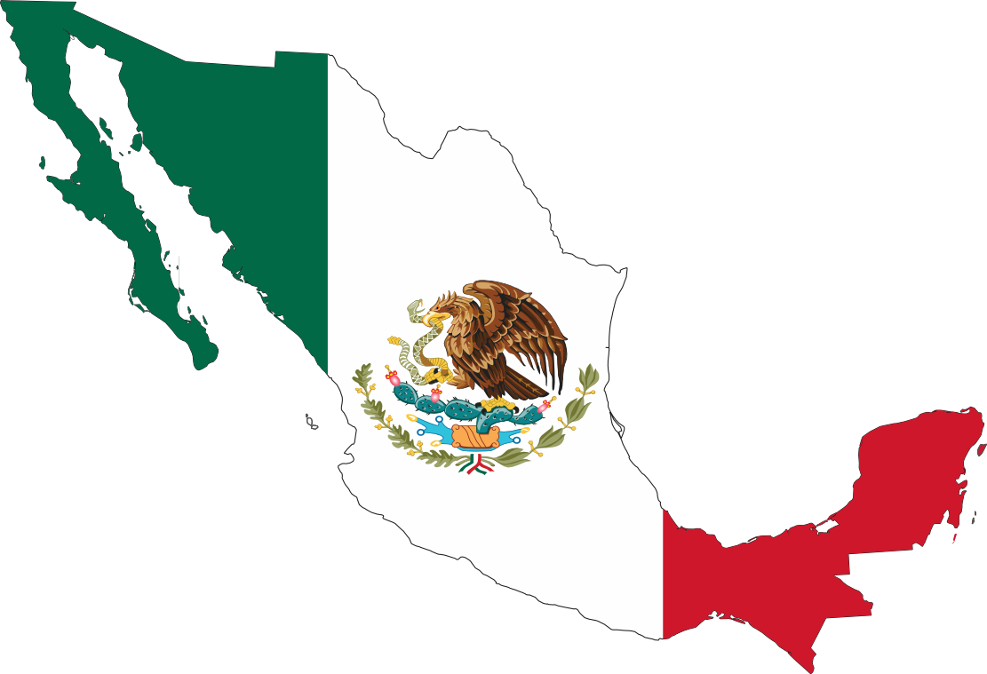
Oficinas Regionales
Latinoamérica
Canadá
Reino Unido
India
Europa
Próximas oficinas

Slide 4
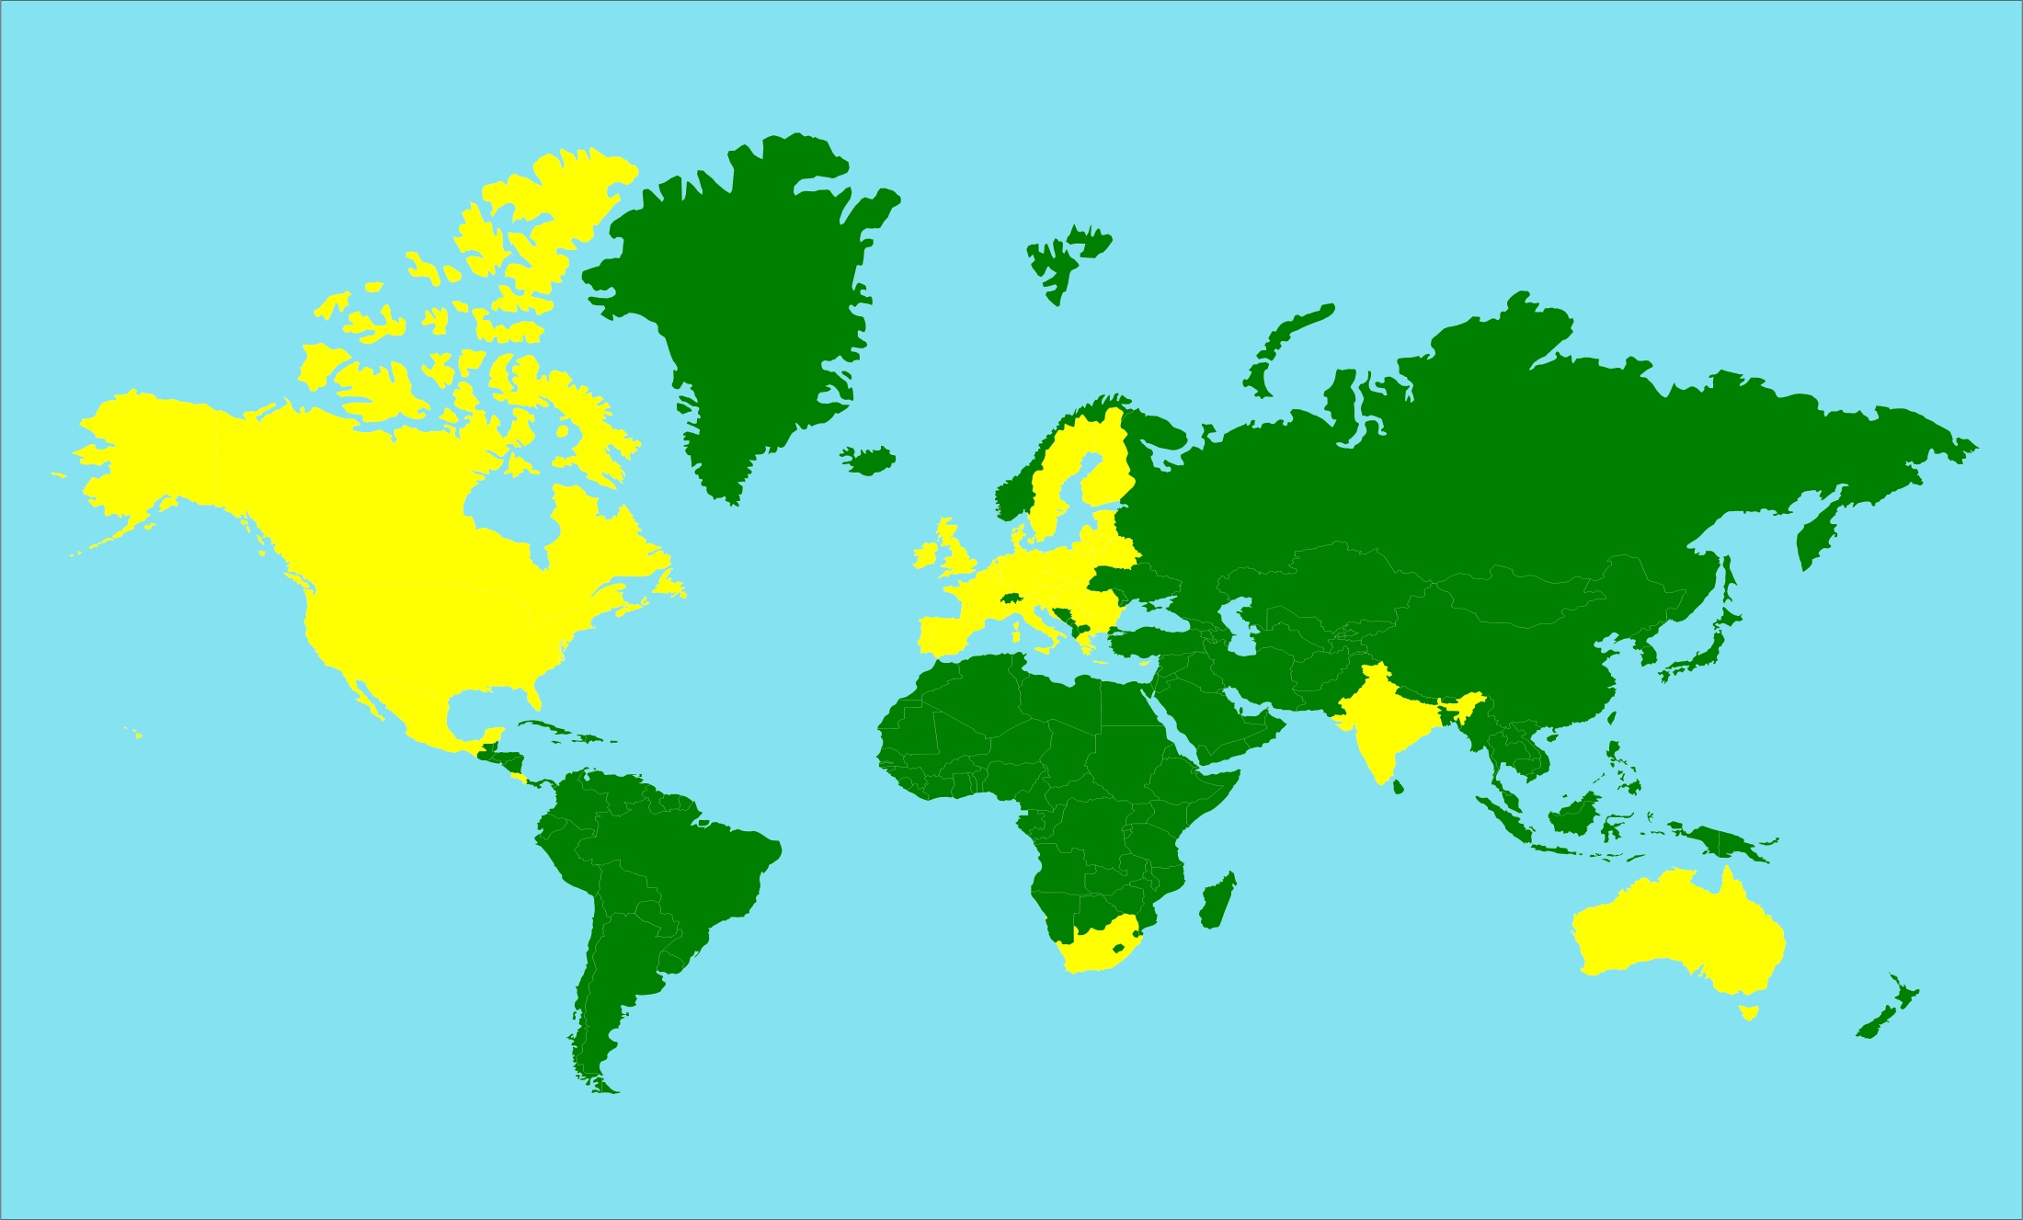
Donde trabajamos
HSI EU: Bruselas
HSI Canadá
HSI UK
HSUS/HSI Oficina Global
HSI México
HSI India
HSI Latinoamérica
HSI Australia
HSI Sudáfrica
= Consultores
= Oficinas Regionales

Slide 5
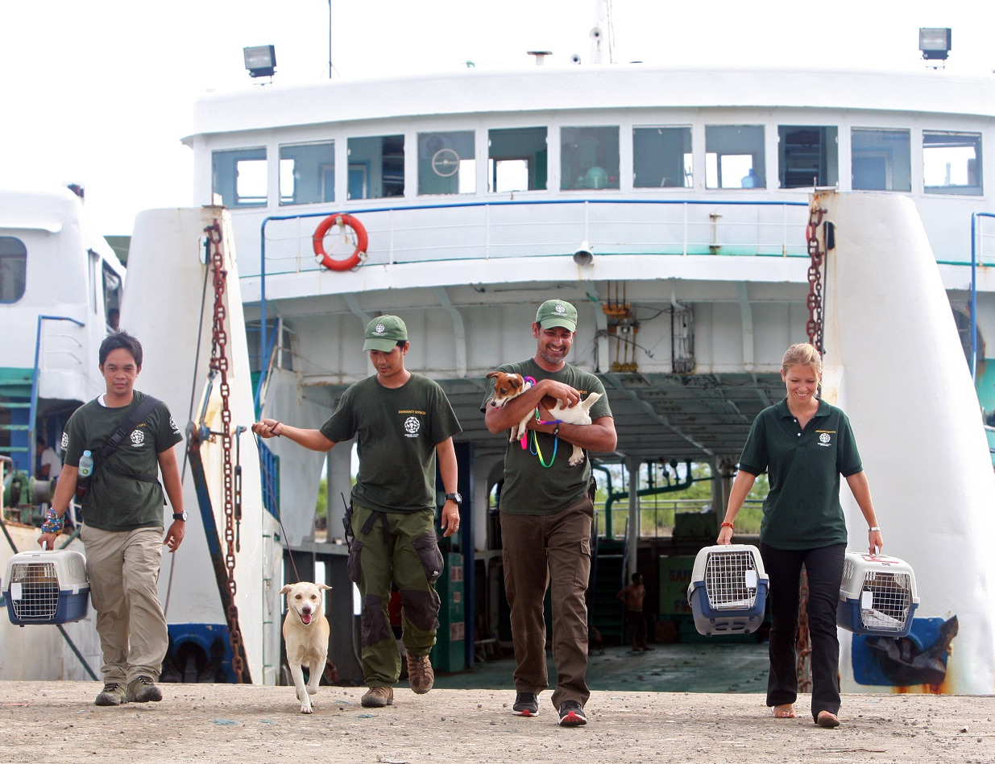
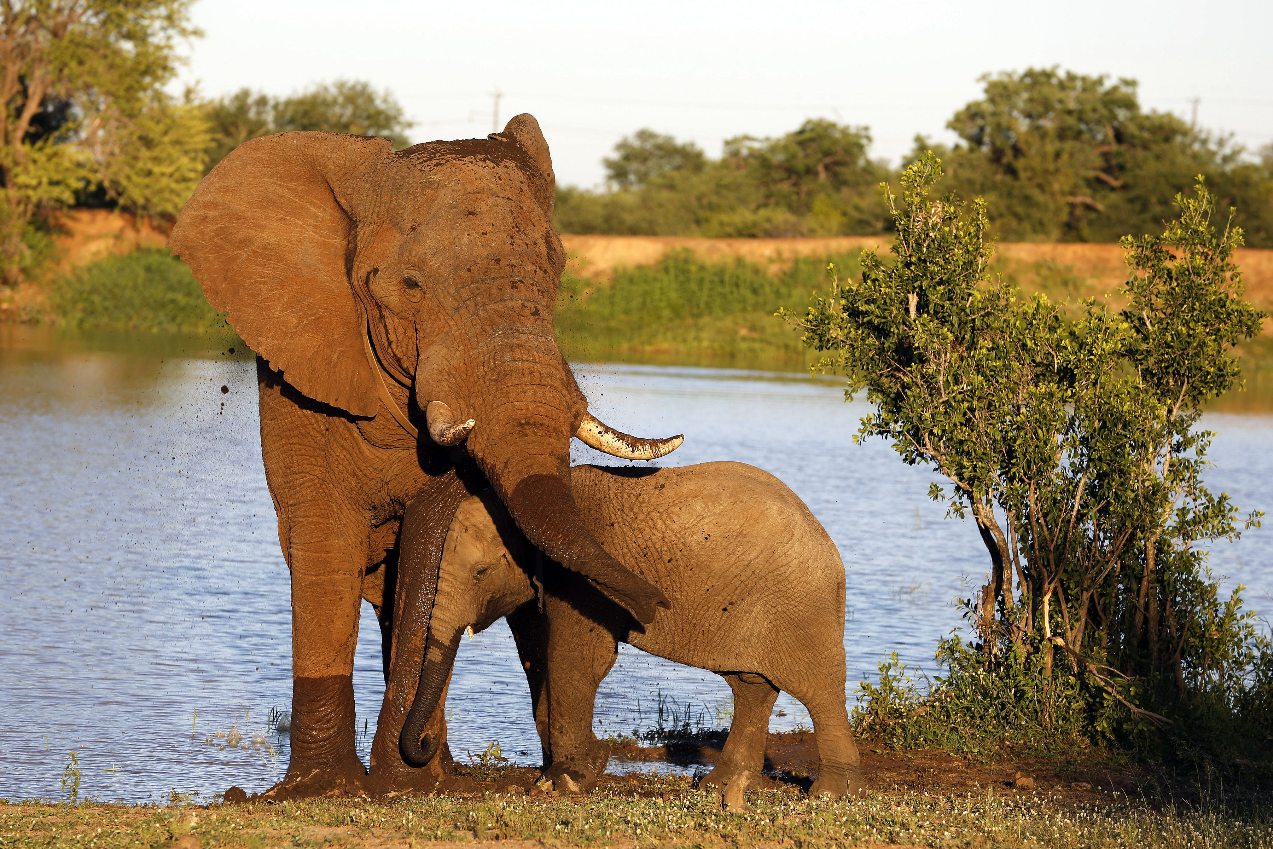
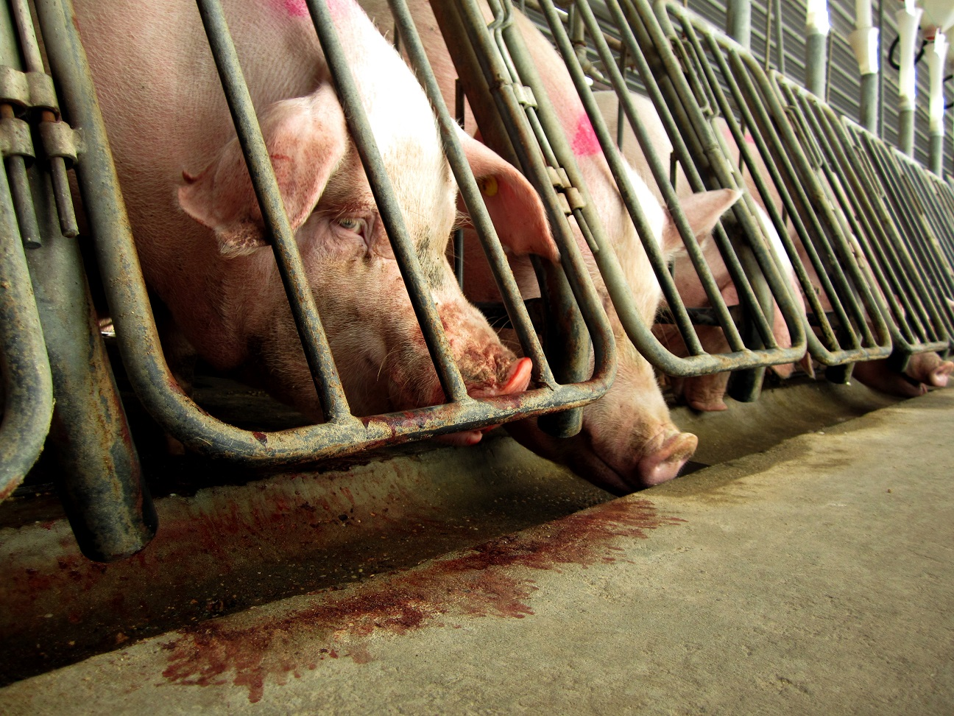
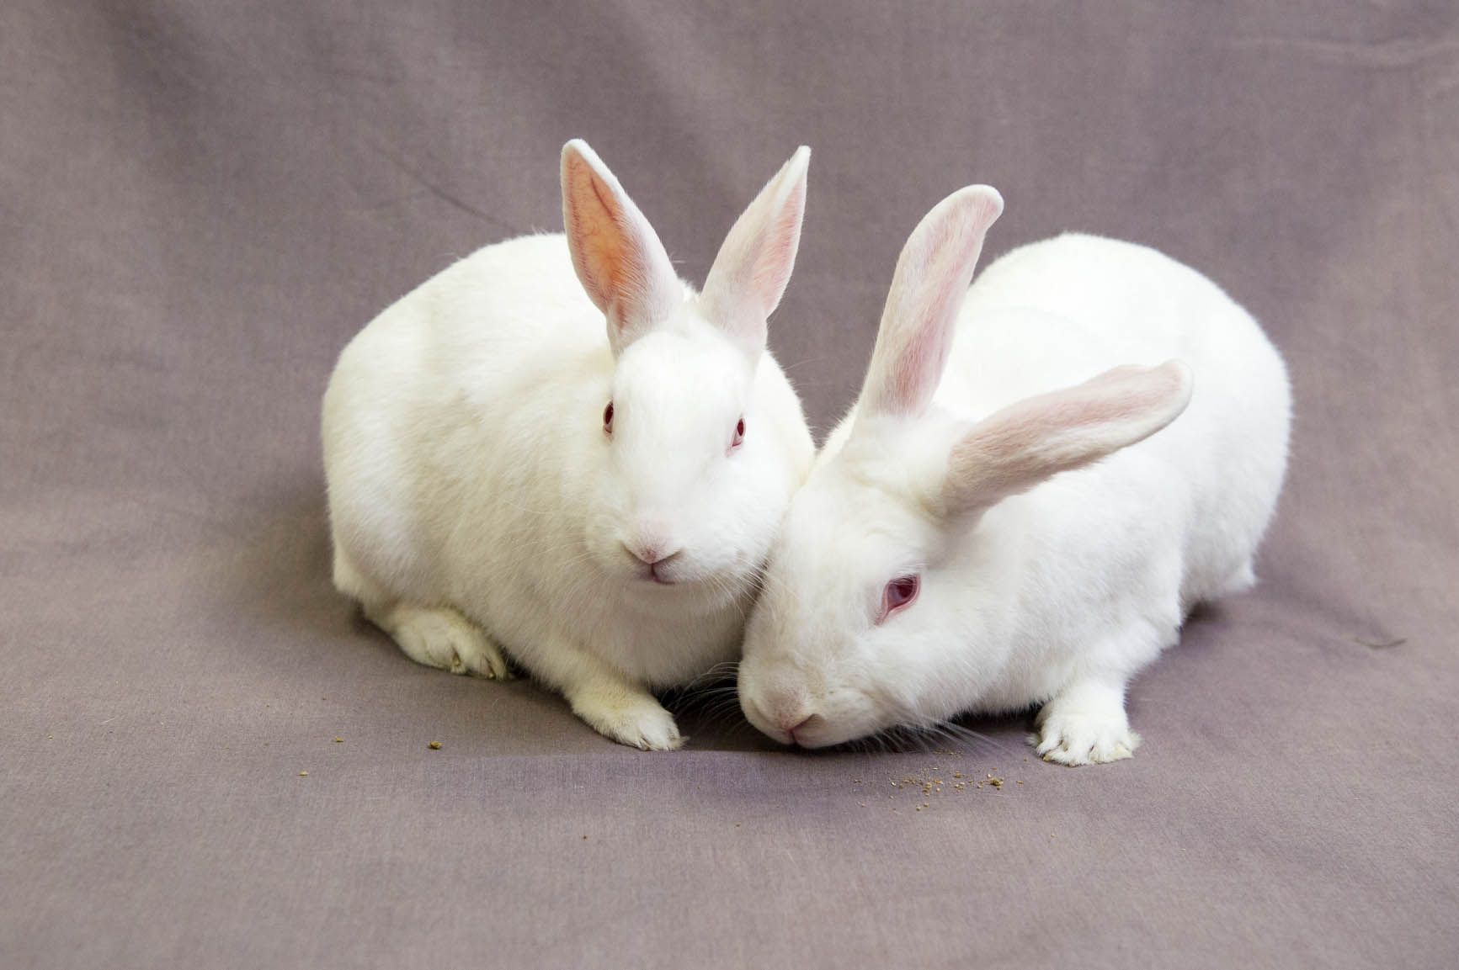
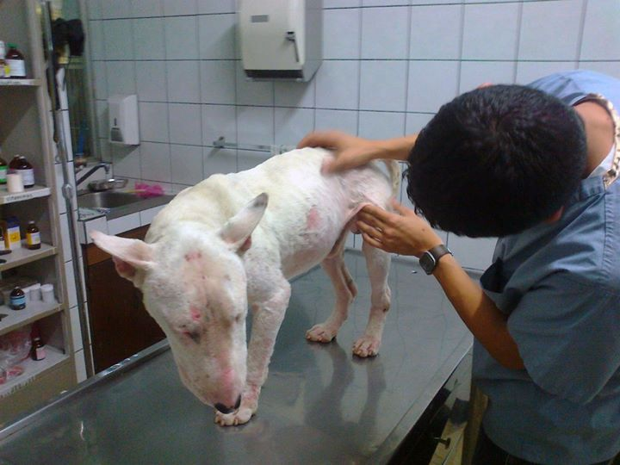
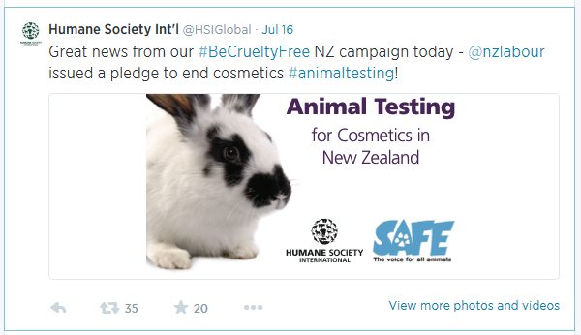
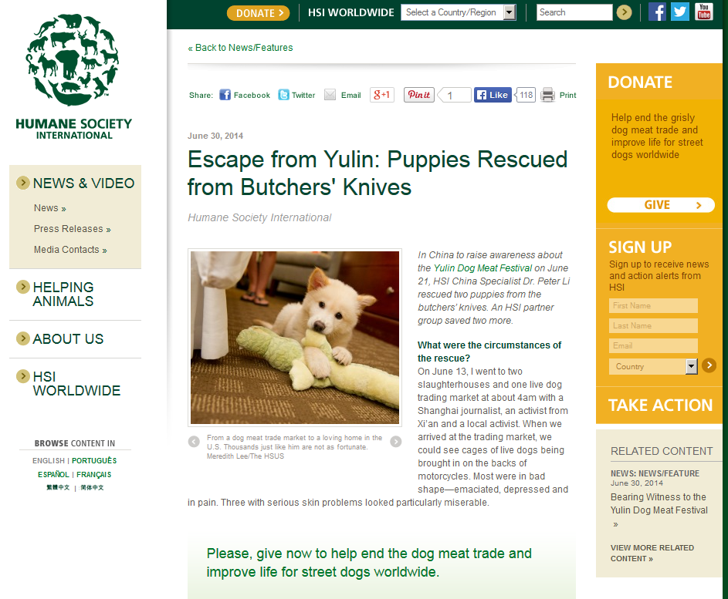

Quiénes somos
Departamentos
Animales de Compañía
Vida Silvestre
Animales de Granja
Investigación y Toxicología
HSI Global
Comunicaciones En Línea

Slide 6
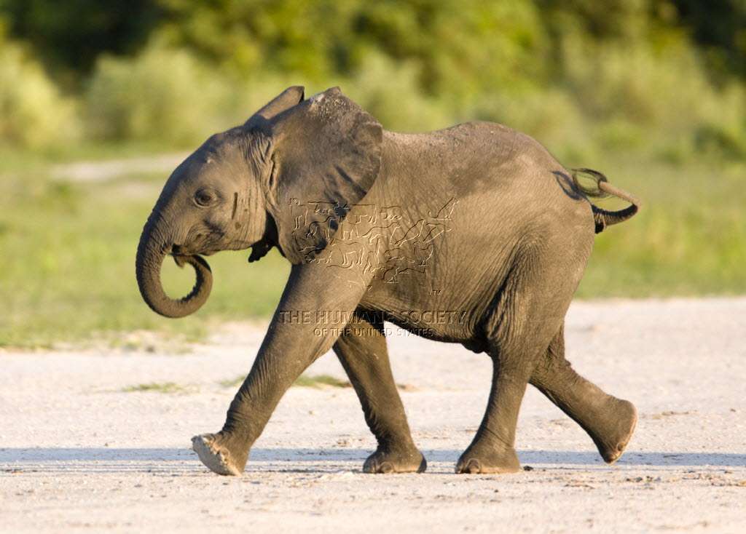
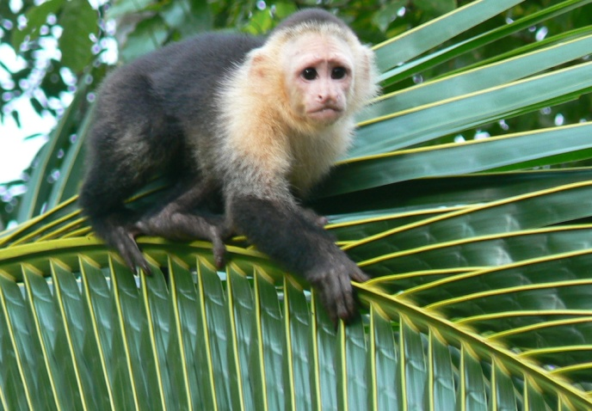
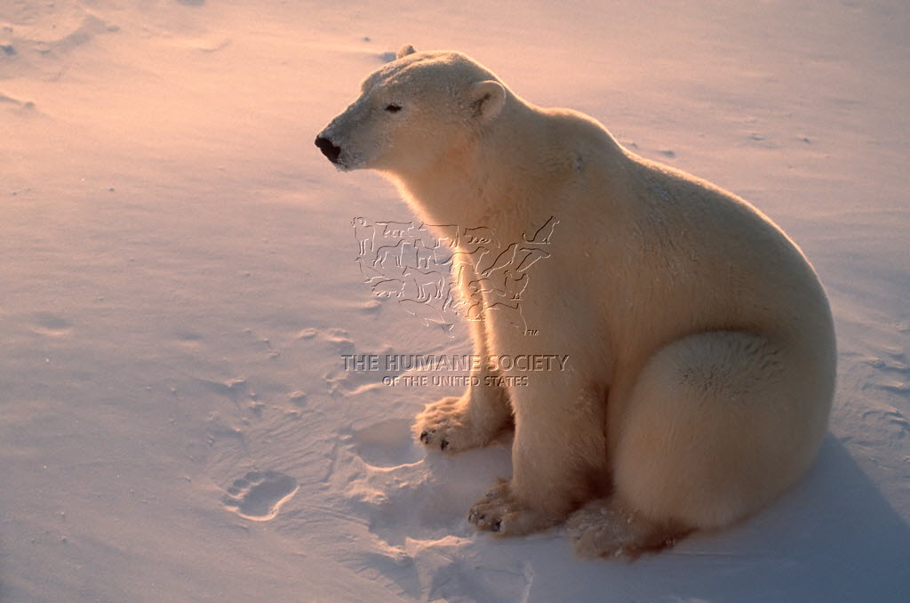
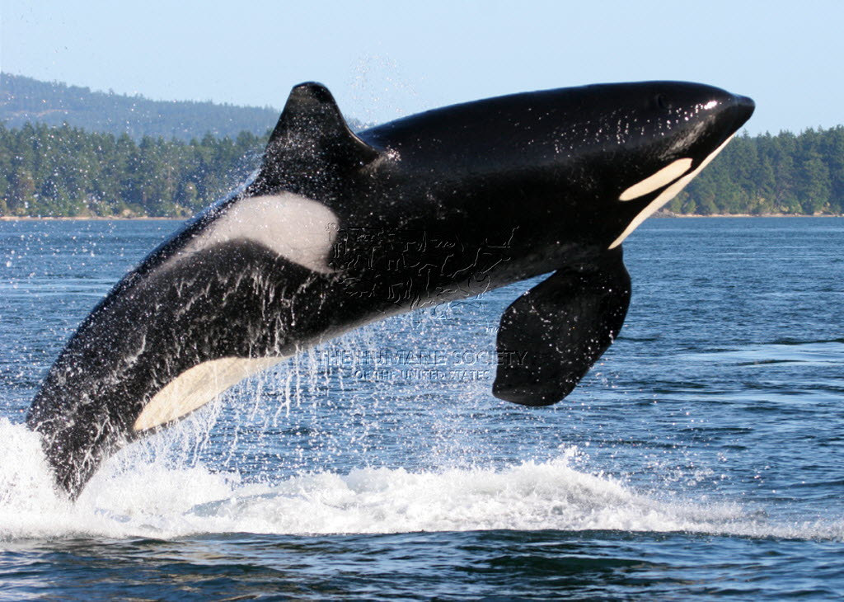
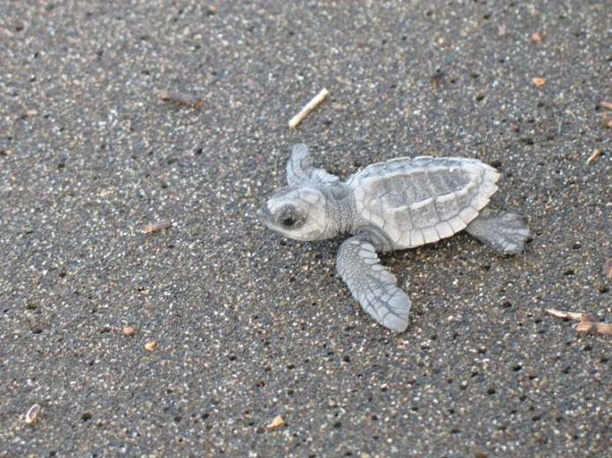
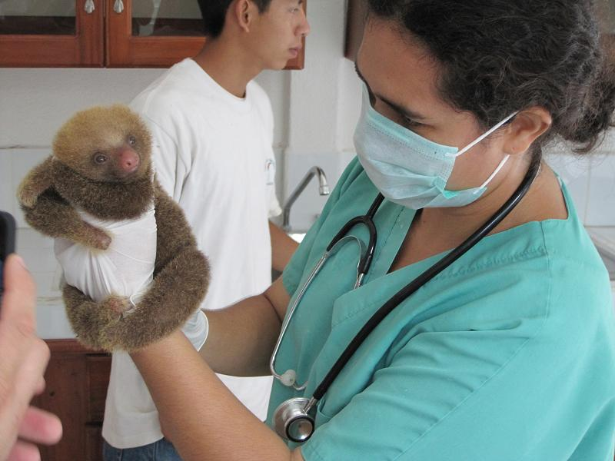
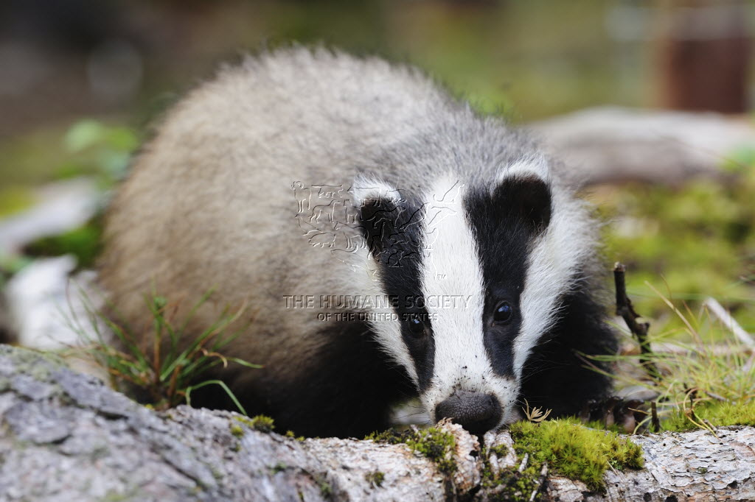
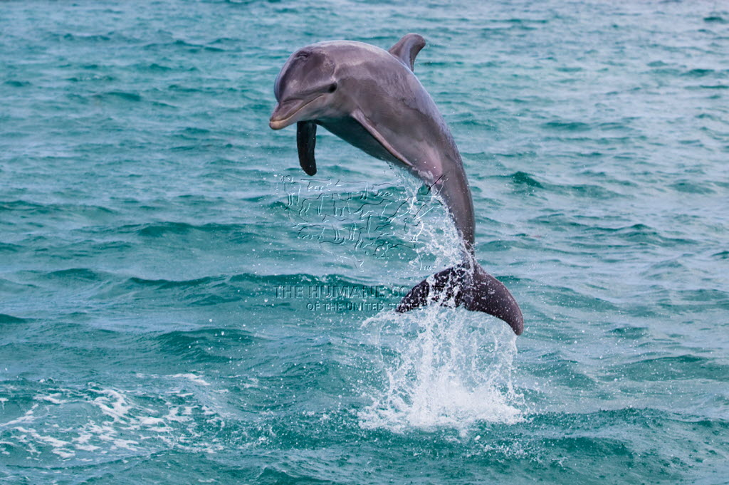
VIDA SILVESTRE

Slide 7
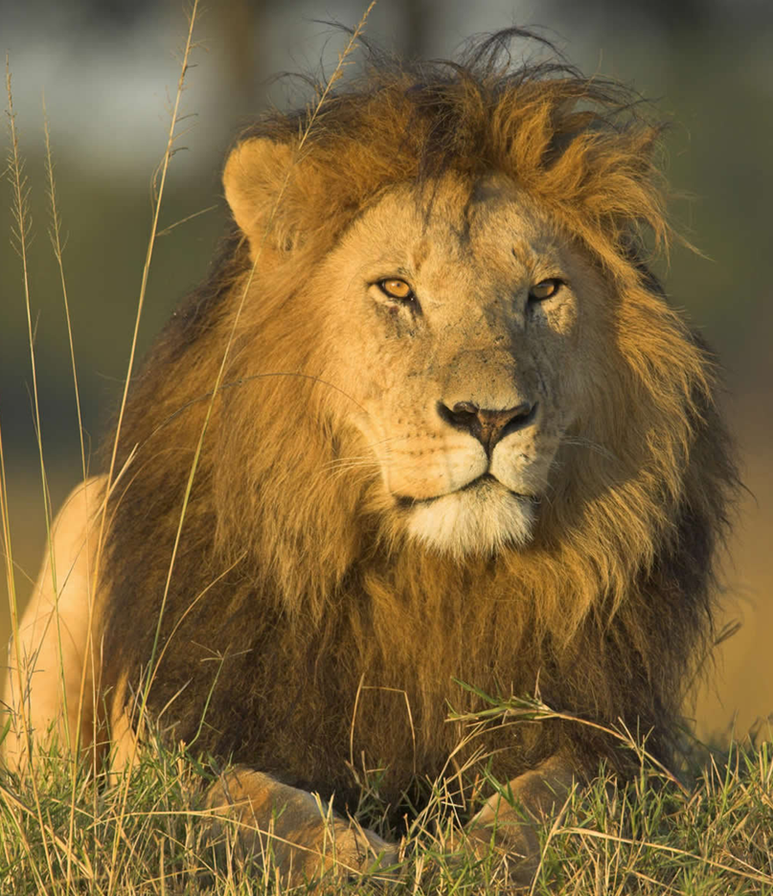
Lo que hacemos
Cambio en Políticas
Caza furtiva y tráfico ilegal
Comercio
Caza de trofeos
Turismo mal regulado
Plagas
Zoológicos y centros con manejo deficiente
Uso religioso inapropiado
Notes:
HSI protects wildlife around the globe from a wide variety of harm and threats including trophy hunting, commercial trade, poaching and illegal trade, poorly regulated tourism, persecution as pests, poorly managed zoos and aquaria, and inappropriate religious uses. To do so, HSI’s wildlife programs and projects focus primarily on the organizational objective of changing policy at global, regional, national and local levels of government. Policy change is brought about as a result of influencing policy makers through education, provision of scientific and legal advice, and public engagement.

Slide 8
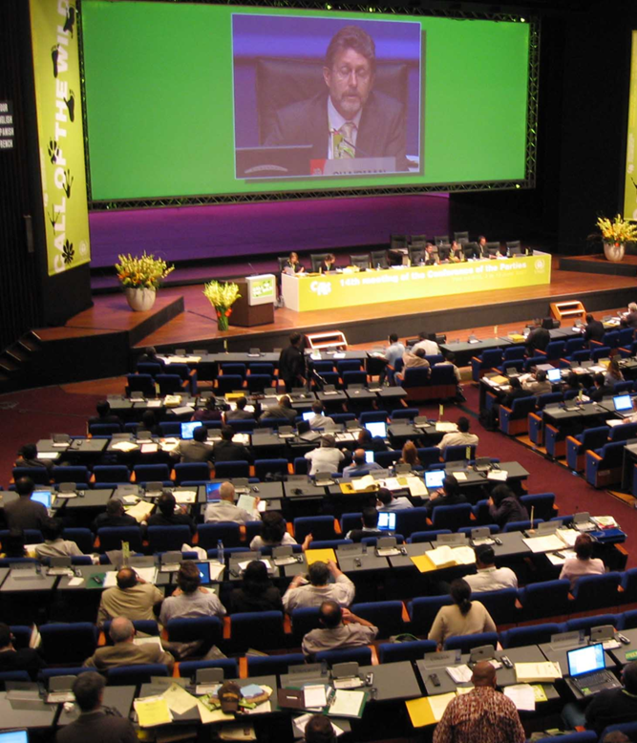
Lo que hacemos
Convenciones y Tratados
CITES
IWC (CBI)
CMS
IATTC (CIAT)
IAC (CIT)
OIE
DR-CAFTA
TPP
Notes:
Our work at global and regional levels to effect lasting change is primarily through the following international and regional bodies which means that our legislative protections are adopted by countries signatories to the treaties and agreements: Convention on International Trade in Endangered Species of Wild Fauna and Flora (CITES), International Whaling Commission , Convention on Migratory Species , Agreement on International Dolphin Conservation Program, The Inter-American Convention on the Protection and Conservation of Sea Turtles, Convention for the Conservation of European Wildlife and Natural Habitats, World Organization for Animal Health, Trans Pacific Partnership Agreement, and the Dominican Republic-Central America-United States Free Trade Agreement.

Slide 9
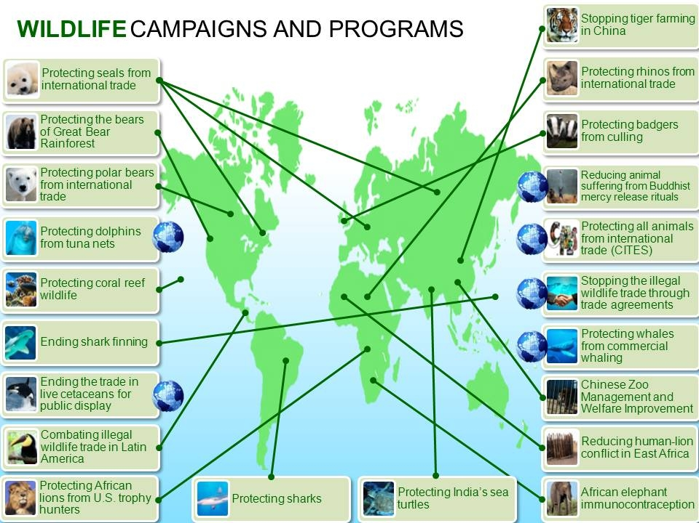
Donde trabajamos
Programas y Campañas de Vida Silvestre

Slide 10
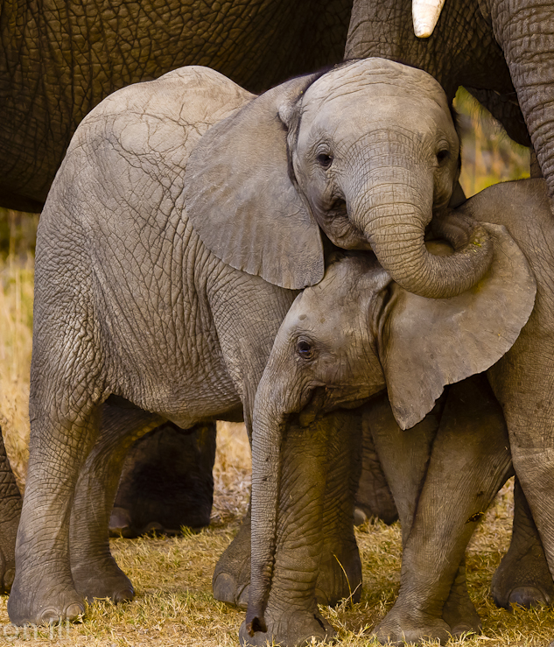

Lo que hacemos
Programas Animales Terrestres
Elefantes africanos
Leones africanos
Rinocerontes
Animales silvestres en Centro y Suramérica

Slide 11
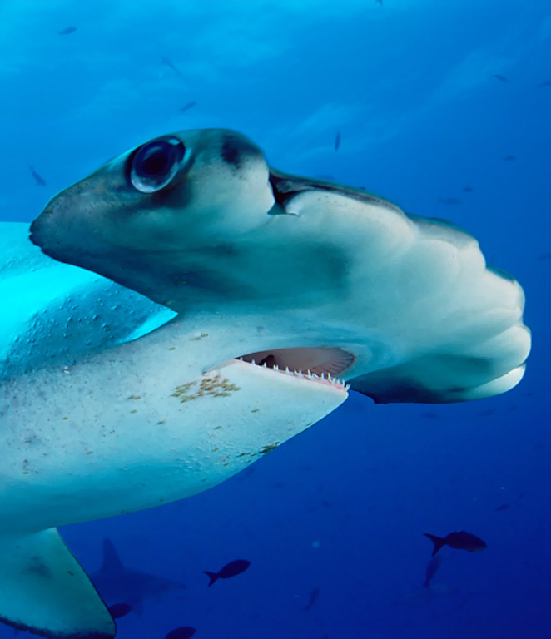
Lo que hacemos
Programas de Animales Marinos
Ballenas
Delfines
Tortugas marinas
Tiburones y rayas
Vida silvestre en arrecifes de coral
Osos polares

Slide 12
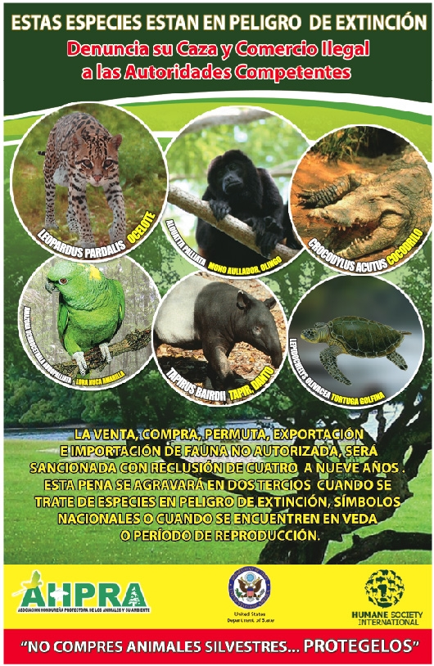
Quiénes somos,
Cómo trabajamos
Ejes Transversales
Tráfico ilegal de animales silvestres en Latinoamérica
Mejoras y Buenas Prácticas en Centros de Rescate LA
Mejoras en Zoológicos de China
Liberación compasiva
Campaña“Don’t Buy Wild”
Tratados de Libre Comercio
Litigación Internacional
Notes:
Cross-cutting Programs:
Illegal Wildlife Trade, Latin America: We are protecting wildlife populations by increasing the capacity of government officials to handle animals confiscated from the illegal wildlife trade, and increasing the probability for confiscated wildlife can be released back into the wild by improving wildlife rescue centers.
China Zoo Improvement: We are working with the China Zoo Association to improve the welfare of wild animals kept at zoos and aquaria in China by improving zoo management, animal care, and housing conditions.
Mercy Release: We are encouraging Buddhist leaders and congregation members to stop mercy release rituals that involve capturing and releasing wild animals, and to instead participate in humane alternatives, such as supporting animal welfare groups or animal sanctuaries.
Don’t Buy Wild: We are educating the public about the wildlife trade, reducing tourists’ consumption of wildlife products and reducing tourist patronage of facilities that profit from the wildlife trade or that keep wildlife under inhumane conditions.
Ecotourism: We are increasing protection for wildlife through promotion of responsible ecotourism and other economic alternatives to wildlife capture and trade.
Free-trade Agreements: We are working to ensure that free-trade agreements contain enforceable provisions on wildlife protection with potential to benefit millions of animals.
International Litigation: When wildlife protection laws—such as U.S. dolphin protection laws—are challenged under the rules of the World Trade Organization, we are defending those laws through the work of the HSUS Animal Protection Litigation department.

Slide 13
[ Protecting Wildlife ]
Rebecca Regnery
rregnery@hsi.org
Grettel Delgadillo
gdelgadillo@hsi.org

