Slide 1
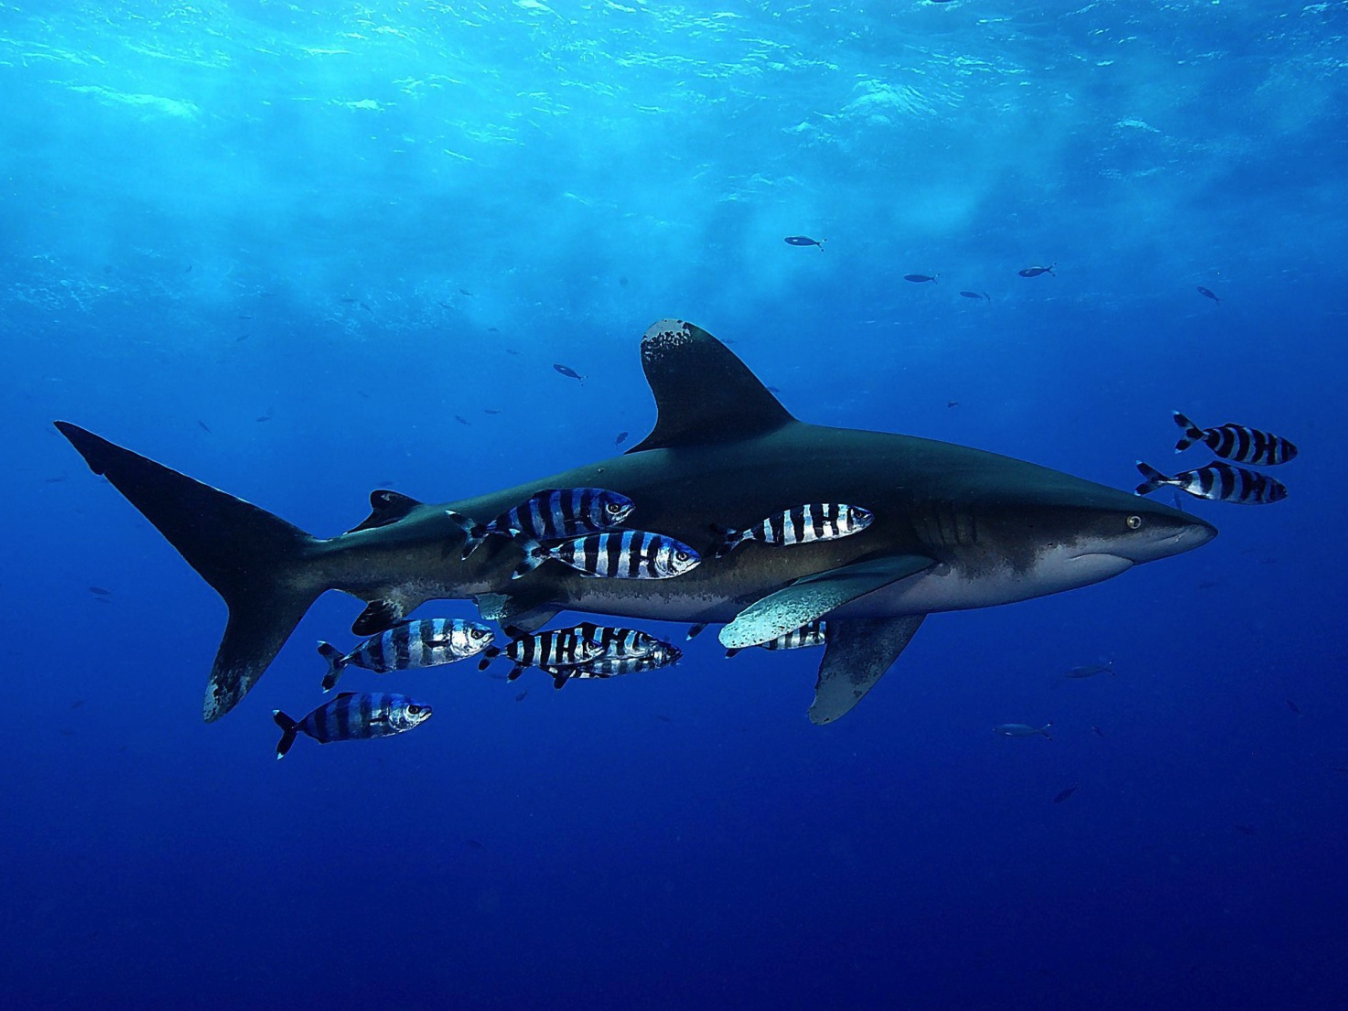
Tiburones en CITES, CoP16
Maximiliano Bello
Senior Officer, International Ocean Policy
The Pew Charitable Trusts
© Manu San Felix

Slide 2
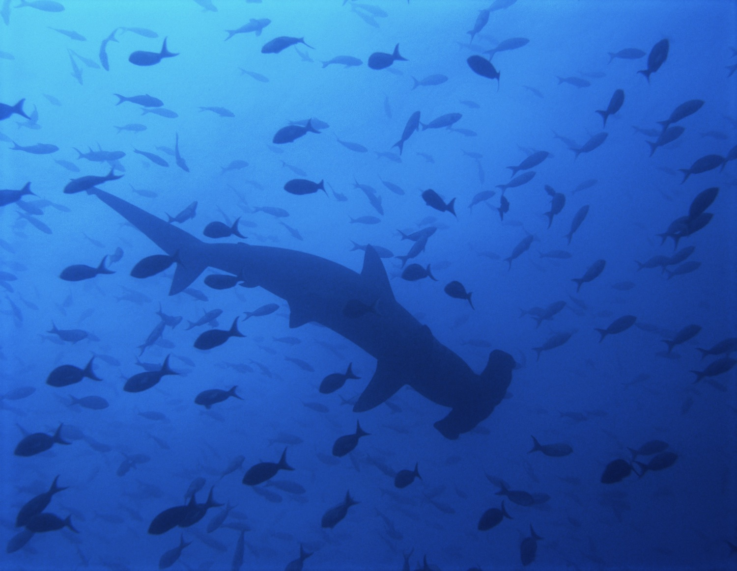
Resultados de la CoP16
Jaquetón oceánico o de punta blanca (Carcharhinus longimanus) al Apéndice II
Tiburón martillo (Sphyrna lewini) al Apéndice II
“similares”
Martillo ojichico o cornuda cruz (S. zygaena)
Martillo gigante (S. mokarran)
Sardinero (Lamna nasus) al Apéndice II
Género Manta al Apéndice II
Mantarraya oceánica (Manta birostris)
Mantarraya de arrecife (Manta alfredi)

Slide 3
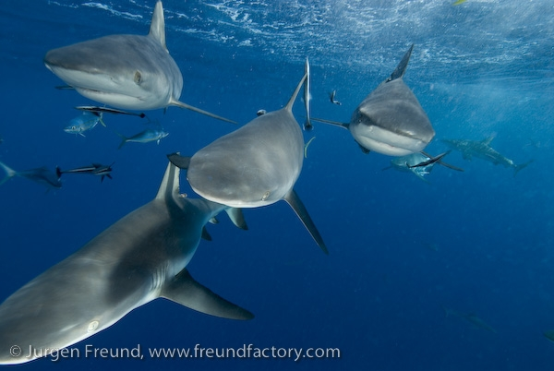
Sharks 101
Tiburones
¿Por qué estan en problemas y cuales son las opociones de manejo?
Sharks: Why They Are in Trouble, and Options for Their Management

Slide 4
Notes:
This is probably what most people think of when they hear the word shark. What words come to mind? Jaws. Dangerous. Terrifying.

Slide 5
Notes:
But most sharks are completely harmless, like this whale shark. This shark is the biggest fish in the sea. Of the approximately 450 species of sharks, only three are responsible for most of the world’s shark attacks: the one we just saw – the great white – along with bull sharks and tiger sharks. So instead of DANGEROUS, the word we should think of when we talk about sharks is DIVERSITY. There’s a huge number of shark species and the number is growing as we discover more of them.

Slide 6
Notes:
Most sharks are small, less than a meter long, like this whitetip reef shark. You have probably seen this swimming around Fiji and other Pacific islands. I’ve seen it myself when I was snorkelling in the Mamanucas a couple of years ago. This species of shark has never killed anybody.

Slide 7
Notes:
Some sharks are even smaller, some sharks are tiny, like this dwarf lantern shark. This is a fully grown shark, believe it or not.

Slide 8
Notes:
Sharks also have some very cool and interesting morphologies that may surprise you. This cat shark actually glows in the dark. It is a defense mechanism that says “DON”T EAT ME”

Slide 9
Notes:
And this hammerhead has a very cool shaped head that it uses to find food. It is one of the species we will be discussing this week.

Slide 10
Notes:
And this thresher has a giant long tail that it uses to slap and catch mackerel. A paper recently described how this is done. The shark swims up to a ball of mackerel, and then slams on the brakes, flips its tale over its head, and stuns the fish. Very nifty!

Slide 11
Notes:
And this is a greenland shark. That’s ice in the background. So the water is very cold. Sharks swim in every ocean, in almost every habitat. They swim in the open ocean, on the ocean floor, along the coast, on top of reefs, and everywhere in between.

Slide 12
Tiburones, asombrosos animales
Alrededor de 450 especies
Han estado en el planeta por mas tiempo que cualquier animal terrestre
Han evolucionado en el mar por mas de 400 millones de años.
Notes:
You’ve just seen 8 of the world’s shark species. But as I mentioned earlier, there are about 450 species of sharks in the ocean and only 3 are responsible for most of the world’s shark attacks. [STATE ABOVE FACTS] .

Slide 13
Los tiburones no son como otras especies de peces
Los tiburones son:
De lento crecimiento
Madurez tardía
Y producen pocas crías
Notes:
Sharks are fishy, but they’re not like other fish. [READ OUT LIST] That makes them especially vulnerable to overfishing.

Slide 14
Notes:
Here’s why sharks shouldn’t be managed as fish, even though we do. This chart shows that while bony fish will produce millions of eggs several times per year, sharks will only reproduce a handful of pups every year, or every couple of years. Because of their biology, sharks require special management, just like marine mammals and turtles.

Slide 15
¿Qué amenaza a los tiburones?
Notes:
Many of you have heard that sharks are endangered. What is the #1 thing killing sharks today?

Slide 16
La pesadilla de los tiburones
Notes:
Shark fins are used as an ingredient in shark fin soup, an expensive dish an Asia.

Slide 17
Notes:
And here it is. The ingredient is like a noodle. It’s the shark fin trade that is driving the severe depletion of almost every large-bodied, migratory sharks.

Slide 18
Notes:
The noodles are made out of the cartilage fibres in the fins. Angelo is holding the caudal fin of a blue shark in this photo – you can clearly see the cartilage fibers that could end up in a bowl of soup.

Slide 19
Notes:
So how do fishermen get these fins? Mostly from longline vessels, but also from purse seiners. You have both here in Pacific. The longliners catch about 10 times as many sharks as the purse seiners.

Slide 20
Notes:
In many places around the world the sharks are landed whole. The best science says that about 40% at most are finned here in the Pacific.

Slide 21
Notes:
It’s the fins that have the most value. The whole adult shark sells for about $5 here in Fiji. But the fins are worth much more.

Slide 22
Notes:
The fins are first dried, and then later processed with bleach and other chemicals.

Slide 23
Notes:
And end up looking like this, where they can sell for as much as $1,500 per kilogram, but the price varies depending on the species and the size of the fin.

Slide 24
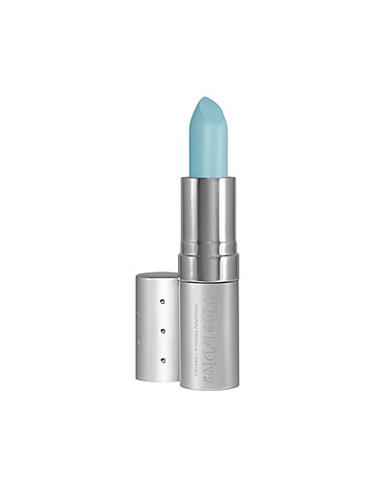
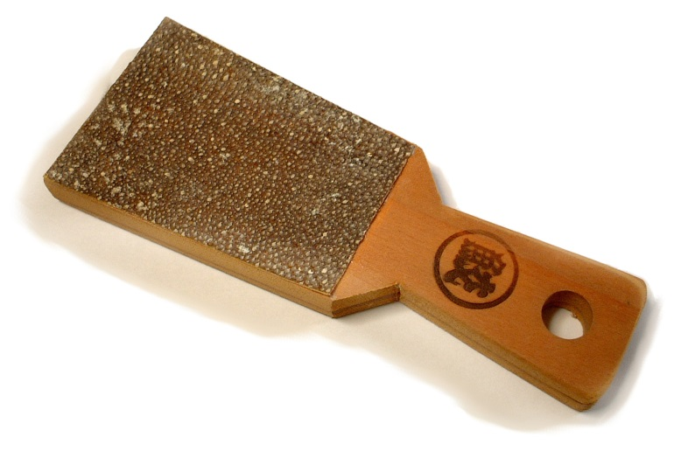
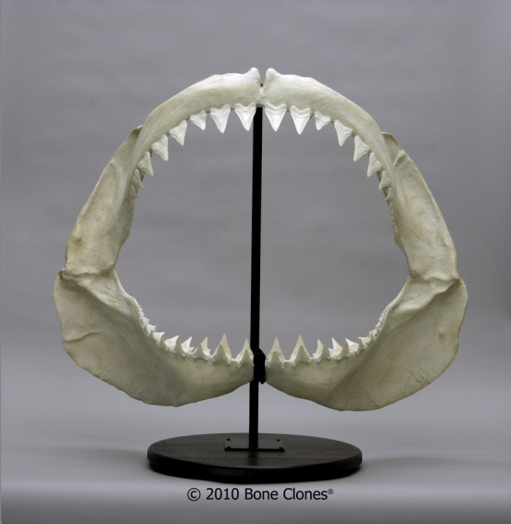
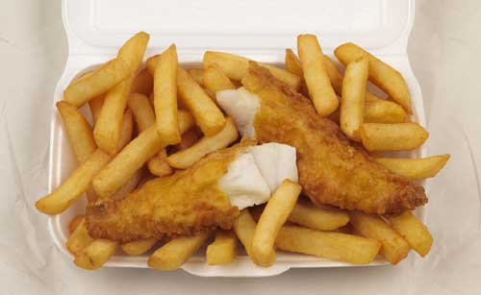
Pero también…
Notes:
It’s not just the fins. Sharks are used for their meat, skins, jaws and livers as well. And they end up in many different products – some may surprise you.

Slide 25
100 Millones
De tiburones muertos cada año
Notes:
As a result of this demand, too many sharks are killed each year. A study released by Dr. Boris Worm et al last year estimated that 100 million sharks are killed each year – and the paper stated that this was a conservative estimate. Dr. Demian Chapman was a co-author of this paper and can answer any questions you might have about it. 100 m translates to 11,415 per hour - a number far higher than the replacement rate.

Slide 26
54%
De especies de condríctios– tiburones, rayas y quimeras – se estiman se encuentran amenazados o casi amenazados de extinción.
Notes:
Dr. Nick Dulvy – co chair of the SSG of the IUCN - and others published a new study last month which estimated the population status of all chondrichthyan species – meaning sharks, rays and chimaeras. They estimated that 54% of chondrichthyan species are threatened or near threatened with extinction. Dr Colin Simpfendorfer was a co-author of this study and can also answer any questions you may have about this study.

Slide 27
Los tiburones vivos valen más
Notes:
Culture: Here in the Pacific there are many cultural connections to sharks, such as the Ri Bako in the Marshall Islands, and the clans here in Fiji that have sharks as part of their totem.
Economy: Most divers agree that seeing a shark is the most exciting thing to see on a dive. A study in Palau show that over their lifetime a shark was worth $1.9 million to the dive tourism industry compared to $108 dead on the dock.
Environment: sharks are critical to a healthy reef ecosystem. Without sharks, the reef ecosystem is thrown out of balance.

Slide 28
Como los países del mundo están protegiendo a los tiburones
Notes:
Many countries have started protecting sharks because of their cultural, economic and environmental value. Your countries also have a number of domestic measures. Palau and the Marshall Islands are shark sanctuaries, which ban all commercial targeted fishing of all shark species. I also believe Fiji is finalising your NPOA, Samoa has completed its NPOA, and the Solomon Islands are beginning theirs.

Slide 29
Como los países en el Pacifico protegen a los tiburones
WCPFC
CITES
Prohíbe la retención del tiburón oceánico de punta blanca
Prohíbe la retención de los tiburones sedosos
Requiere que las aletas de tiburones sean descargadas, correspondiendo a un 5% del peso total de los cuerpos.
Listó al tiburón oceánico de punta blanca, sardinero, tres martillos en el Apéndice II.
También ha listado al gran tiburón blanco, peregrino, y tiburón ballena, todos en Apéndice II.
Notes:
At the regional level, there’s the Western & Central Pacific Fisheries Commission which manages fisheries in this part of the world. WCPFC has banned the retention on board of oceanic whitetips and silky sharks. And like all other regional fisheries management bodies, it has banned sharks finning at sea (where the fins are removed and the carcasses discarded). Shark fins can be removed at sea, but they must be landed with the corresponding shark carcasses. The fins must comprise no more than 5% of the weight of the carcasses.
And of course internationally, there’s CITES. And as we all know, last March CITES parties listed five species of sharks, which we will spend the next two days discussing.

Slide 30
Notes:
So I will finish by showing you first some gruesome and then some inspiring photos. Over the next two days, we’ll discuss what you need to do when you come across a sack of sharks.

Slide 31
Notes:
You may also come across shark skins

Slide 32
Notes:
You may also come across shark bodies used for meat.

Slide 33
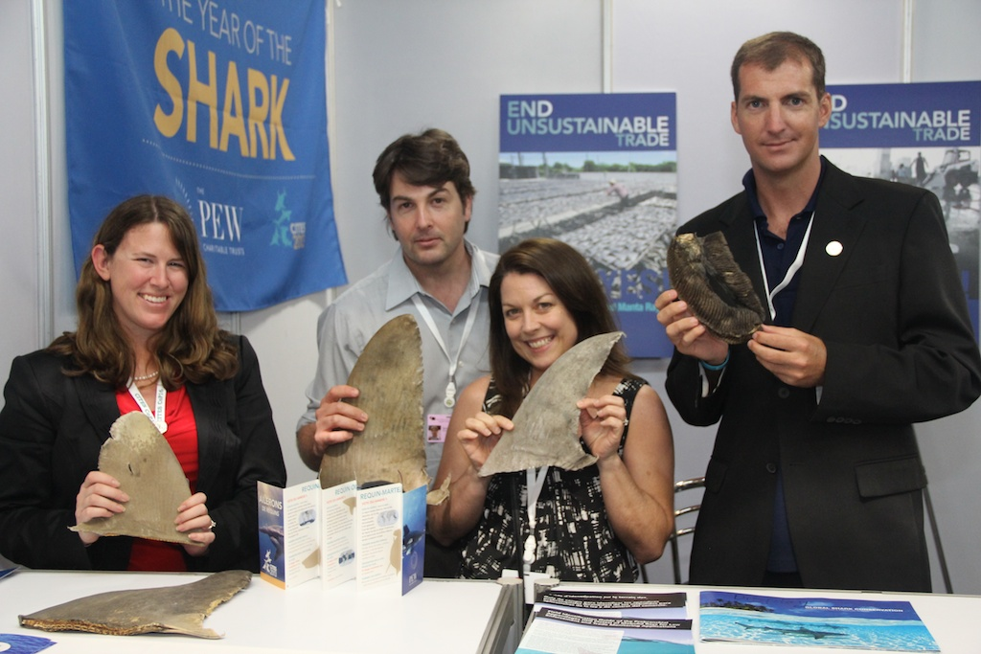
Notes:
But we’re hear to continue to support you with tools such as shark identification guides.

Slide 34
Notes:
And we’ll stay engaged through workshops like this one, as well as by attending the meetings of WCPFC and other regional meetings. Additionally, we have a number of contractors throughout the region.

Slide 35
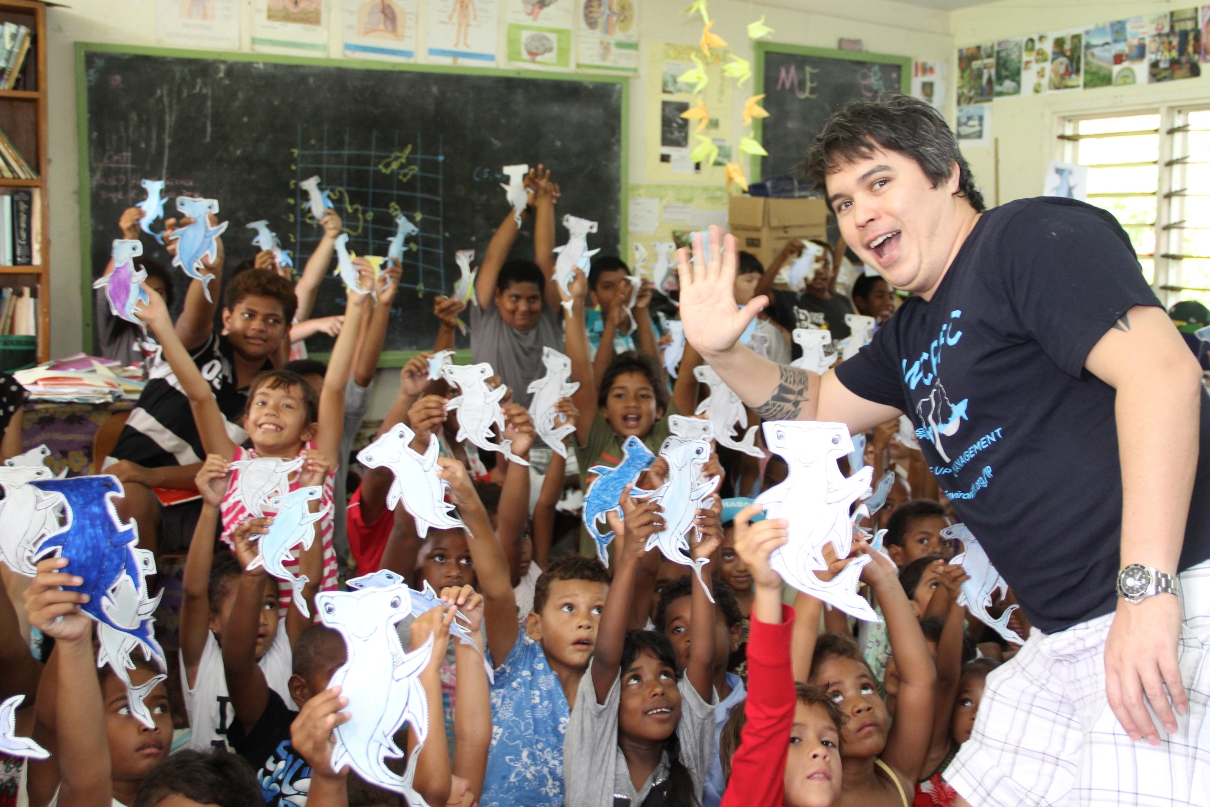
Notes:
And of course, we also hope to continue working with your communities at a grass roots level.

Slide 36
Gracias!
Maximiliano Bello
Mbello-consultant@pewtrusts.org

