Slide 1
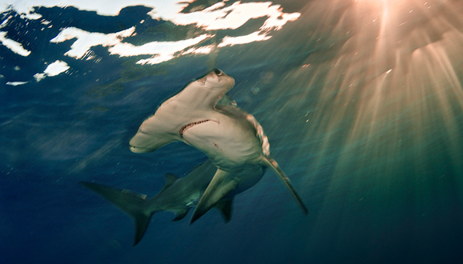
U.S. Fish & Wildlife Service
Credit: Bryan Skerry
Notes:
The U.S. delegation would like to thank Colombia for its leadership in developing and hosting this workshop.
It demonstrates their unwavering commitment to shark conservation, following the successes for sharks at CoP16.
I am Lisa Lierheimer, a policy specialist in the U.S. CITES Management Authority.

Slide 2
UNITED STATES & CITES
The U.S. Fish and Wildlife Service has the jurisdiction for implementation of CITES.
Management Authority
  Branch of Permits
  Wildlife Trade and Conservation Branch
Scientific Authority
Law Enforcement
Notes:
In the U.S., the Fish and Wildlife Service is the designated CITES Authority.
We are made up of the Management Authority that has two branches, Permits & Wildlife Trade and Conservation
And the Scientific Authority.
Unlike other countries, Our Office of Law Enforcement, NOT customs, enforces CITES.

Slide 3
Presentation Overview
Background information
  U.S. Federal Shark Management
  CITES Permits
Wildlife Inspection Process
  Import/Export License
  Designated Ports
  Non-Designated Ports
  Prior Notification Requirements for Wildlife Products
Notes:
Here’s an overview of what we will be presenting today.
I’ll be giving the first part of this presentation, covering U.S. Shark management and CITES permits
Then, I will turn it over to Tamesha Woulard, from the our Office of Law Enforcement, who will walk you through the U.S. Wildlife Inspection Process.

Slide 4
U.S. Federal Management for Sharks (NOAA Fisheries)
Fishery management plans and regulations
  Permits required for U.S. fishermen and dealers
  Reporting requirements
  Commercial quotas, recreational retention limits
  Prohibited species
  Requirement to land sharks with fins naturally attached
  Importers, exporters, re-exporters of shark fins must have permit
Monitoring of imports to ensure compliance
Certain shark dealers must attend shark identification workshops
Notes:
In the United States, our sister Agency, NOAA Fisheries has the authority to manage CITES-listed shark species, as well as other shark species, under various federal laws.
Here is a brief overview of U.S. shark regulations:
Permits are required for U.S. fishermen and dealers.
Fishermen in federal waters are subject to reporting requirements.
There are also commercial quotas and recreational retention limits.
Many shark species are prohibited from retention by U.S. fishermen in federal waters and must be released. (for example, whale shark)
Under U.S. law, all sharks (with the exception of one species) must be landed with their fins naturally-attached.
All importers, exporters, re-exporters of shark fins in the United States must have a NOAA Fisheries International Trade Permit.
NOAA Fisheries is required to monitor the importation of fish or fish products into the United States to ensure compliance.
Certain shark dealers must attend shark identification workshops

Slide 5

CITES Permit Process for Sharks
Notes:
Now I will explain the U.S. CITES permitting process for sharks.

Slide 6
Two part process in order to issue a CITES permit.
  Division of Management Authority (DMA)
  Legal Acquisition Finding
    wildlife was legally acquired (50 CFR § 23.60)
  Division of Scientific Authority (DSA)
  Non-Detriment Finding
    The proposed activity would not be detrimental to the survival of the species (50 CFR § 23.61)
Notes:
As you already know, there is a two part process to issuing a CITES permit.
Under U.S. regulations, The DMA must make a legal acquisition finding
AND
The DSA must make a non-detriment finding.

Slide 7
Legal Acquisition
Documentation demonstrating an unbroken chain of custody, or sequential ownership, from the fisher, through all intermediaries, to the exporter.
Fisher → Company A → Company B → the U.S. exporter
This might be accomplished by providing copies of :
  Valid state fishing licenses
  Required permits
  Catch records
Notes:
In order to make the legal acquisition finding, we must review documentation showing chain of custody, from the fisher, any intermediaries, to the exporter.
This could be accomplished by providing the state fishing licenses, valid NOAA fishing permits, and catch records.

Slide 8
Flowchart for Fishers
http://www.fws.gov/international/permits/by-species/sharks-and-rays.html
Notes:
In order to help fishers determine what CITES documents they need when they land their catch, we developed this “Flowchart”
(I’ve listed the weblink at the bottom of the slide.)
There are different scenarios depending on whether fishers will be landing sharks taken on the high seas, in U.S. waters, foreign waters, or a combination of all of these.
Not only where they fished, but where they plan to land their catch will determine what types of CITES documents are required.
Starting at the top, you can see that if the catch was from the high seas, landed in the U.S., they would be directed to a link to the “Introduction from the Sea” application form.

Slide 9
Flowchart for Exporters
http://www.fws.gov/international/permits/by-species/sharks-and-rays.html
Notes:
We developed a similar flowchart for exporters based on where the sharks were fished and landed.
Exporters would be directed to either a link for a CITES export permit application, or re-export certificate.

Slide 10
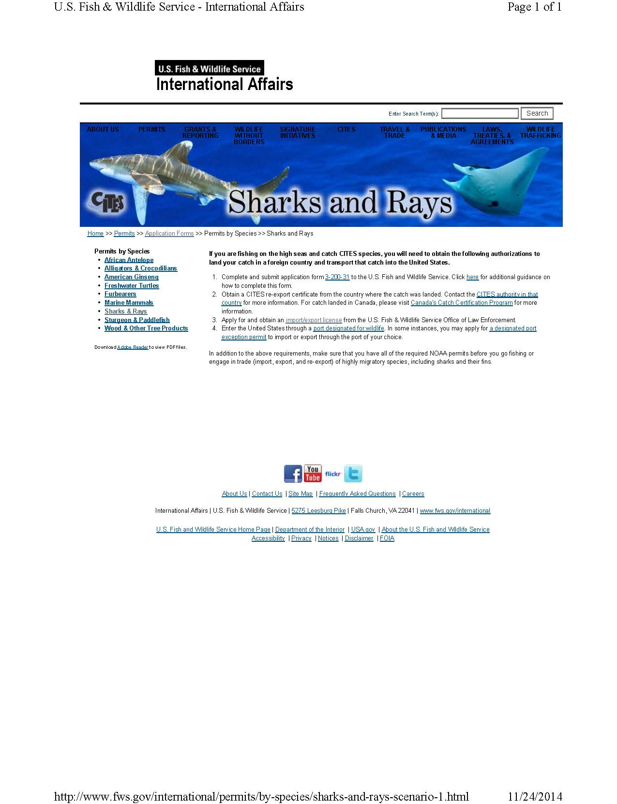
http://www.fws.gov/international/permits/by-species/sharks-and-rays-scenario-1.html
Notes:
All of this information is available on our FWS webpages.
I would be happy to answer any questions you have about the U.S. CITES permit process.
Now, I will turn it over to Tamesha, who will give you an overview of the Law Enforcement inspection process.

Slide 11


US FISH AND WILDLIFE SERVICE
OFFICE OF LAW ENFORCEMENT
WILDLIFE INSPECTION OVERVIEW
Credit: Bryan Skerry
Notes:
The Office of Law Enforcement is designated to determine admissibility for all wildlife specimens imported and exported to and from the United States

Slide 12
Import/Export License
The import/export license is required for all individuals or companies that engage in commercial trade as an importer or exporter of wildlife. This license, which is valid for one year, must be acquired before importing or exporting.
The licensee must keep records and allow inspection of records and wildlife inventory.
The license must be renewed each year as long as the commercial trade activity continues.

Slide 13
Designated Ports
All CITES listed wildlife must be imported or exported through one of the following designated ports:
Anchorage, Alaska Atlanta, Georgia
Baltimore, Maryland Boston, Massachusetts
Chicago, Illinois Dallas/Ft. Worth, Texas
Honolulu, Hawaii Houston, Texas
Los Angeles, California Louisville, Kentucky
Memphis, Tennessee Miami, Florida
New Orleans, Louisiana New York, New York
Newark, New Jersey Portland, Oregon
San Francisco, California Seattle, Washington

Slide 14
Non-designated Ports
Canadian Border Ports
Unless specific authorization is given, Canadian border ports may only be used for the import or export of wildlife that does not require a permit under certain wildlife laws, and whose country of origin is Canada or the United States.
http://www.fws.gov/le/canadian-border-ports.html

Slide 15
Non-designated Ports
Mexican Border Ports
Unless specific authorization is given, Mexican border ports may only be used for the import or export of wildlife that does not require a permit under certain wildlife laws and whose country of origin is Mexico or the United States.
http://www.fws.gov/le/mexican-border-ports.html

Slide 16
Designated Port Exception Permit
(DPEP)
An exemption to the required use of certain ports for wildlife import or export can be granted by this permit.
The DPEP, which is valid for no more than two years, must be acquired before importing or exporting.
A DPEP may be issued for single or multiple transactions and may be granted for scientific purposes, to minimize deterioration or loss, or to alleviate undue economic hardship.
The final criterion that must be met for issuance of a DPEP is a determination that FWS staff is available.

Slide 17
Prior Notification Process
The trade/importer must notify FWS 48 hours in advance of the import of a live or perishable shipment subject to FWS requirements.
The trade/exporter must notify FWS and make the shipment available 48 hours in advance of the export of any wildlife, whether perishable or not.
The trade/importer/exporter must also notify FWS a minimum of 48 hours in advance of the import or export of any commodity subject to FWS requirements when using a DPEP. This latter notification may require additional prior notification depending upon the port, species, and special conditions listed on the DPEP.

Slide 18
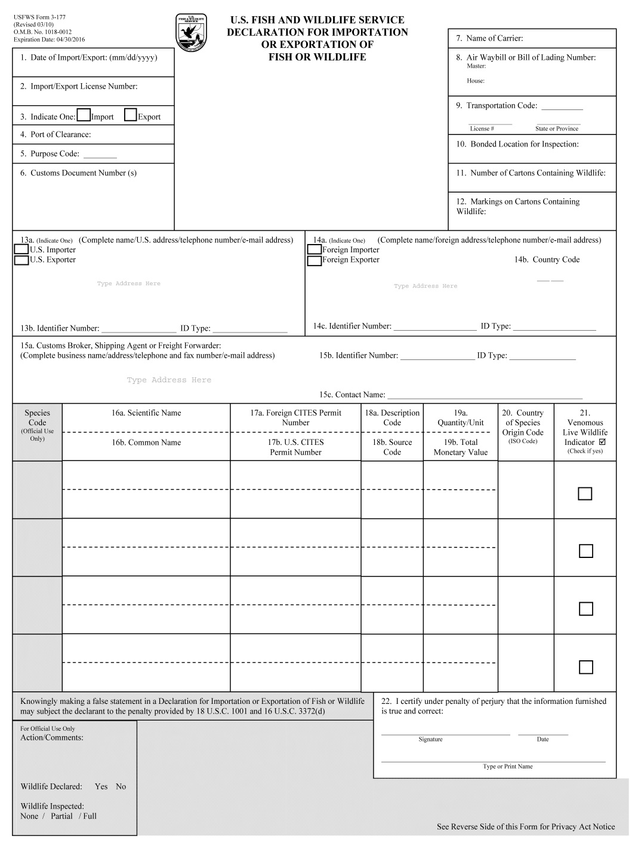

Slide 20
Contact Information for U.S. CITES Authorities:
Management Authority
Telephone: +1-703-358-2104
Fax: +1-703-358-2280
Email: managementauthority@fws.gov
Scientific Authority
Telephone: +1703-358-1708
Fax: +1-703-358-2276
Email: scientificauthority@fws.gov

Slide 21
Contact Information for U.S. CITES Authorities:
Office of Law Enforcement
Telephone: +1-703-358-1949
Fax: +1-703-358-1947
Email: lawenforcement@fws.gov

