Slide 1

Case of study for the Scalloped Hammerhead shark from the Southern Mexican Pacific
Dr. Javier Tovar Ávila
(CRIP Bahía Banderas)
Dr. José Leonardo Castillo Géniz
(CRIP Ensenada)

Slide 2
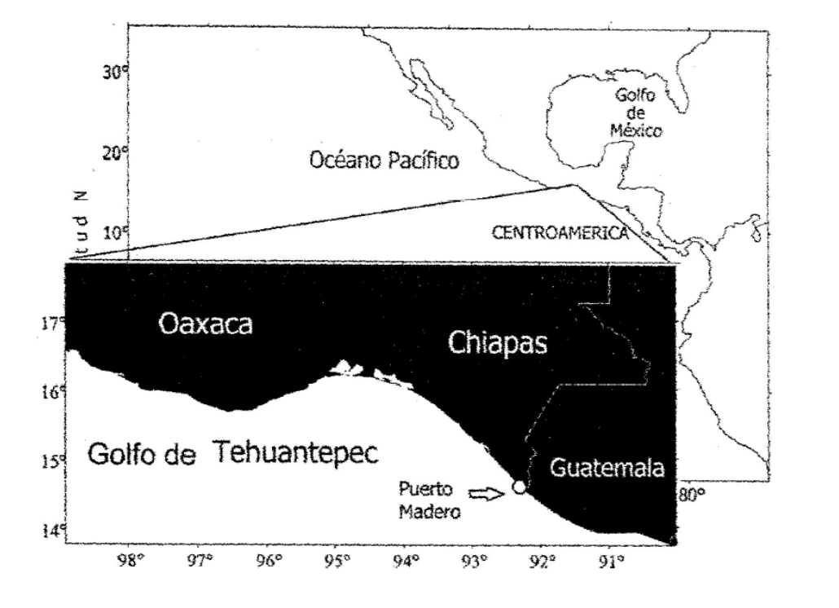
Gulf of Tehuantepec, Southern Mexican Pacific
Puerto Chiapas

Slide 3
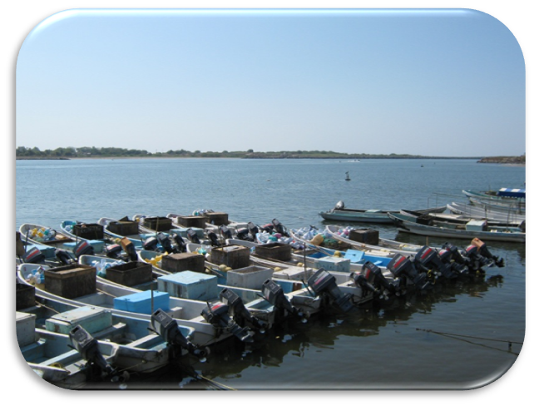
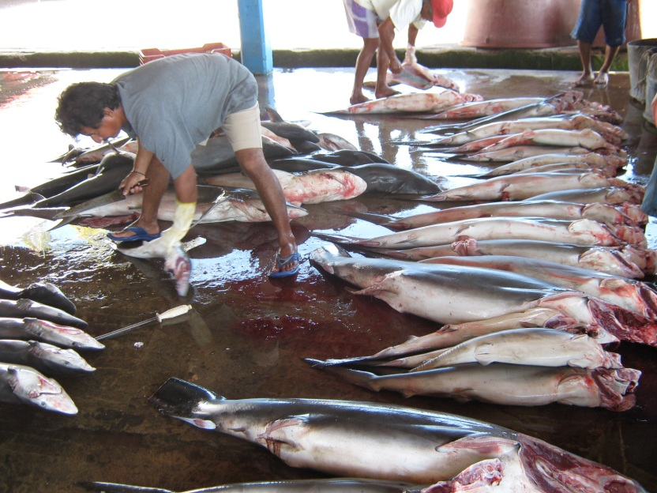
Artisanal Shark Fishery

Slide 4
Step 2 Intrinsic biological vulnerability to harvest and conservation concern
Section 2.1 Evaluate intrinsic biological vulnerability to harvest
Question 2.1 What is the level of intrinsic biological vulnerability of the species to harvest?
Intrinsic biological factors
Average age at which 50% of a cohort reaches maturity
4-5 years considering the TL₅₀ reported by Soriano-Velasquez et al. (2006) and growth parameters reported by Anislado-Tolentino & Robinson-Mendoza (2001), L∞=353.3 cm, k= 0.16 for females and L∞= 336.4 cm, k=0.13 for males.
6 years considering the length at first maturity reported by Bejarano-Álvarez et al. (2010).
Low-Medium vulnerability
8-12 years assuming one pair of bands in the vertebrae per year (Branstetter 1987, Piercy et al. 2007, Kotas et al. 2011).
Medium vulnerability

Slide 5
b) Average size at which 50% of a cohort reaches maturity
TL₅₀= 169 cm for females and 154 cm for males off Chiapas during 1996-2003 (n=10,919) (Soriano-Velasquez et al. 2006).
Medium vulnerability
Length at first maturity= 220 cm TL for females (based on the condition of the ovaries and uteri, n= 342 of which 79 were mature) and 180 cm TL for males (based on the condition of claspers, n= 649) from Oaxaca during 2004-2006 (Bejarano-Alvarez et al. 2010).
Medium-High vulnerability

Slide 6
c) Maximum age/longevity
18.6 years (female of 335.6 cm TL) in the Central Mexican Pacific assuming the annual formation of two pair of bands in the vertebrae (Anislado-Tolentino & Robinson-Mendoza 2001).
Medium vulnerability
Over 30 years assuming the annual formation of one pair of bands (Branstetter 1987, Piercy et al. 2007, Kotas et al. 2011).
High vulnerability

Slide 7
d) Maximum size
420 cm TL (Fishbase) and 306 cm TL for the Eastern Pacific (Compagno et al. 1995).
380 cm of TL for a female in the Gulf of Tehuantepec (unpublished data INAPESCA).
288 cm TL in Oaxaca (Bejarano-Alvarez et al. 2011).
Medium-High vulnerability

Slide 8
e) Natural Mortality rate (M)
0.13 in the Gulf of Tehuantepec using Hoenig method and maximum age reported by Anislado-Tolentino (1995) (Soriano-Velásquez et al. 2006).
0.12-0.22 for the Central Mexican Pacific using Honeig method, maximum age reported by Anislado-Tolentino & Robinson-Mendoza (2001) and cosidering the formation of one or two pair of growth bands in the vertebrae (Tovar-Avila et al. in review).
Medium-High vulnerability
Low M should correspond to high vulnerability.
Sharks M rarely gets over 0.3 e.g. S. tiburo 0.37, R. terraenovae 0.44 & M. californicus 0.37 (Smith et al. 1998).

Slide 9
f) Fecundity (maximum litter size or number of eggs)
48 embryos maximum (average= 19.3) (n= 140 pregnant females) in Puerto Chiapas during 1996-2003 (Soriano-Velásquez et al. 2006).
40 embryos maximum (n= 50 pregnant females) in Oaxaca (Bejarano-Alvarez et al. 2011).
High vulnerability
g) Reproductive rate/ intrinsic rate of population increase
r= 0.25 (λ= 1.284) (Soriano-Velásquez et al. 2006).
Medium vulnerability
* Low r should correspond to high vulnerability.

Slide 10
h) Geographic distribution
Broad and continuous distribution in the Mexican Pacific (from the Gulf of California to the Gulf of Tehuantepec).
Medium vulnerability
*The characteristics of distribution for each level of vulnerability should be established.
i) Stock size and abundance
The only population size estimation from the Gulf of Tenhuantepec was undertaken with a virtual population analysis (VPA), indicating an inicial population size of 147,000 individuals and a biomass of 2,466 t (Soriano-Velásquez et al. 2006). This was considered by the authors as an underestimation due to the mortality assumed. It is unknown the current level.
*Definition of percentage intervals unclear, 50% of initial biomass usually equals RMS.

Slide 11
j) Reliance on critical habitats and habitat vulnerability
The presence of neonates and small juveniles in the Gulf of Tehuantepec (Both Chiapas and Oaxaca) and all the Mexican Pacific coast have been widely documented.
Some specific regions have been reported as nursery areas in Chiapas (Soriano-Velásquez et al. 2006) and Oaxaca (Alejo-Plata et al. 2007) mainly during the rainy season.
Such regions are important fishing grounds for the artisanal fleet, making the species highly susceptible to being caught and other human activities.
High vulnerability
*The characteristics of distribution for each level of vulnerability should be established.

Slide 12
Section 2.2. Evaluate conservation concern
Question 2.2 What is the severity and geographic extent of conservation concern?
Evaluated as Globally Threatened by the IUCN and as Threatened (A4bd) in the Eastern Central Pacific region.
The INAPESCA evaluated the species at high risk for the effects of the shark fisheries in the Mexican Pacific (more information provided in Section 3.1.

Slide 13
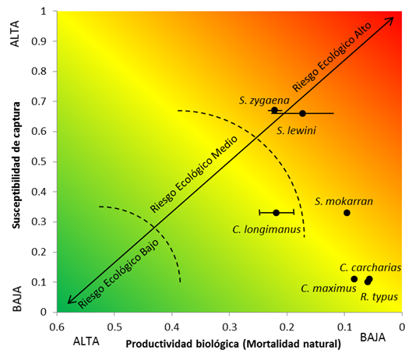
Step 3 Pressures on species
Section 3.1 Evaluate fishing pressures
Question 3.1(a) What is the severity of risk of fishing on the stock of the species concerned?
No stock assessment has been undertaken for the species due to the limited catch and effort time series. Until 2007 all mexican shark catches reported were generic.
The ecological risk to the effects of shark fisheries in the Mexican Pacific was estimated as high for the species and as the most vulnerable among mexican shark species enlisted by CITES, due to its low biological productivity and high catch susceptibility (Tovar-Ávila et al. in review).
Neonates and juveniles are also commonly caught in the Mexican Pacific by other fisheries such as the shrimp and scale trawl fishery.

Slide 14
Fishing effort
439 shark fishing permits registered in the Mexican Pacific for artisanal vessels during 2012, including the use of 2,079 vessels, 1,569 longlines and 1,028 gillnets, and 186 fishing permits for industrial vessels, with a similar number of vessels and longlines.
30 shark fishing permits in Chiapas, including 245 small vessels, 175 longlines and 216 gillnets.
10 shark fishing permits in Oaxaca including 45 small vessels, 18 longlines and 52 gillnets.
Small vessels: 7.62 m, 75-115 HP outboard motors.
Fishing is carried out all year around, up to 200 km off the coast, during one day trips (5-10 hrs). Each longline has up to 800 m and 390 hooks.

Slide 15
Landings
Puerto Chiapas is one of the main shark landing sites in Mexico, with the largest fleet in the Southern Mexican Pacific.
Puerto Chiapas average shark landing during 1996-2007 was 2,063 t (maximum 3,047 t in 2002 and minimum 1,535 t in 2000), representing between 45-65% of the Chiapas state production (Soriano-Velásquez et al. 2006).
Average shark production during 1996-2011
(Anuarios de Pesca y Avisos de Arribo de la CONAPESCA).

Slide 16
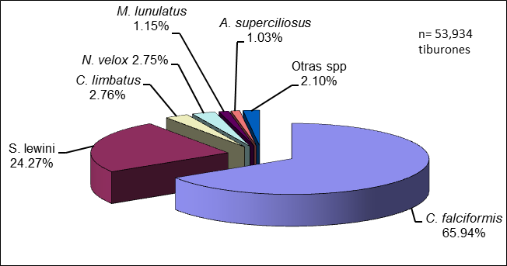
Catch composition
Fishery and biological surveys of shark landings in Puerto Chiapas were carried out by the INAPESCA during 1996-2008, registering 3,346 fishing trips and 53,944 sharks caught.
Sphyrna lewini represented 24% of the landings.

Slide 17
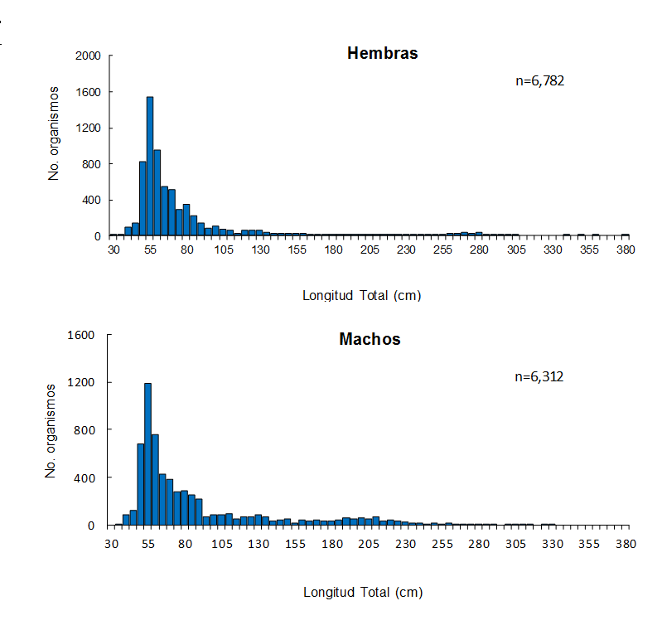
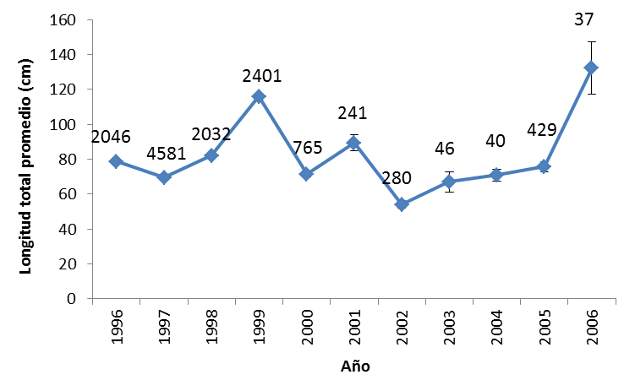
Size composition
Catches of S. lewini during 1996-2008 (n=13,094) included mainly juveniles.
Females ranged 30-380 cm TL (average= 77.8 ± 0.60) and males 34-330 cm TL (average 86.1 ± 0.64).

Slide 18
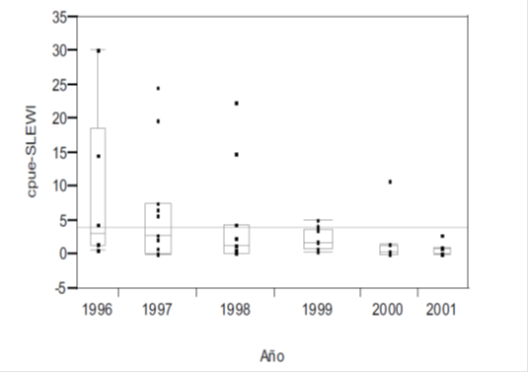
Abundance estimates
CPUE has been estimated using day trips as the unit of effort. Tha largest montlhy CPUE for S. lewini was registered during June-July.
A declining trend in the annual average CPUE was determined for S. lewini during 1996-2001 (Soriano-Velasquez et al. 2006).

Slide 19
Question 3.1(b) Based on the information available, what is the level of confidence associated with the evaluation of fishing risk made under Question 3.1(a)?
The von Bertalanffy growth parameters used to estimate the biological productivity in the ERAEF present a high level of uncertainty, however this method uses the higher level of risk based on the precautory approach.
CPUE and fishing indicators come from a sample taken by the INAPESCA during surveys in 1996-2008 of a much higher number of fishing trips undertaken in the region. Though it can be considered as representative of the trends in the fishery and species for some years CPUE has not been standardized.
Sampling size by month and year in Puerto Chiapas (INAPESCA)

Slide 20
Section 3.2 Evaluate trade pressures
Question 3.2(a) What is the severity of risk of trade on the stock of the species concerned?
The meat, fins and skin are traditionally marketed in the Gulf of Tehuantepec.
Fins are exported but the amount by region and species is unknown. According to the official statistics, shark fin exportation increased from 133 t in 1980 to 190 t in 1987 (representing 2.056 million of USD) (SEPESCA 1989).
Shark fins value in Puerto Chiapas ranged from $90 to 30 USD/Kg.
Though the fins represent a high percentage of the shark fishing value, the meat still represents a considerable amount (around 30%) due to its higher proportion in weight and good acceptance in the domestic market (Lizárraga-Rodríguez, 2012).

Slide 21
Question 3.2(b) Based on the information available, what is the level of confidence associated with the evaluation of trade risk made under Question 3.2(a)?
Due to the limited information on domestic and international trade it is not possible to obtain relaiable estimations of its impact on the populations. It is believed, however that the risk is similar to that for the species estimated in other regions
The level of Illegal, unregistered and unreported (IUU) catch of S. lewini in the Gulf of Tehuantepec is unknown, but it has been estimated that the total IUU shark catch in the Mexican Pacific during 1950-2010 was similar to the official catch (Cisneros et al. 2013).

Slide 22
Step 4 Existing management measures
Question 4.1(a) What generic and species-specific management measures are in place for the stock of the species concerned?
Several shark management measures were developed in Mexico during the last decade (all generic):
National Fishing Chart. Resuming information about all Mexican fisheries, including abundance levels (if available), common/scientific names of species, fishing areas and gears allowed, permisible effort, strategies and management measures. Includes information of three shark fisheries from the Mexican Pacific: Coastal sharks, Oceanic sharks and Sharks from the Gulf of Tehuantepec.
2. National Shark Plan of Action. Includes research, management, surveillance and education programs necessary to ensure the sustainable use of sharks/rays in Mexico.
3. Shark official regulation norm (NOM-029-PESC-2006). Include the technical characteristics and regulations of the shark/ray fisheries. It is compulsory for all Mexican shark fishers.
4. No shark fishing period. Its aim is to protect the main reproductive period of sharks/rays. Determined from May 1st to July 31st in the Mexican Pacific.
5. Sharks and Rays fishery Management Plan. Stablishes the regulation mechanisms on the long term for the fishery base on social, economic and biological information.

Slide 23
Question 4.1(b) Are the management measures identified in Question 4.1(a) appropriate to address the pressures affecting the stock of the species concerned?
All management measures include S. lewini. The no fishing period established since 2012 in particular protects the main reproductive season of this species in the region (May-July according to Soriano-Velásquez et al. 2006 and July-August according to Alejo-Plata et al. 2007).
The National Fishing Chart and the Official Regulation Norm establishes that the shark fishing levels has reached its maximum sustainable level (considering a precautory approach), thus does not allowe increments on the fishing effort for this fishery since 2007.
Question 4.1(c) Are the management measures identified in Question 4.1(a) being implemented?
All management measures mentioned have been implemented, except for the Fishery Management Plan which is currently under review.
Question 4.1(d) Are the management measures identified in Question 4.1(a) effective or likely to be effective in reducing the impacts on the stock of the species concerned?
Due to the recent implementation of all management measures, its effectiveness has not been evaluated yet. However, it is believed they will have a positive impact in the long term for the shark populations, all the measures were developed using the best biological and fishery information available.

