Slide 1
Management Measures
Positive NDF with Conditions
Further Measures
A U.S. perspective on improving species conservation through the NDF process

Slide 2
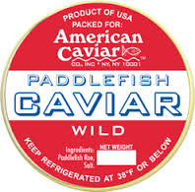
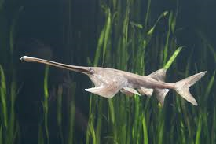
U.S. Appendix II Fish Example:
North American Paddlefish
Long-lived, late to mature sturgeon species
Harvested from wild for its meat and roe
International demand increased as the European sturgeon species stocks decreased

Slide 3
U.S. Appendix II Fish Example:
North American Paddlefish
U.S. State Management Measures
  Fishing license and reporting requirements to limit entry and reduce pressure
  Open/Closed season to minimize by-catch mortality of juveniles during warm months
  Gear restrictions to minimize by-catch of juveniles
  Length limit to ensure opportunity of adult females to contribute to recruitment

Slide 4
U.S. Appendix II Fish Example:
North American Paddlefish
German Document Step 6 - Further Measures
  Peer-reviewed scientific literature - length limits were not conserving an adequate percentage of adult female paddlefish from harvest to sustain the species.
  U.S. Scientific Authority worked with State to increase the length limits on a 5-year timeline.
  When the 5-year plan abandoned, U.S. Scientific Authority made a negative NDF until the length limit was increased.

Slide 5
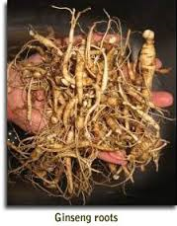
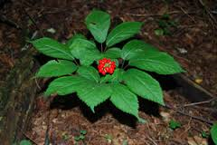
U.S. Appendix II Plant Example:
American Ginseng
Long-lived, slow growing, perennial plant
Harvest of roots from the wild for medicinal use
International demand primarily from Asia

Slide 6
U.S. Appendix II Plant Example:
American Ginseng
U.S. State Management Measures:
  Harvest restricted or prohibited on most State and Federal lands to provide refugia from harvest
  Closed/Open Season to ensure opportunity for seed production to further to recruitment
  State certification of roots

Slide 7
U.S. Appendix II Plant Example:
American Ginseng
German Document Step 5 – Positive NDF with Conditions:
U.S. Scientific Authority NDF is only positive for roots that are 5 years old or older in order to ensure that plants have an opportunity to contribute to recruitment before they are harvested.

Slide 8
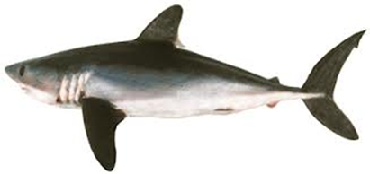
Step 5 – Positive NDF with Conditions for Appendix II Sharks
What Could these conditions look like?
Provide support for National Shark Management Plans and RFMO Scientific Advice, such as
  Fishing license , permitting and mandatory reporting requirements
  Harvest seasons, gear restrictions, minimum size for fins, minimum length of sharks caught????
  Worth a discussion here at workshop.

Slide 9
Step 6 – Further Measures for Appendix II Sharks
Other Ideas:
  A Scientific Authority might work with fisheries agency (or up through fisheries agency leadership if it is the SA for fish) to strengthen management measure to ensure future positive NDFs for shark species
  If SA had concerns about ability to make NDF due to harvest of the same stock by neighboring Parties, it might approach fisheries agency (or up through leadership) and foreign affairs in order vet those concerns bilaterially or via the appropriate RFMO forum to ensure adequate management measures.

