Slide 1
FAO’s Work and Collaboration with CITES on Aquatic Species
Yimin Ye
Chief
Marine and Inland Fisheries Branch
FAO
WWW.FAO.ORG

Slide 2
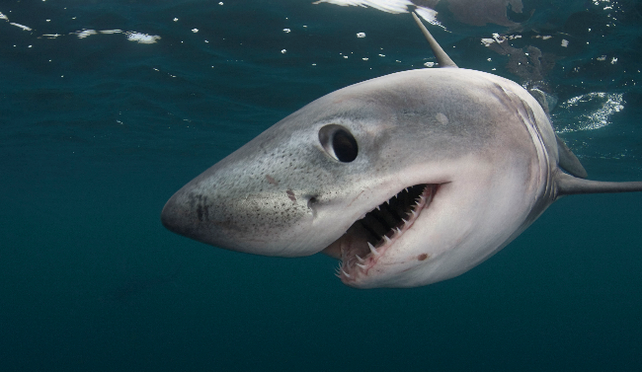
Outline
Main areas of FAO’s collaboration with CITES
FAO’s work on shark conservation
The current FAO/CITES collaborative program
The FAO-Japan project on sharks
Outlook
WWW.FAO.ORG

Slide 3
FAO’s Mandate and Strategic Objectives
Mandate: to build a world without hunger through technical cooperation and assistance
Strategic objectives:
Help eliminate hunger, food insecurity and malnutrition
Make agriculture, forestry and
fisheries more productive and sustainable
Reduce rural poverty
Enable inclusive and efficient agricultural and food systems
Increase the resilience of livelihoods to threats and crises
WWW.FAO.ORG

Slide 4
Main Areas of FAO’s Collaboration with CITES
FAO Expert Advisory Panel
Assess the listing proposals to CITES concerning commercially exploited aquatic species
Works on CITES-listed species
sharks, Caribbean queen conch, humphead wrasse, sea cucumbers, sea horses, sturgeons
Technical evaluation and capacity development
Reviewing the application and effectiveness of international regulatory measures for the conservation and sustainable use of aquatic specie
Capacity assessments for the implementation of the new CITES listing of sharks and manta rays
WWW.FAO.ORG

Slide 5
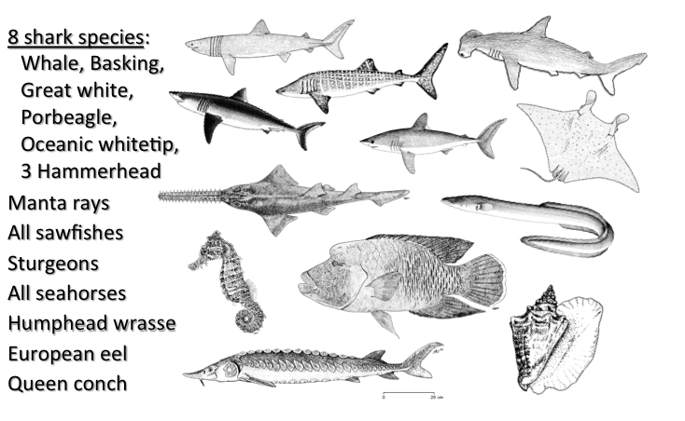
About 100 Commercially Exploited Aquatic Species Currently Included in CITES Appendices
WWW.FAO.ORG

Slide 6
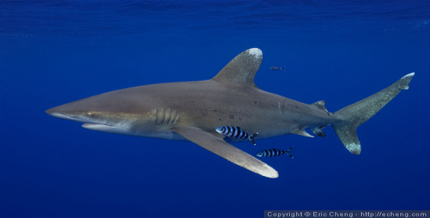
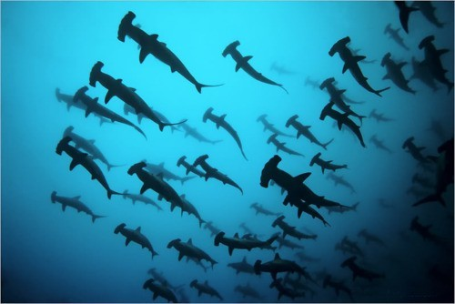
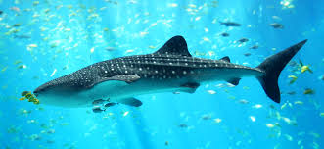
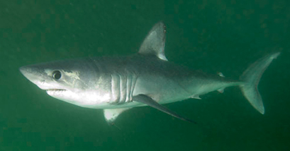
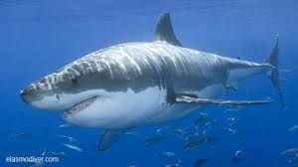
Sharks and Manta Rays
Listed in CITES Appendix II
Basking shark
Oceanic whitetip shark
Hammerhead sharks
(3 species)
Whale shark
Porbeagle shark
Manta rays
Entry into effect delayed to 14 Sept 2014
Great white shark
WWW.FAO.ORG

Slide 7
Landings of the Eight Listed Shark Species
Highest catches in 1960s-70s
Current catch close to zero
The radical declining trend after 1970 reflecting the necessity of the CITES listing
WWW.FAO.ORG

Slide 8
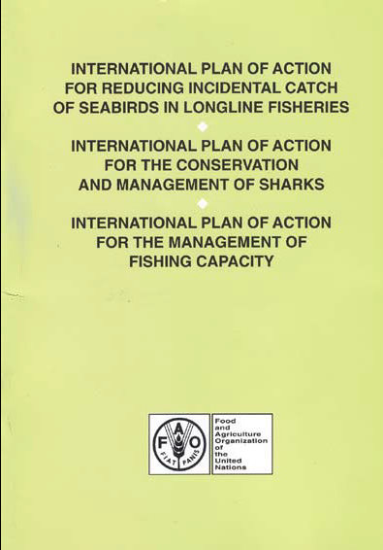
IPOA Sharks (adopted in 1999)
States should implement a NPOA if their vessels conduct directed fisheries for sharks or if their vessels regularly catch sharks in non-directed fisheries.
Each State is responsible for developing, implementing and monitoring its Shark-plan
States should carry out a regular assessment of the status of shark stocks subject to fishing
WWW.FAO.ORG

Slide 9
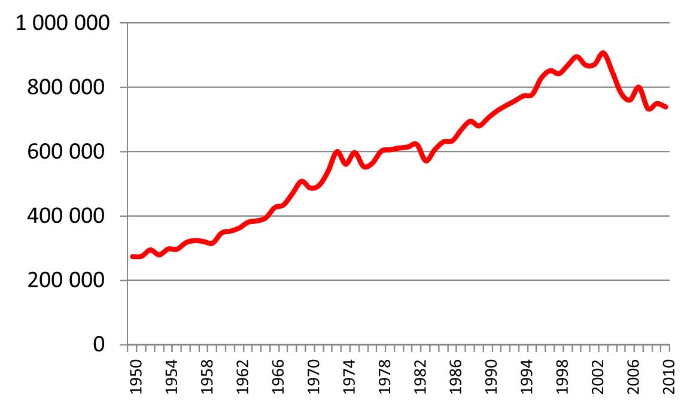
Global Shark Landings Reported to FAO
Adoption of IPOA Sharks
Landings (t)
WWW.FAO.ORG

Slide 10
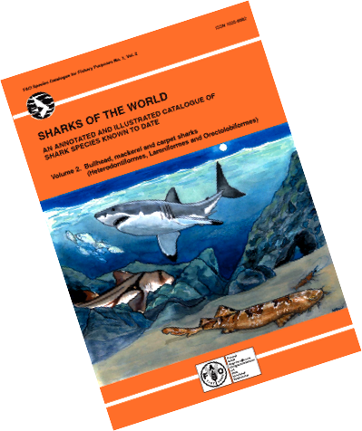
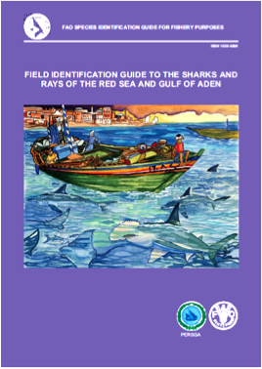
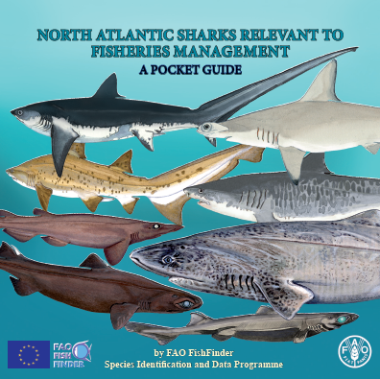
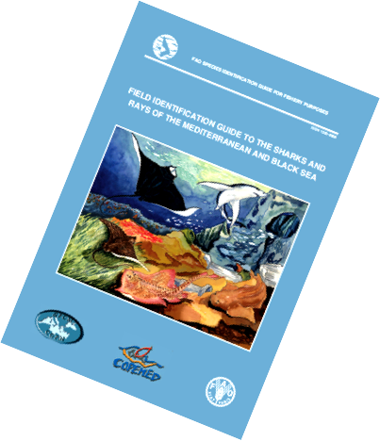
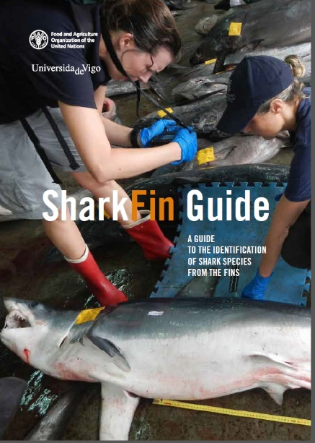
Shark Identification Guides
WWW.FAO.ORG

Slide 11
FAO’s Activities Related to Sharks
FAO. 2012. Report of the FAO/CITES Workshop to Review the Application and Effectiveness of International Regulatory Measures for the Conservation and Sustainable Use of Elasmobranchs. Genazzano, Italy, 19–23 July 2010. FAO Fisheries and Aquaculture Report. No. 984. Rome, FAO. 31 p.
Musick, J.A. and S. Musick. 2011. Sharks. FAO Fisheries and Aquaculture Reviews and Studies. Rome, FAO. 13 p
FAO. 2006. Report of the FAO Expert Consultation on the Implementation of the FAO International Plan of Action for the Conservation and Management of Sharks. Rome, 6–8 December 2005. FAO Fisheries Report. No. 795. Rome, FAO. 24 p.
Musick, J.A. and R. Bonfil (eds). 2005. Management techniques for elasmobranch fisheries. FAO Fisheries Technical Paper. No. 474. Rome, FAO. 251 p.
FAO Marine Resources Service. 2000. Fisheries management. 1. Conservation and management of sharks. FAO Technical Guidelines for Responsible Fisheries. No. 4, Suppl. 1. Rome, FAO. 37 p.
FAO. 1999. Report of the FAO Technical Working Group on the Conservation and Management of Sharks. Tokyo, Japan, 23-27 April 1998. FAO Fisheries Report. No. 583. Rome, FAO. 28 p.
Shotton, R. (ed.). 1999. Case studies of the management of elasmobranch fisheries. FAO Fisheries Technical Paper. No. 378, 2 parts. Rome, FAO. 920 p.
WWW.FAO.ORG

Slide 12
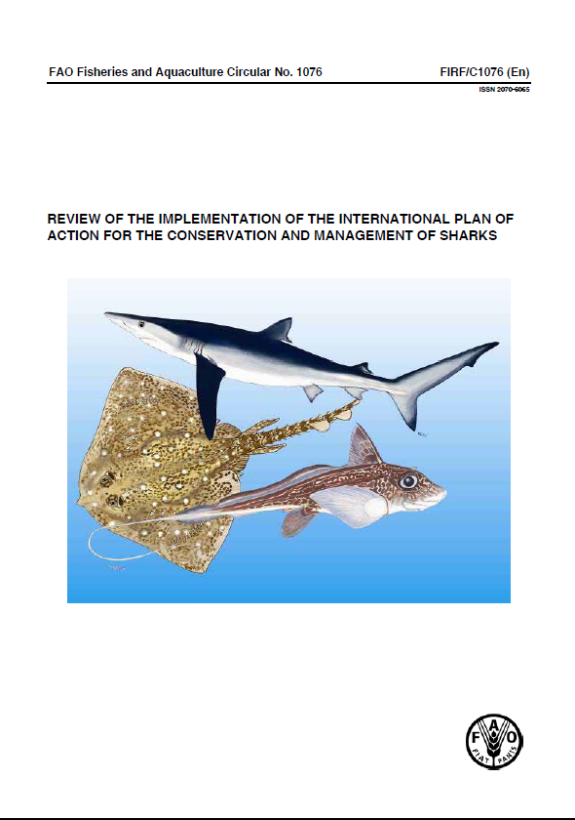
Review of the Implementation of the IPOA Sharks
Requested by COFI in 2011 and supported by the CITES Working Group on Sharks.
http://www.fao.org/docrep/017/i3036e/i3036e.pdf
The review focuses on the 26 top shark-fishing countries
Array of management measures adopted: shark fin measure, closed area and season, discard regulation etc.
Most countries have taken steps to combat IUU fishing
Internationally binding shark measures in place for the majority of high seas covered by RFBs
WWW.FAO.ORG

Slide 13
Top Shark-Fishing Countries
(2000-2009 average annual ladings)
The 26 top shark-fishing countries produced 84% of the global shark catches reported to FAO
WWW.FAO.ORG

Slide 14
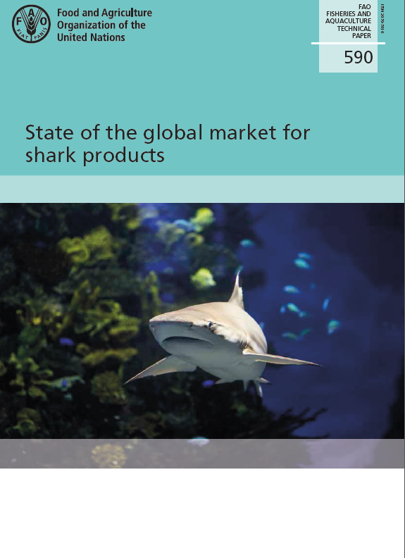
FAO/CITES Collaborative Program(1)
Project 1 - promote good practice in national and regional traceability system in Asia
Work plan
Capacity building - a workshop on trade traceability (Kochi, India, Jan 2016; 30 officials from at least 10 countries in Asia)
Synergy btwn Guidelines for Catch Documentation Schemes to Improve the Traceability of Fishery Products” and CITES trade certificate requirements
Indicators of good national traceability practice
WWW.FAO.ORG

Slide 15
FAO/CITES Collaborative Program(2)
Project 2: - Supporting fisheries legislation to include the new CITES listings
Work plan
Help develop draft legislation in accordance with CITES listings
Prepare a report on legal implications of CITES listing in fisheries legislation
Organize a workshop on fisheries legislation and CITES listing
WWW.FAO.ORG

Slide 16
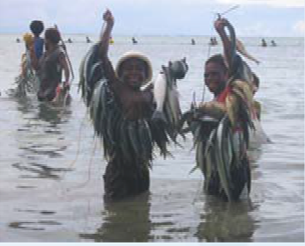
FAO/CITES Collaborative Program(3)
Project 3: - Developing Voluntary Guidelines for Catch Documentation Schemes
Work plan
developing the draft Guidelines
Organising expert & stakeholder consultation
Ensuring synergy between CITES listing and catch document schemes
WWW.FAO.ORG

Slide 17
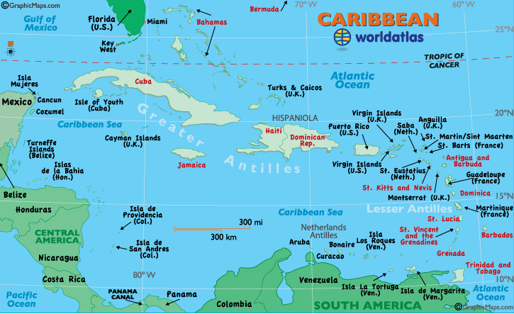
FAO/CITES Collaborative Program(4)
Project 4 – Developing and implementing NPOAs (Barbados, Suriname, Trinidad & Tobago, Caribbean region)
Work plan
Stakeholder consultation workshops
Help develop shark NPOAs
Development of guides to incorporate CITES provisions into fisheries legislations
WWW.FAO.ORG

Slide 18
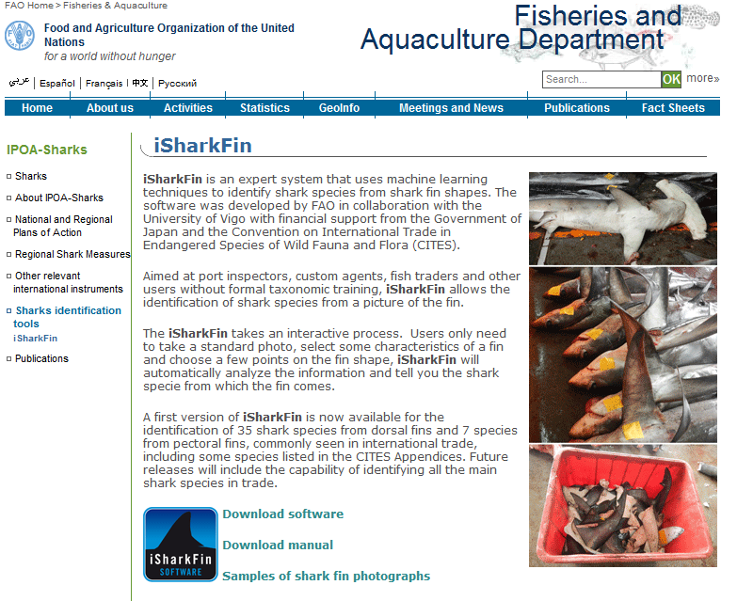
FAO/CITES Collaborative Program (5)
Project 5 – IsharkFin Software
Work plan
Further field data collection
Improving the iSharkFin software
Conducting training courses
WWW.FAO.ORG

Slide 19
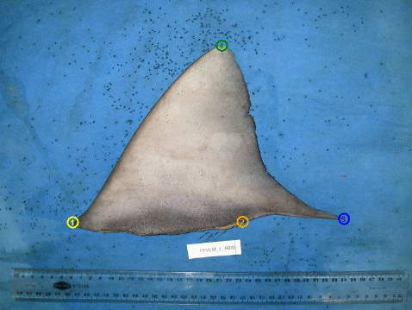
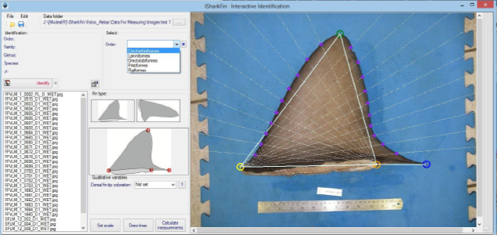
iSharkFin
– software for species identification
Identifying 35 shark species
WWW.FAO.ORG

Slide 20
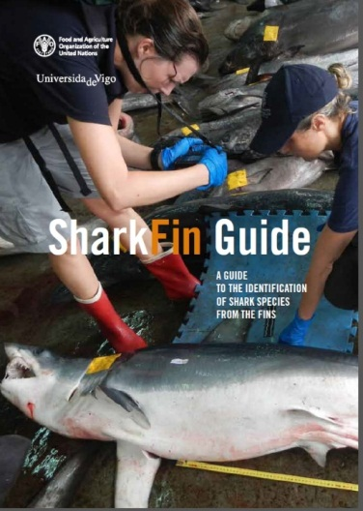
Further Development of the iSharkFin
WWW.FAO.ORG

Slide 21
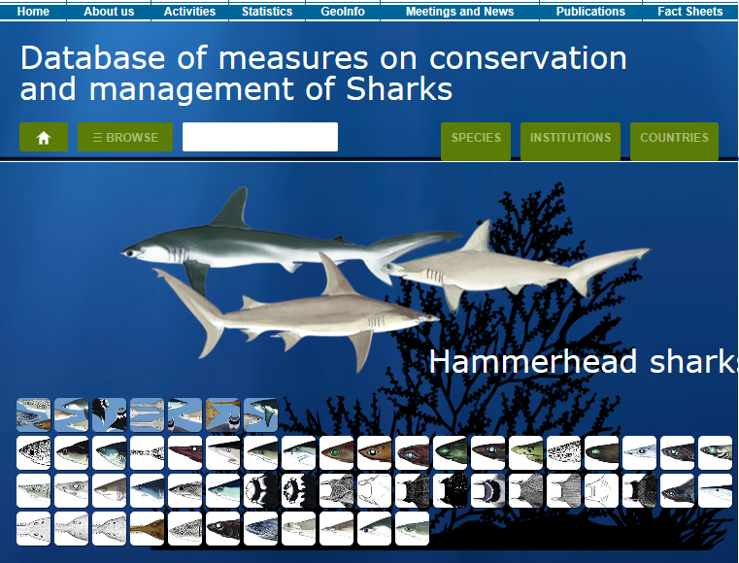
FAO/CITES Collaborative Program(6)
Project 6 - Developing a database on shark conservation measures
Output:
One site with links to documents from global instruments, regional bodies and national authories
binding and non-binding Conservation and Management Measures,
Plans of Action (national and regional)
and national legislation
Searchable database by species, institution/organization or country
WWW.FAO.ORG

Slide 22
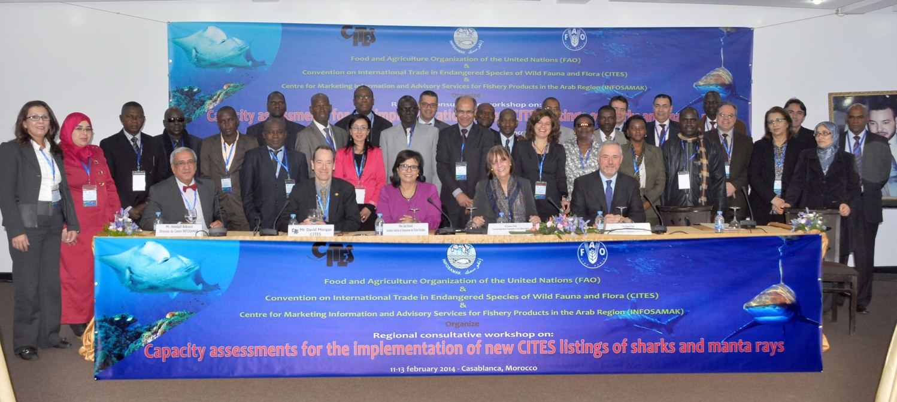
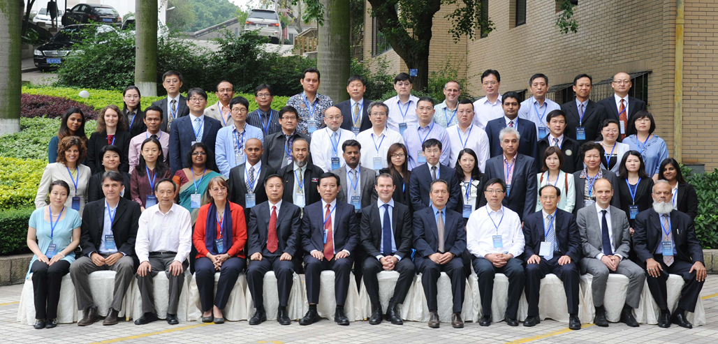
FAO/CITES Collaborative Program(7)
Project 7 – assessment of the capacity in the implementation of new CITES listing of sharks and manta rays
Work plan:
FAO workshops
Morocco, Feb 2014
China, May 2014
Study on the needs for capacity development
WWW.FAO.ORG

Slide 23
Priority Countries for Capacity Development in Implementation of the Recently listed Shark Species
Highest priority
Secondary priority
WWW.FAO.ORG

Slide 24
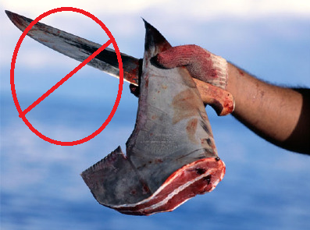
FAO-Japan Project on Sharks (2015-16)
Review of the CITES listing impact on shark trade, stock status and fisheries
The review covers:
changes in legislation, management practice, and national or local ordinances
the impacts seen so far on shark fishing, landings, domestic and international trading, and social-economic aspects
impact of CITES’ listing on shark stocks and relevant ecosystems
the need for data collection, social-economic analysis, proper legislation, and capacity building in implementing the CITES listing
indicators that can be used to better monitor shark resources, their fisheries, trade and social-economic consequences
WWW.FAO.ORG

Slide 25
Outlook
FAO will continue the collaboration with CITES on
Commercially exploited aquatic species
Implementation of CITES’ listings
Technical support and capacity building for member states
FAO will review and monitor the status of listed species (eg the review project)
FAO will develop strategies and plans for technical assistance
WWW.FAO.ORG

Slide 26
Thanks for Your Attention!
WWW.FAO.ORG

