Slide 1
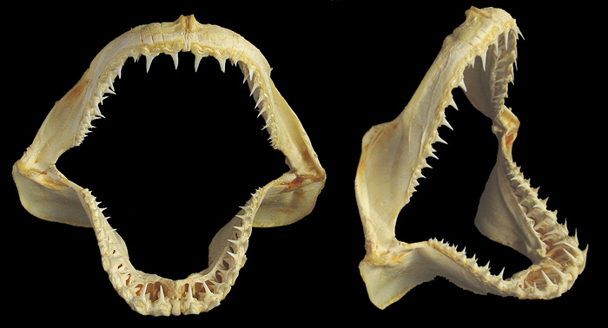
Newly listed sharks and manta rays:
What should Parties do by 14 Sept. 2014: Traceability
Notes:
The requirements of CITES implementation can be divided into the three main objectives of CITES: ensuring legality, sustainability, and traceability. Under each of them, there are a number of processes and tools that could be considered by countries.

Slide 2
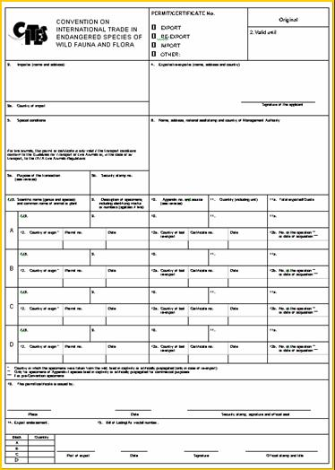
Traceability
Record and trace trade from the country of origin to the country of destination, through:
  Issuance of appropriate CITES permits or certificates
  Inclusion of all relevant trade in national annual reports (CITES Trade Database)
  Identification/verification of specimens
  collaboration between CITES
  Authorities and fisheries
  agencies
  enhancing enforcement
  authorities

Slide 3
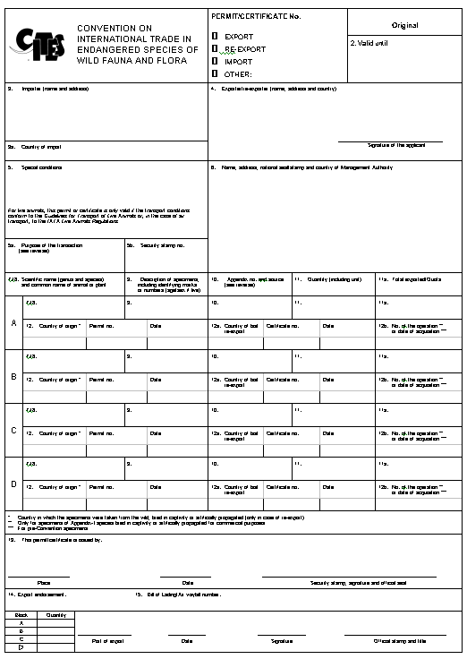
Traceability: Framework for tracing trade
CITES uses a system of permits
and certificates to regulate
international trade in specimens
of shark species which are listed in
one of the three Appendices
An appropriate permit or
certificate accompanies
shark specimens, which makes
their trade traceable
General preconditions for granting
such permits/certificates are:
specimens were lawfully
obtained (legality) and their trade
will not be detrimental to the survival
of the species (sustainability)
Notes:
National-level partnerships are also very important for the effective implementation of the Convention, in particular those between implementing agencies.
Such partnerships include close communication and collaboration between CITES Authorities (between Management Authorities, between Scientific Authorities, and between Management and Scientific Authorities); and between CITES Authorities and Customs, police and the judiciary; and between CITES Authorities and other branches of Government (such as resource sectors – e.g. fisheries and forestry).
Partnerships between CITES Authorities and the private sector can also be very important in securing compliance with the Convention.

Slide 4
Scope of the trade being traced
Trade = export, import, re-export and introduction from the sea
Purpose = commercial or non-commercial
Source = wild (or aquaculture, if any)
Shark specimens in trade include: live or dead animals; cartilage; fresh, frozen or processed fins and meat; dried-salted meat; fishmeal; oil; skin; teeth; trophies; and other parts or derivatives

Slide 5
Transport of live specimens
The Convention requires that any living specimen will be so prepared and shipped as to minimize the risk of injury, damage to health or cruel treatment
Resolution Conf. 10.21 (Rev. CoP16) of the Conference of the Parties to CITES recommends that, for as long as the CITES Secretariat and the Standing Committee agree, the IATA LAR (for animals), the IATA PCR (for plants) and the CITES guidelines for the non-air transport of live wild animals and plants in their most recent edition be deemed to meet CITES transport requirements

Slide 6
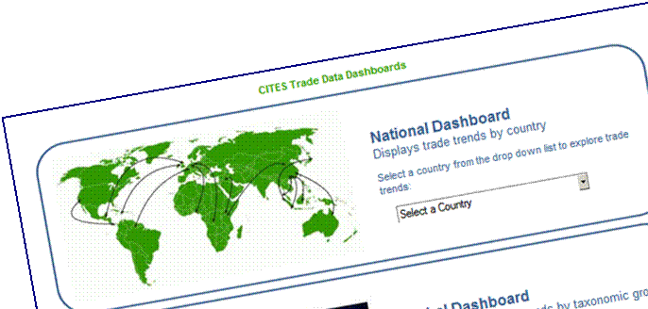
Document control and recordkeeping
Effective implementation and enforcement of the Convention depend largely on control over the issuance, inspection and acceptance of CITES documentation
Each Party maintains records of its CITES trade and submits annual trade reports, which are available through the CITES trade database

Slide 7

ICCWC and other collaboration
Multi-agency (and cross-sectoral and trans-disciplinary) cooperation and partnerships at the local, state or provincial, national, regional and global levels (as well as between these levels) are essential.
An intergovernmental initiative, the International
Consortium on Combating Wildlife Crime (ICCWC),
was established in November 2010.
Its partners are:
  CITES
  INTERPOL
  UNODC
  World Bank
  World Customs Organization
Aims = facilitating multi-agency cooperation, materials and tools to enhance knowledge and skills, research on the drivers and scale and value of wildlife crime and related offences and national assessments of scope of illegal wildlife trafficking and associated responses.

Slide 8
Cooperation with IATA and fishery/trade sectors
There is longstanding cooperation between CITES and IATA, as reflected in Resolution Conf. 10.21 (Rev. CoP16) on Transport of live specimens
Efforts are underway to enhance this cooperation through the development of a cooperative MoU between the IATA and CITES secretariats
Observers in CITES meetings include the: International Convention for Conservation of Atlantic Tunas; Southeast Asian Fisheries Development Centre; Association of Fish and Wildlife Agencies; International Coalition of Fisheries Associations; Ornamental Fish International; International Caviar Importers Association; Pet Industry Joint Advisory Council; World Association of Zoos and Aquariums; China Aquatic Products Processing and Marketing Alliance; Marine Products Association; Precious Coral Protection and Development Association

Slide 9







Thank you for your attention!
CITES and FAO working for legal, sustainable and traceable international trade in sharks and manta rays, supported by the European Union

