Slide 1
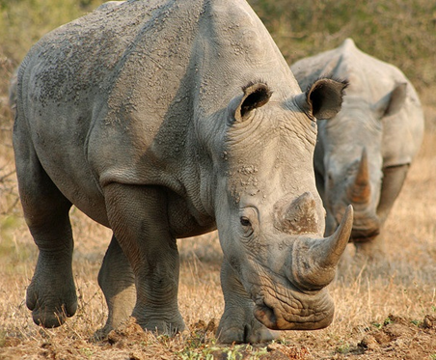
ITC technical assistance to CITES Parties
Alexander Kasterine
Head of Trade and Environment Programme, ITC

Slide 2
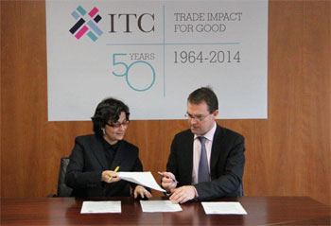
Promoting sustainable sourcing of CITES-listed species

Slide 3
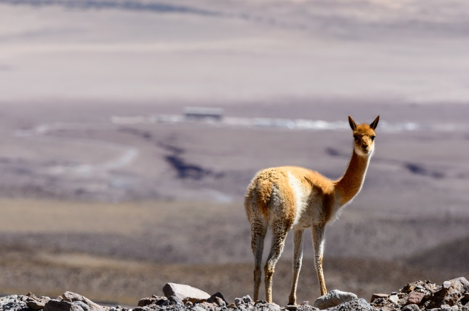
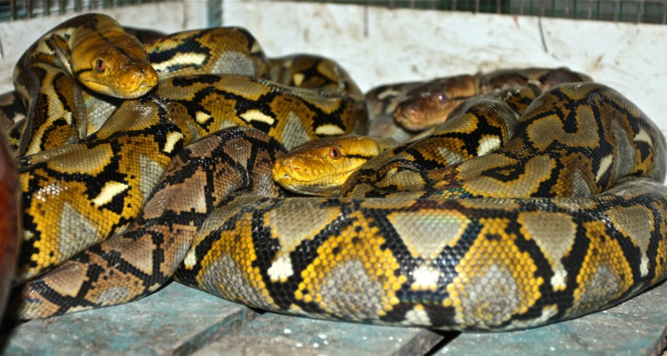
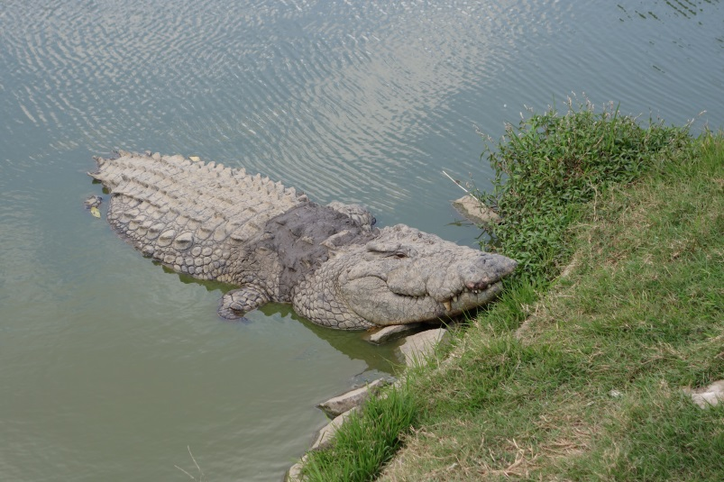
Capacity building for the sustainable sourcing of CITES-listed species

Slide 4
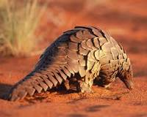
Providing economic & market analyses

Slide 5
THANK YOU
https://www.facebook.com/ITCenvironment
https://ch.linkedin.com/in/itcenvironment
@ITCenvironment
email.: kasterine@intracen.org

