Slide 1
C ompliance
A ssistance
P rogramme
CITES

Slide 2
CAP - MANDATE
CoP Decision 18.69
The Secretariat shall, subject to the availability of external funding, establish a Compliance Assistance Programme – CAP
Full proposal contained in document CoP18 Doc. 28
‘Compliance’ means to act in accordance with and in fulfilment of the Convention requirements

Slide 3
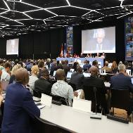
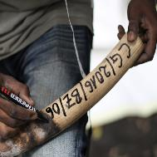
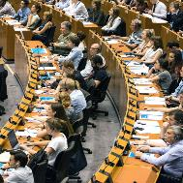

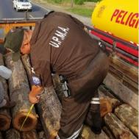
CAP - JUSTIFICATIONS
CURRENT CHALLENGES FACED BY PARTIES
Understand
and
Prioritize recommendations
Manage, leverage, coordinate assistance
Mobilize financial and technical resources
Respond to communications and reporting obligations in a timely and substantive manner
Involve relevant authorities/actors/institutions

Slide 4
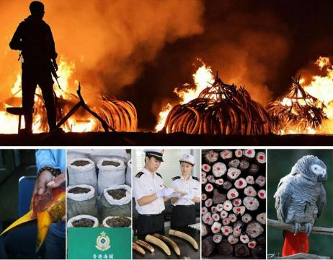
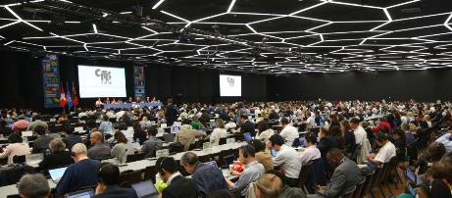
CAP - DEFINITION
Programme
Managed by the Secretariat
Targeted towards assisting Parties with difficulties in achieving compliance with the Convention and related recommendations of the Standing Committee

Slide 5
CITES COMPLIANCE SYSTEM
PARTY-DRIVEN
Article XIII
Legislation
NLP
Sig-trade
Captive bred
Reporting
NIAPs
The CAP aims at streamlining and consolidating the assistance provided to Parties subject to compliance measures under different CITES compliance mechanisms, including the National Legislation Project, the Review of Significant Trade, annual reporting, Article XIII process (international measures) and other compliance processes, such as NIAPs, species-specific plans, and captive-breeding operations (production systems).

Slide 6


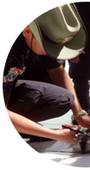



CAP - OBJECTIVES
Enhance the quality of assistance,
promote common vision,
address gaps that cannot be addressed in isolation and
create the conditions for joint funding, planning and delivery
Avoid duplications and ensure better alignment of interventions
Accelerate compliance and help Parties to understand and
prioritize recommendations

Slide 7
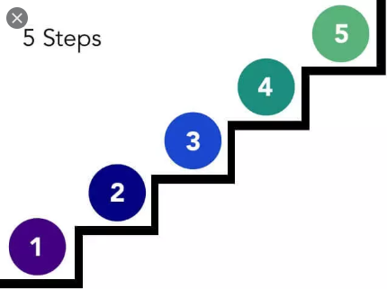
CAP - METHODOLOGY
A five-step approach
Monitoring, tracking and evaluation
Technical assistance and guidance
Identification of in-country assistance
coordination mechanisms
Identification of Parties’ strengths and needs
Selection of eligible Parties

Slide 8

CAP - METHODOLOGY
Selection of eligible Parties
Parties will be eligible* to benefit from the CAP based on the recommendations of the Standing Committee and the overall assessment by the Secretariat of the following criteria:
Parties currently subject to one or several compliance mechanisms handled under Article XIII and described in paragraph 30 of the Annex to Resolution Conf. 14.3 on CITES compliance procedures;
Parties currently subject to one or several compliance processes when combined with other related compliance mechanisms mentioned in a);
Parties with persistent implementation issues identified through compliance mechanisms;
Parties with significant volumes of exports of CITES-listed species;
Parties committed to take part in the CAP and to nominate a national focal point from the CITES Management Authority to absorb and benefit from the assistance.
*The assistance will be provided upon request to the CITES Secretariat from the Party concerned

Slide 9

CAP - METHODOLOGY
Technical Assistance and Guidance Examples of support
CITES authorities are coached and mentored to implement effectively and timely the Standing Committee’s recommendations and deal with legal, scientific, enforcement and other relevant matters.
Via the Secretariat’s technical assistance, training workshops, experience sharing between Parties, with the opportunity to deploy on the ground short-term personnel placements to assist Parties during three to six months, when relevant and appropriate.
Examples of assistance through the CAP :
Designation, functions and coordination of Management and Scientific Authorities
Making of non-detriment findings and legal acquisition findings
Good practices and procedures in developing legislation related to CITES
Procedures to issue, authenticate and control permits and shipments
Guidance to report on legal trade and other reporting requirements
Protocols and tools to detect and prosecute illegal wildlife trade
Good practices and procedures to dispose of seized and confiscated specimens

Slide 10

GUIDANCE
www.cites.org
Compliance web page: https://cites.org/compliance
CITES virtual college: www.cites.unia.es
Secretariat’s compliance team
Taylored technical assistance

