Slide 1
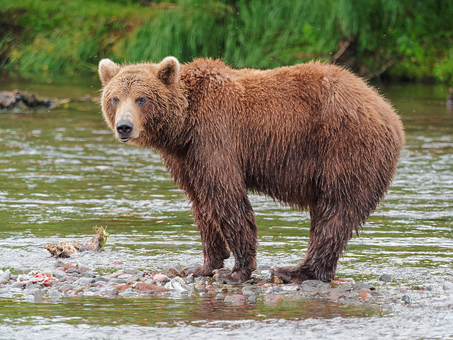
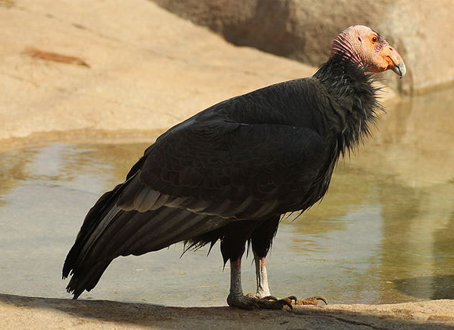
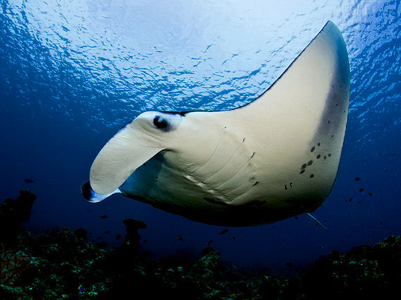
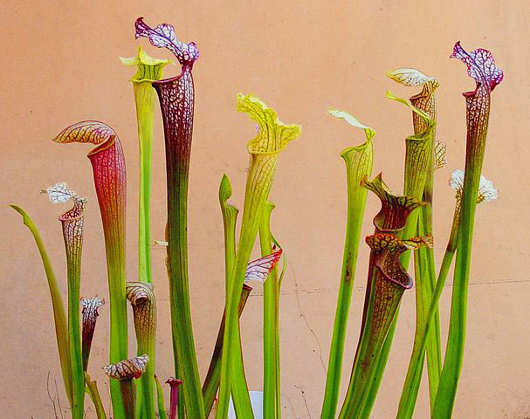
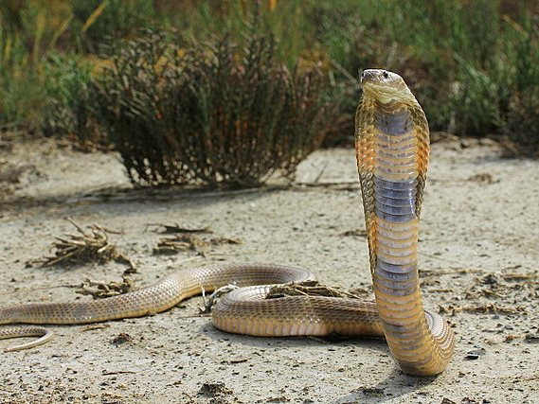
CITES and WAZA: how zoos & aquariums can support in keeping the wildlife trade legal and sustainable
By Ivonne Higuero
Secretary-General, CITES
WAZA Annual Conference
15 October 2020

Slide 2
What is CITES?

Slide 3
What does ‘CITES’ mean?
Convention on International Trade in Endangered Species of Wild Fauna and Flora
CITES is a Multilateral Environmental Agreement (MEA), signed on 3 March 1973, entered into force in 1975
Notes:
The Convention on International Trade in Endangered Species of Wild Fauna and Flora (CITES) is an international agreement between governments. Its aim is to ensure that international trade in specimens of wild animals and plants does not threaten their survival.
It was first proposed in the 1960s, as the then relatively new discussion on the regulation of international wildlife trade for conservation purposes started gaining clout.
Today, CITES enshrines varying degrees of protection to more than 37,000 species of animals and plants, whether they are traded as live specimens, fur coats or dried herbs.

Slide 4
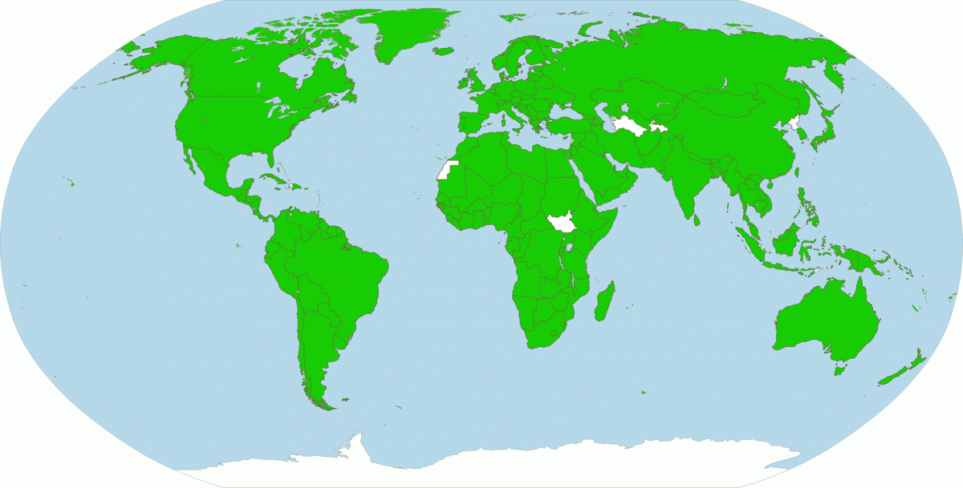
Who is involved in CITES?
CITES has 183 signatory Parties:
182 UN-States and the EU.
Notes:
CITES Parties include 182 States and the European Union.
Of the 193 members of the United Nations, only 11 are not Parties to the Convention.

Slide 5
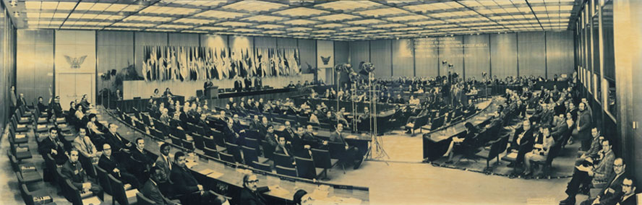
The purpose of CITES:
CITES aims to regulate trade in 38’000 species of wild fauna and flora to ensure it does not threaten their survival.
Combines wildlife and trade themes within a legally binding instrument
It is aimed at achieving conservation and sustainable use objectives
The signing of the CITES
Convention. Washington, D.C., 3 March 1973.
Notes:
CITES is a voluntary legal agreement between and by States. Major decisions, most notably regarding the amendment of the CITES Appendices, are taken by the supreme decision-making body of the Convention: the Conference Of the Parties, a gathering of all Parties every 3 years. Decisions made at the CoP are advised by, and their enforcement is supervised by the governing bodies of the Convention: the Standing Committee, the Animals Committee, and the Plants Committee, which meat yearly. The CITES Secretariat, based in Geneva, also plays a coordinating, monitoring, advisory and servicing role in the working of the Convention.
The Convention is a legally binding international agreement. Parties must to adopt legislation to ensure that CITES is implemented at the national level, most notably by establishing national authorities that oversee that wildlife is traded according to CITES requirements.
CITES was not established in order to completely halt international trade in wildlife, but to ensure that such trade was not carried out at the expense of the survival of species. As such, CITES fosters a sustainable use of all wild fauna and flora that can benefit both the people and groups whose livelihoods depend on wildlife and the conservation of species.

Slide 6
What kind of trade is covered by CITES?

Slide 7

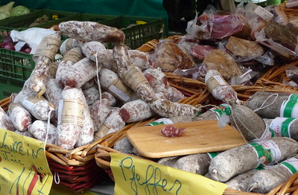

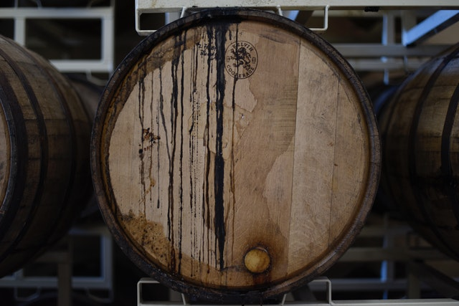
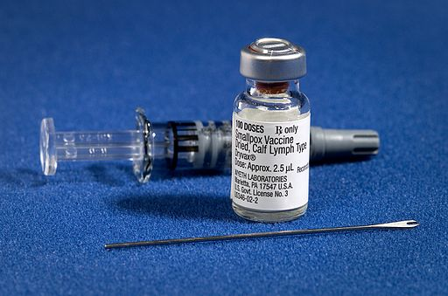

Entire economic sectors rely on wildlife:
Food: Fish, wild meat & plant foods
Housing &
Furniture:
Wood, timber & other materials
Health
& Beauty:
Pharmaceuticals,
cosmetics, fragrances
Notes:
In 2018, the World Bank estimated that 55% of the global population lived in urban centers. For these people, over half of humanity – many of us included -, wild fauna and flora might seem a distant concept. We might not always be aware of the direct impacts and many benefits of the international trade in wildlife for our lives.
Here are just a few sectors that depend almost entirely on the exploitation and wildlife resources. Some of them are vital for our most basic needs (food, medicine, shelter) and, overall, they employ hundreds of millions of people around the world.

Slide 8
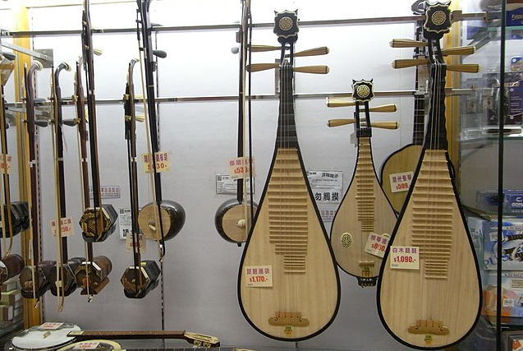
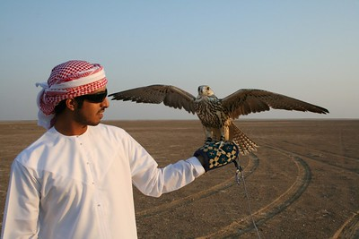
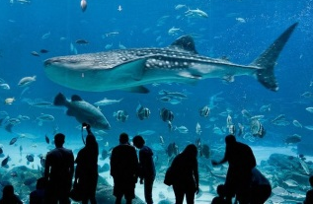

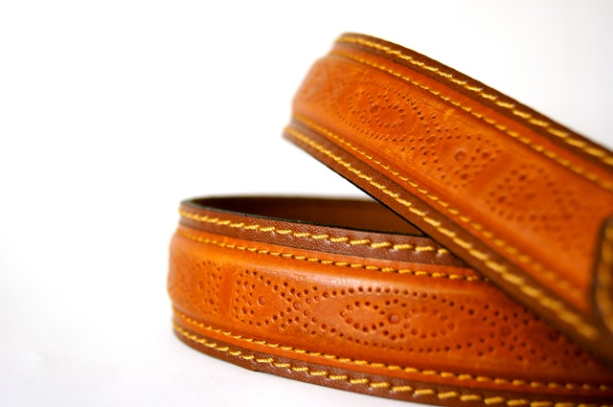

Leisure: Musical instruments,
pets, ornamentals
Tourism: Museums, souvenirs,
botanical gardens
Fashion: Leather, furs, fibers, jewelry
Notes:
The wildlife trade extends beyond strictly-speaking essential goods and services: it also plays a major part in leisure industries and contributes immensely to human well-being and entertainment.

Slide 9
How does CITES work?
IMPORT & EXPORT:
RE-EXPORT
INTODUCTION FROM THE SEA
Nationally appointed authorities deliver certificates and permits…
… for the trade of listed animals and plants (live, dead, parts or derivatives)
… in these four cases:
Notes:
At the national level, CITES is implemented by the action of Parties: they must establish national Management and Scientific Authorities who are tasked with overseeing trade carried out within Parties’ territories and ensure it is done according to CITES regulations. Management authorities, often attached to environmental ministries or similar government departments, deliver the CITES permits necessary for trade in any direction. Scientific authorities advise these Management Authorities, based on conservation data and information on the status of species involved in trade transactions.
This is the case for all transactions involving any of the 37,000+ species listed in the CITES Appendices, and more specifically in these four cases:

Slide 10
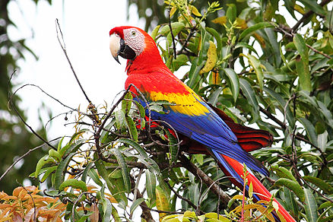
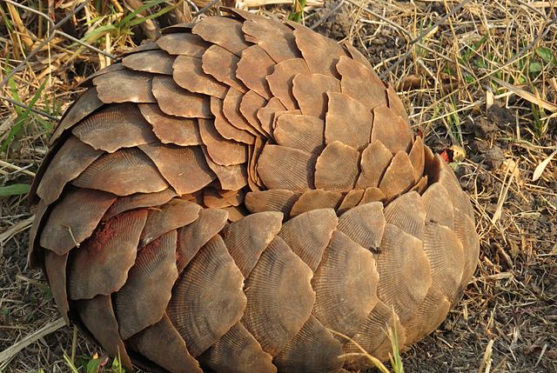
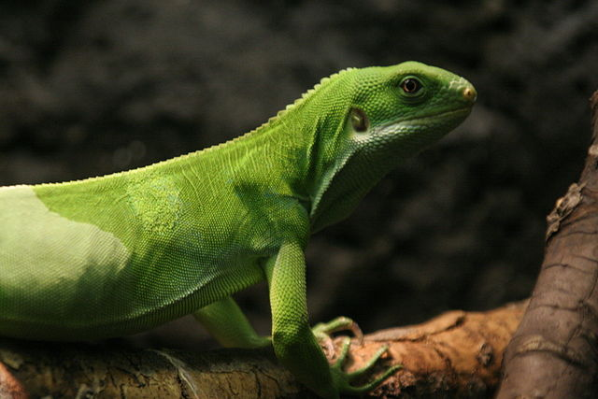
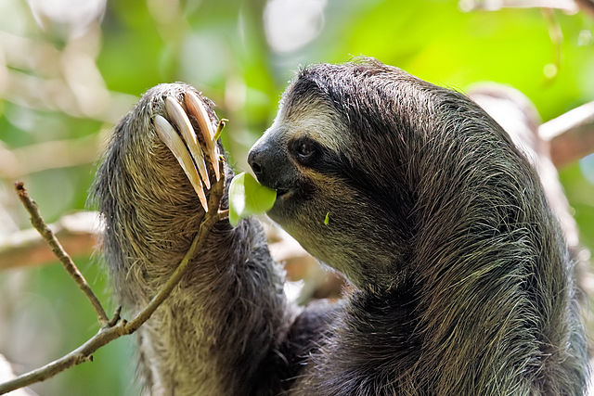
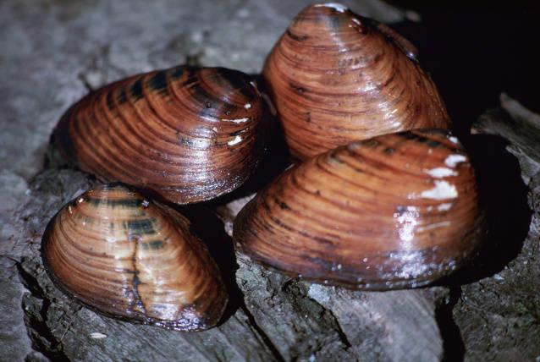
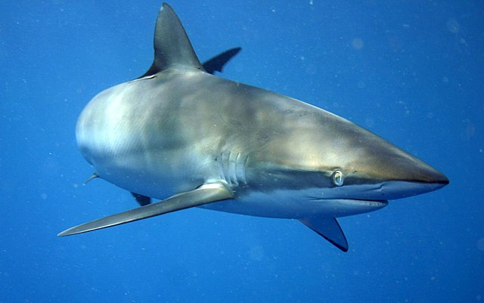
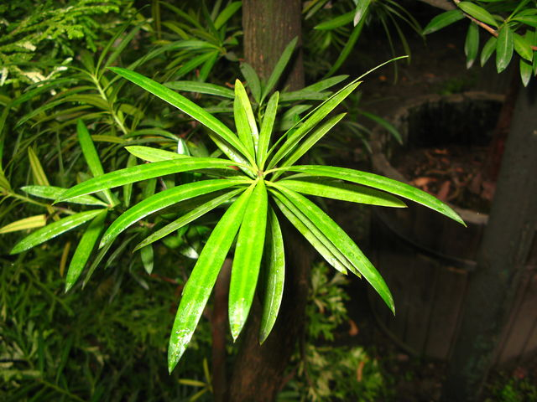
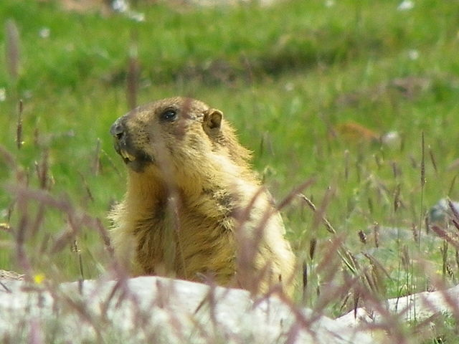
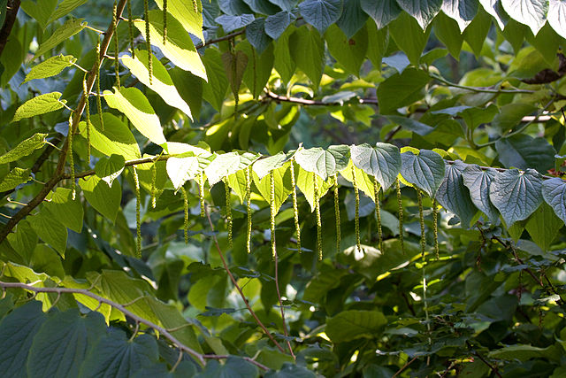
The CITES Appendices:
Species* subject to CITES regulations are divided into three Appendices:
Appendix I
Appendix II
Appendix III
  * “Species” means any species, subspecies, or geographically separate population thereof.
Notes:
CITES oversees trade in over 37,000 species, which are distributed in 3 different appendices according to various levels of concern for the survival of these species. The overwhelming majority of species are plants. Here are a few examples.
List of species selected in this slid (left to right):
A1: Ara Macao (Ara Macao); Manis temminckii (ground/Temminck’s pangolin); Brachylophus fasciatus (Lau banded iguana)
A2: Bradypus variegatus (brown-throated sloth); Pleurobema clava (clubshell); Carcharhinus falciformis (Silky shark)
A3: Podocarpus neriifolius; Marmota caudata (long-tailed marmot); Tetracentron sinense;

Slide 11
CITES Appendices: which species go where?
Appendix I
Species threatened with extinction - 700 species of fauna and some 400 species of flora
Species not necessarily threatened with extinction, but for which trade must be controlled to avoid threats to their survival - Includes ‘look-alike species’; +/- 32’000 species of flora and 5’000 species of fauna
Appendix II
Appendix III
Species for which a single country is asking other Parties to help with its protection – some 200 species.
Notes:
The levels of concern that inform the provisions for each Appendix can be broadly summarized like this.
Inclusions in Appendix I and II are the decided by the CoP, while single Parties can include specific species in Appendix III.
The set of biological and trade criteria to help determine whether a species should be included in Appendices I or II can be found in Resolution Conf. 9.24 (Rev. CoP17) on the CITES website.

Slide 12
CITES Appendices: what about trade?
Appendix I
Trade is generally prohibited.
Appendix II
Trade is generally permitted but controlled.
Appendix III
Trade is generally permitted but controlled.
Notes:
The provisions for trade in species listed in the CITES appendices can essentially be summarized like this.
We say *generally* because the are certain exceptional circumstances in which species listed Appendix I can be moved from one country to another, if Management/Scientific authorities are satisfied that such a move does not endanger the specimen in question, the survival of its broader species, etc. These exceptions can include repopulation programs, educational/conservation efforts and other non-commercial endeavors.
As for Appendix II: Management/Scientific authorities must also be satisfied that similar conditions to Appendix I, though the range of purposes for which these species can be traded does include commercial endeavors.

Slide 13
Most trade is permitted:
Of the 38,000+ CITES-listed species:
3% are listed in Appendix I – international commercial trade in specimens is prohibited
96% are listed in Appendix II
Distribution of species in the CITES Appendices
1% are listed in Appendix III
97% of trade of international trade is controlled, but legal.
Notes:
The vas majority of CITES-listed species *can* be legally traded internationally.

Slide 14
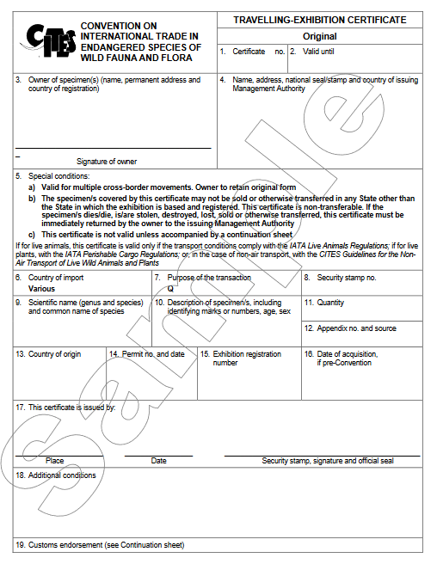
CITES requirements for trade:
  Solid proof of the following:
Legality
  Legal Acquisition finding is mandatory
Sustainability
  Non-Detriment Findings (NDFs)
Traceability
  Valid CITES Permits must be issued
Notes:
This is what a CITES Certificate looks like, and it contains a series of boxes for national authorities to tick to provide record a wide range of indicators: country of origin of the species, destination, quantity, purpose of the transaction, etc.
It too reflects CITES’ three-pronged vision based on legality, sustainability and traceability.

Slide 15
CITES: A dynamic Convention

Slide 16
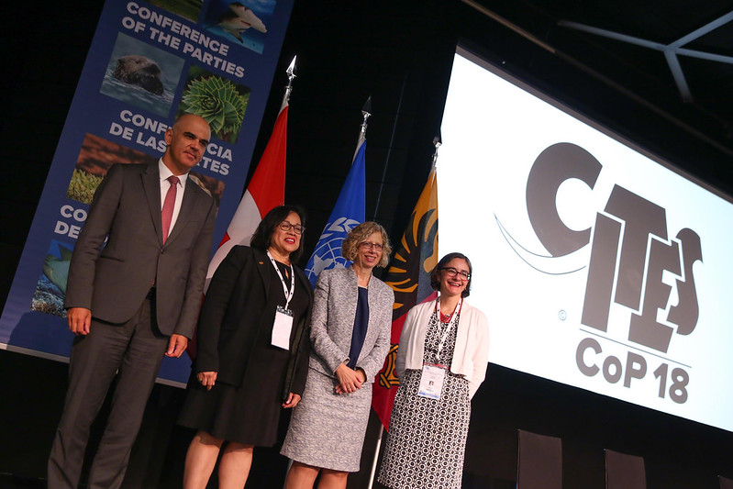
‘CoP 18: a landmark for conservation
Sweeping regulations passed for dozens of species from around the world
Listing of ‘charismatic’ giraffes and less known but valuable marine species, plant and timber species and more

Slide 17
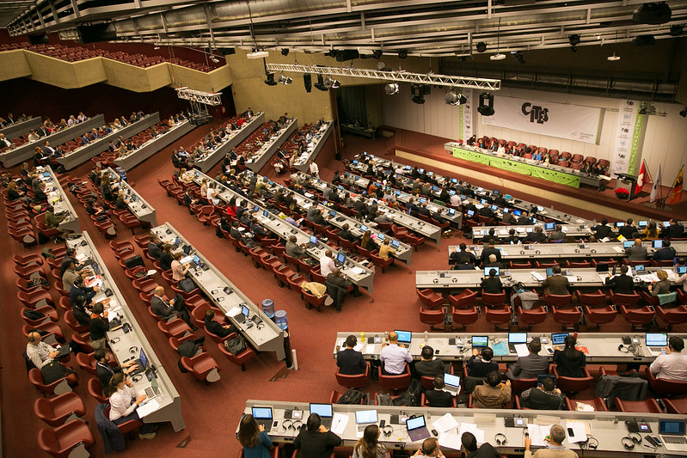
CITES: A ‘Convention with teeth’
The Convention has strong compliance procedures
The CITES Standing Committee can take action when Parties do not fulfil their obligations
View of the 69th meeting of the CITES Standing Committee (2017)

Slide 18
CITES and sustainable development

Slide 19
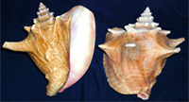
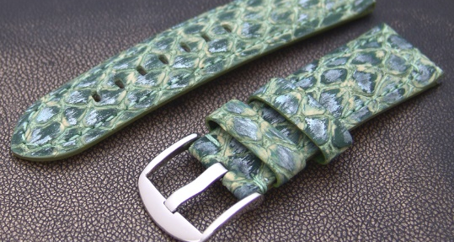
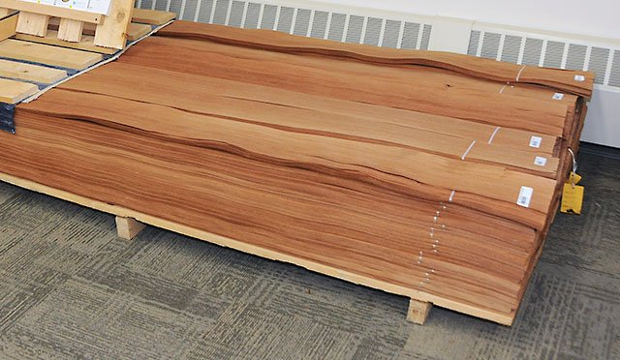
The value of trade in CITES species:
Trade in individual species or derivative products valued in
the billions of US dollars every year
About 1 million transactions of CITES species every year; Parties have recorded over 21 million transactions on the CITES trade Database.
Queen conch:
$60 million/year
Pythons
$1billion/year
Bigleaf Mahogany
$33million/year
Notes:
The text of the Convention requires all CITES Parties to submit yearly records of wildlife trade in species listed in the CITES Appendices taking place within their borders (exports, imports, re-exports, introductions from the sea). From these figures we can get an idea of just how valuable this trade can be.
CITES Parties have recorded over 20 millions transactions since the treaty entered into force in 1975, and the financial value of the trade these figures reveal is significant.

Slide 20
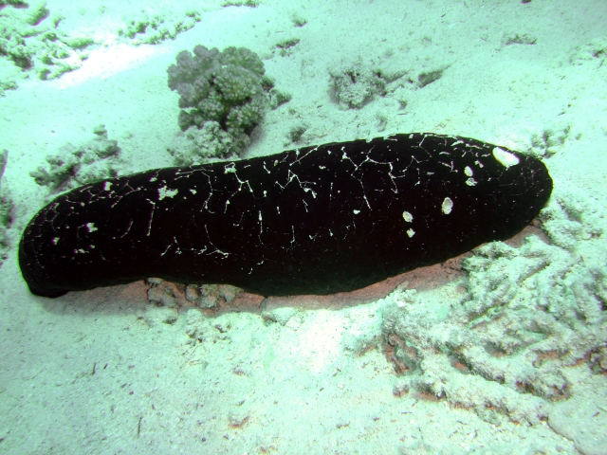
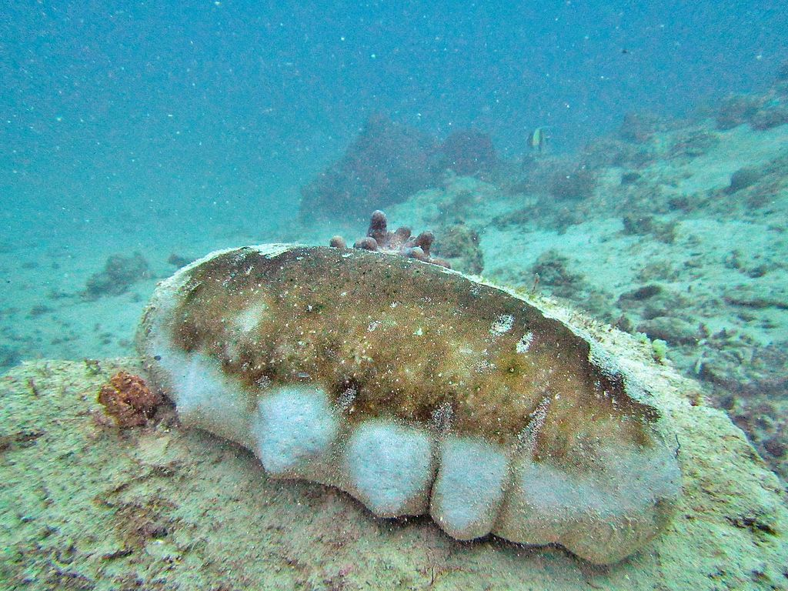
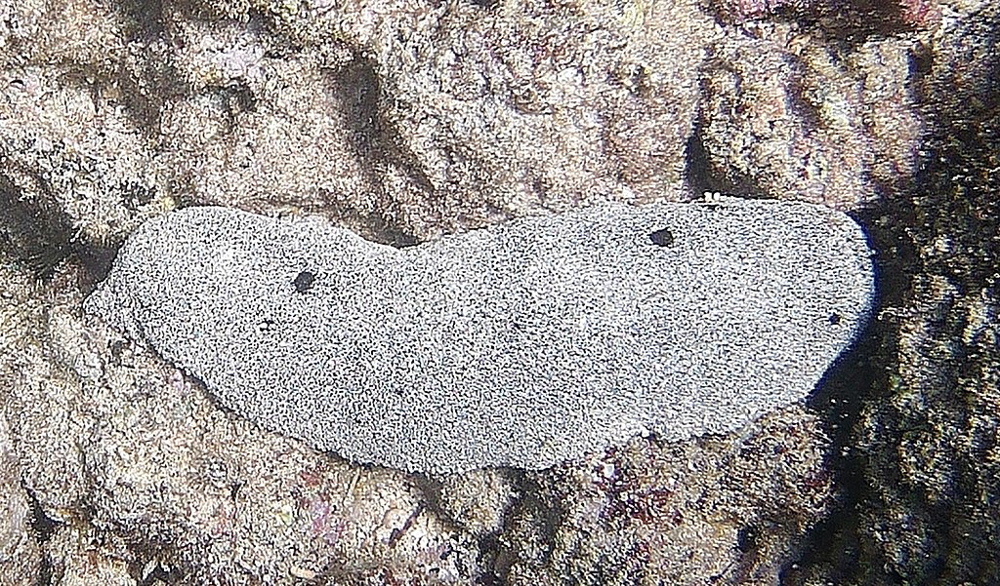
Teatfish: barely known, hugely valuable
Holothuria nobilis
Holothuria fuscogilva
Holothuria whitmaei
Listed in Appendix II after CoP 18 (entered in to force in August 2020)
Can be processed into edible beche-de-mer, an Indo-Pacific delicacy
Basis for a fishing industry that employs 3 million small-scale fishers

Slide 21
CITES and illegal
wildlife trade

Slide 22
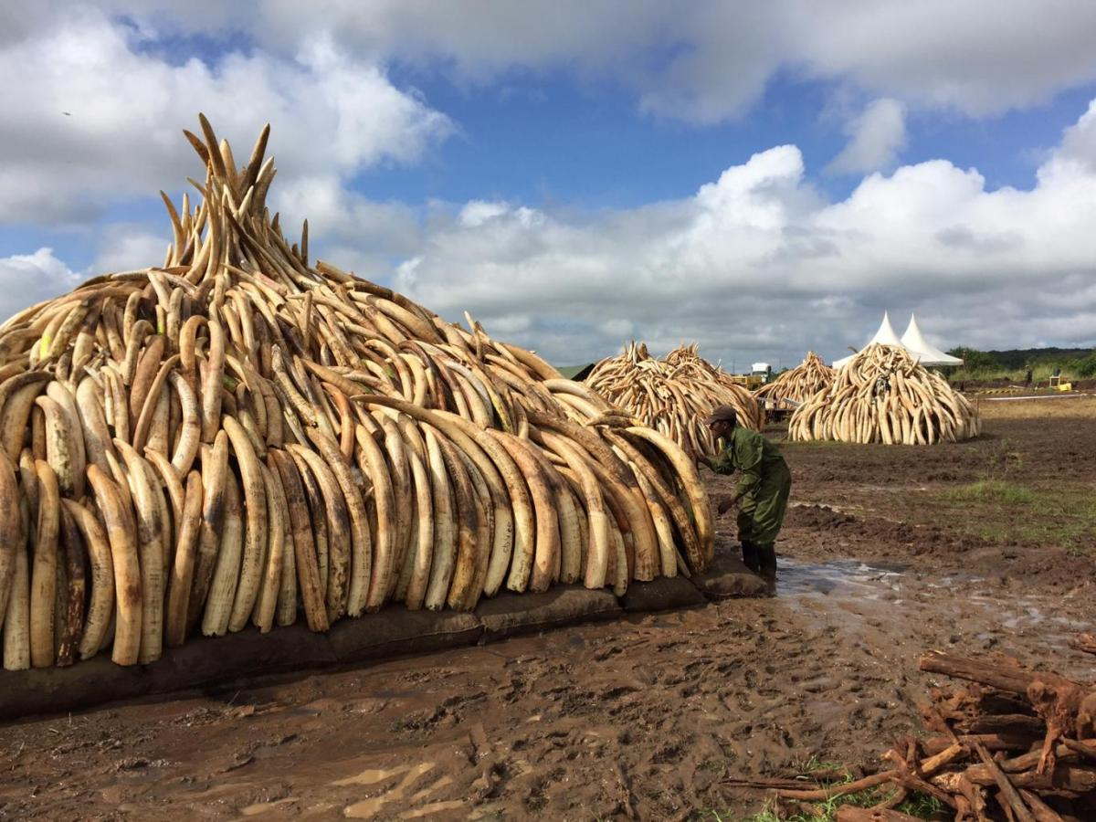
Illegal trade: a lucrative crime
USD 5-20 billion /year*
Illegal trade can involve:
  Specimens that cannot be commercially traded
  Specimens that can be lawfully traded, but not in accordance with CITES
* Estimated, excludes marine & timber
Notes:
So far, we’ve only addressed *legal trade*.
There is, sadly, another side to this coin: illegal wildlife trad is a massive global phenomenon that involves international organized crime networks which deal in the illegal commercial exploitation of species whose trade is banned, or which circumvent legislation and enforcement efforts to over-trade species whose trade is heavily regulated. Famous cases include the trade in ivory through the poaching of elephants or rhinos, which is globally banned, but illegal trade goes way beyond this, as these figures and those on the following slide can show you.

Slide 23
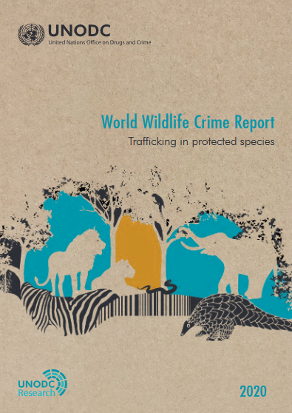
Wildlife crime: progress & new challenges
World Wildlife Crime Report 2020 (WWCRII): wildlife crime remains a threat
Pangolins are now the ‘most trafficked mammal in the world’; seizures of valuable timber species remain high, new markets have emerged
Some good news: poaching figures for rhinos and elephants have declined
WWCRII showed the power of CITES Parties’ data
UNODC’s World Wildlife Crime Report 2020

Slide 24


Combating wildlife crime through ICCWC:
The CITES Secretariat is one of five members of the International Consortium on Combating Wildlife Crime (ICCWC).
ICCWC provides information-sharing and capacity-building tools to States and their enforcement agencies

Slide 25
CITES, animal welfare
and animal rights

Slide 26
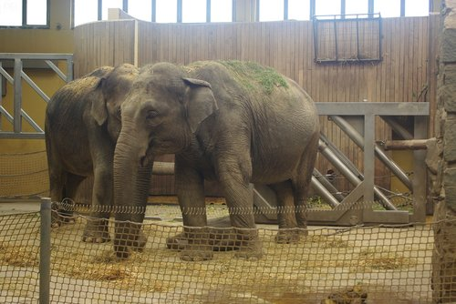
Animal welfare provisions under CITES
Limited to international transport of live animals
Primary aim is to minimize risk of injury, damage to health or cruel treatment
In some cases, rules on the sustainability of destinations apply
Broader health and welfare issues tackled by OIE and others.

Slide 27
CITES and zoos & aquariums

Slide 28
Purpose of trade in live animals by number 2009-2018
In numbers of live animals: 0.06% (~31,700 out of ~52.3 million) were traded for zoological purposes, while 0.01% were traded for circuses/travelling exhibitions
As for transactions of live animals, 0.8% (~9,200 out of ~1.2 million) were for zoological purposes, while 0.2% were for circuses/travelling exhibitions
Zoological purposes was the third most common purpose for transactions of live animals

Slide 29
Direct exports in live animals by number for zoological purposes
The number of live animals traded for zoological purposes appears to have peaked in 2012 according to exporters, whereas importer-reported data indicates a general decline since 2010

Slide 30
Direct exports in live animals by number for circuses or travelling exhibitions
The number of live animals traded for circuses/travelling exhibitions appears to have generally declined over time since 2009

Slide 31
Main taxa in trade as live animals by number for zoological purposes (purpose Z)
~5,000 animals
~31,700 animals
~61,000 animals

Slide 32
Main taxa in trade as live animals by number for circuses and travelling exhibitions (purpose Q)
~5,000 animals
~4,300 animals

Slide 33
Sources of live animals traded by number for zoological purposes and circuses/travelling exhibitions
~31,700 animals
~5,000 animals

Slide 34
CITES and WAZA

Slide 35


CITES-WAZA cooperation:
CITES Secretariat-WAZA memorandum of understanding signed in 2011
Major fields of cooperation:
Care and placement of confiscated live animals
The transport of live animals
Gathering and sharing information about wildlife trade and conservation
Knowledge/experience in captive breeding
communication and awareness
Training and capacity-building.

Slide 36
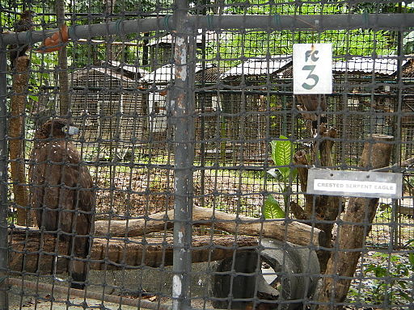
Zoos, aquariums and confiscated animals
Many zoos/aquariums already act as rescue centers or temporary holding facilities
CITES guidance on disposal already greatly influenced by WAZA knowledge, veterinary expertise could be shared further

Slide 37



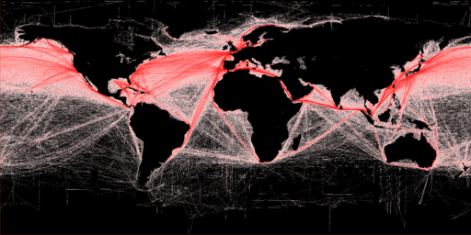
Transport of live animals
CITES requires Parties ensure specimens are well cared for during transport
IATA LAR guidelines are the standard for the transport of live animals
WAZA members could share expertise in the review of these guidelines by CITES Committees

Slide 38




Current Wildlife Trade Issues
WAZA network could assist in data collection on the status of species (e.g. for NDF)
Expertise also welcome for identification, taxonomy, marking or forensics
Several CoP 18 Decisions will require WAZA contribution

Slide 39
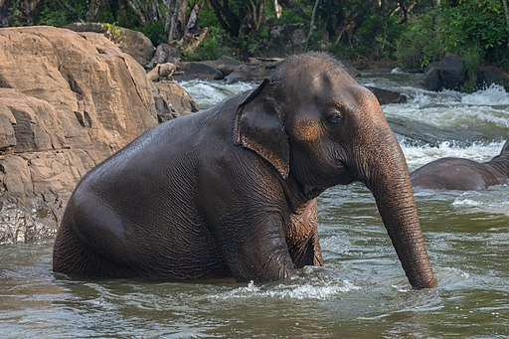
Marking and monitoring of live Asian Elephants
Decisions 18.222-18.227
Parties involved in trade in Asian elephants should “request as necessary assistance from experts”, including WAZA members, to “develop strategies to manage captive elephant populations”.

Slide 40
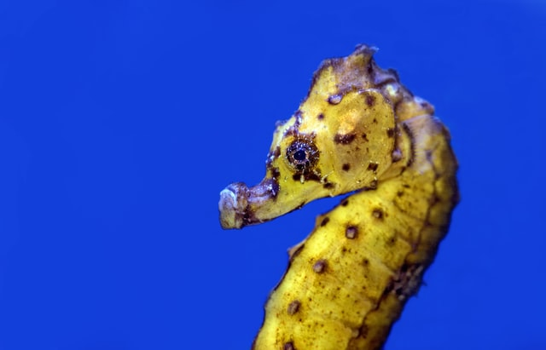
Live ornamental fish trade
Decisions 18.296-18.298
CITES Secretariat to convene a technical workshop on trade in non-CITES-listed ornamental fishes. Workshop to include experts, range States, industry. Inputs and expertise from WAZA highly appreciated.

Slide 41
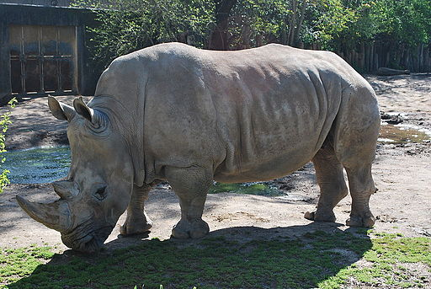
Appropriate & acceptable destinations
The Secretariat is happy to note that WAZA has shown interest in joining a working group on the definition of “appropriate and acceptable destination”, particularly for African elephants and southern white rhinos.

Slide 42
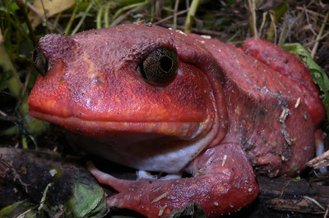
Amphibian trade & breeding
Decisions 18.194-18.196
The WAZA community’s expertise would be highly valuable for a series of CoP-mandated workshops on amphibian trade, particularly the pet market for live amphibians.

Slide 43
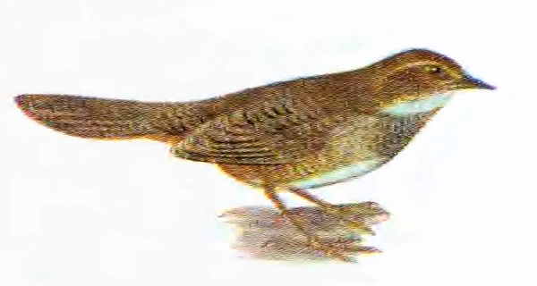
Songbirds trade & management
Decisions 18.256-18.259
WAZA knowledge would also be valuable in determining the scale and scope of trade in songbirds to determine their conservation needs, as per CoP-mandated action.

Slide 44
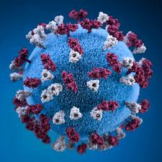
Zoonotic diseases
Secretariat working to inform Standing Committee on how CITES could contribute to reducing the risks posed by zoonotic diseases. WAZA’s veterinary expertise would be highly valuable.

Slide 45
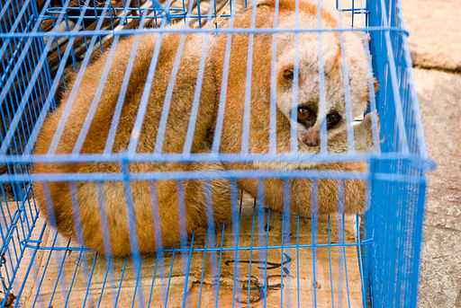
Trade in live animals in accordance with CITES
Members of WAZA can act as eyes and ears of the Convention and share information on suspicious offers, prices or other trade developments.

Slide 46
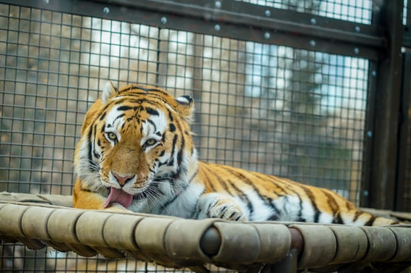
Captive-breeding
Shift in trade specimens from wild-caught to captive-bred poses new conservation challenges. WAZA ideally placed to help enact CoP17 Resolution on review of captive-breeding trade and inspecting breeding facilities, particularly tiger farms.

Slide 47
Communication, training & capacity-building
WAZA members have long history of successful communication work on issues critical to CITES.
Your members’ expertise could reinforce CITES outreach tools like livelihoods case-studies or CITES Virtual College.
We could cooperate to spread messages on conservation and sustainable use.

Slide 48
Conclusions:
CITES lies at the intersection of trade, development, environment and animal welfare and rights.
The Convention relies on collaboration with wide range of partners and experts like WAZA, who shares many of the CITES priorities, and can and should play a big role in future implementation challenges.
Our cooperation, already fruitful, must continue to meet challenges of the future, not least those that have risen with COVID-19.

Slide 49





Thank you for your attention!
www.cites.org
Stay in touch:

