Slide 1
Main themes of FAO - CITES collaboration project on sharks and rays
65th meeting of the
CITES Standing Committee (SC65)
Geneva, 07 June 2014

Slide 2
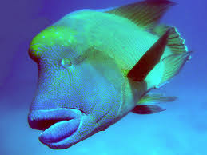
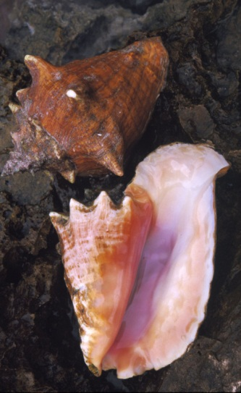
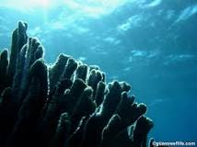
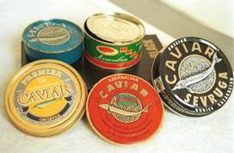
Commercially-exploited aquatic species in CITES Appendices
Humphead wrasse - Appendix II
Queen conch - Appendix II
Giant clams - Appendix II
Hard corals, black corals
- Appendix II
European eel - Appendix II
Sturgeons - Appendix I & II
Seahorses - Appendix II

Slide 3
CoP16 (Bangkok, March 2013)
Five shark species and all manta rays were included in Appendix II
Delayed entry into effect on 14 September 2014
  in order to resolve technical and administrative issues related to their implementation
EU contributing 1.2 million EUR to CITES for assisting developing countries in their implementation of the new listings of sharks and manta rays
Notes:
Specifically on the issue of sharks….at the 16th meeting of the Conference of the Parties to CITES, CoP16, held in Bangkok in March this year, the Parties decided to place five shark species and all manta rays in Appendix II.
Parties also agreed that their entry into effect would be delayed until 14 September 2014 in order to resolve technical and administrative issues related to their implementation.
At the same meeting, the EU announced that it was contributing 1.2 million EUR to CITES for assisting developing countries in their implementation of the new listings of sharks and manta rays. Other bilateral and multilateral support has also been made available to Parties.

Slide 4
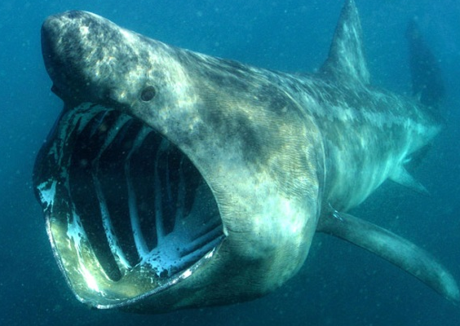
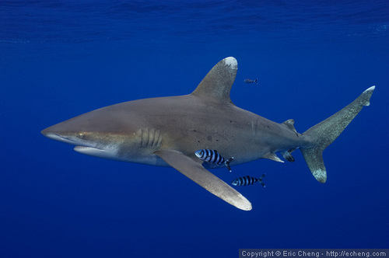
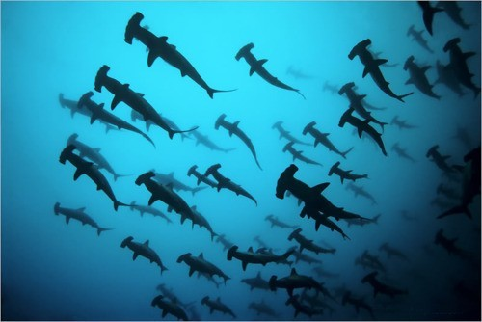
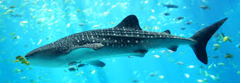
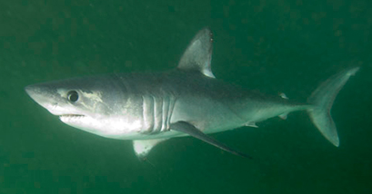
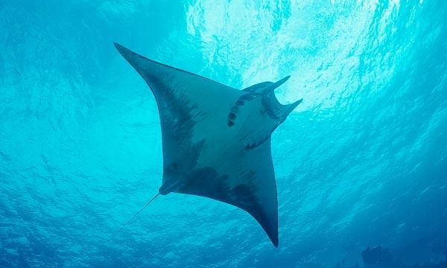
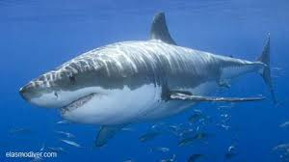
Sharks/Manta rays in Appendix II
Cetorhinus maximus (Basking shark)
Carcharhinus longimanus (Oceanic whitetip shark)
Sphyrna lewini, S.mokarran,
S. zygaena
(Hammerhead sharks)
Rhincodon typus
(Whale shark)
Lamna nasus
(Porbeagle shark)
Manta spp.
(Manta rays)
Entry into effect delayed to 14 September 2014
Carcharodon carcharias
(Great white shark)

Slide 5
What should Parties do by
14 September 2014?
Legality
Trade in legal specimens
Compliance with fishery laws, NPOA-Sharks
Monitoring, inspection, enforcement
Compliance with regional/subregional/bilateral legal agreements (e.g. RFMOs)
Sustainability
Export is not detrimental to the survival of the species / sustainable
Scientific assessments on species status in national/regional territory (non-detriment findings, NDFs)
Science to ensure sustainable fishery
Traceability
Record trade from origin to destination
CITES permits & certificates
National annual CITES reporting/data bases
Identification / verification
Collaboration CITES
Authorities & fisheries agencies
Enhancing enforcement
Notes:
The requirements of CITES implementation can be divided into the three main objectives of CITES: ensuring legality, sustainability, and traceability. Under each of them, there are a number of processes and tools that could be considered by countries.

Slide 6
Collaboration and cooperation are essential for CITES implementation
National stakeholders include:
  CITES Authorities
  Natural resources sector
  Businesses (traders, wholesalers, transport, etc.)
  Fisheries inspectors, food security
  Customs, police
  Judiciary
  Others

Slide 7
Capacity-building for implementation of new shark and ray listings
European Union contribution of EUR 1.2 million
Implemented in partnership with FAO
Quick wins; identification tools
Visibility: brochure, events, web portal (cites.org/eng/prog/shark)
Regional needs assessment workshops
Targeted follow-up actions; synergizing with others

Slide 8


EU-CITES project
European Union: EUR 1.2 million
Implemented in partnership with
FAO
Objective:
  To build scientific, legislative and administrative capacity of developing Parties to help implement new CITES-listed sharks and manta rays whose entry into effect was delayed by 18 months until 14 September 2014

Slide 9

EU-CITES project: Approach
Working in partnership with FAO
  Preparatory studies
  Quick wins; identification tools
  Joint outreach: brochures, events,
  web portal (cites.org/eng/prog/shark)
  Regional needs assessment workshops
  Targeted follow-up actions
  Synergizing with others
Reaching out to RFMOs
Supporting Parties (key shark fishing
nations)
Gathering pertinent information

Slide 10
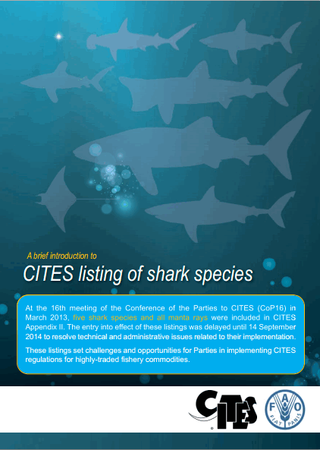
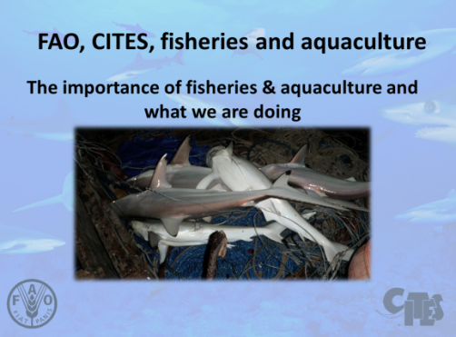
EU-CITES project: Accomplishments
FAO-CITES regional consultative workshops in Africa and Asia
Support to/take part in regional workshops in Latin and Central America, Oceania, Bay of Bengal
Representation at COFI-FT, COFI,
RFMO meetings
CITES-FAO leaflet
Joint presentation materials

Slide 11
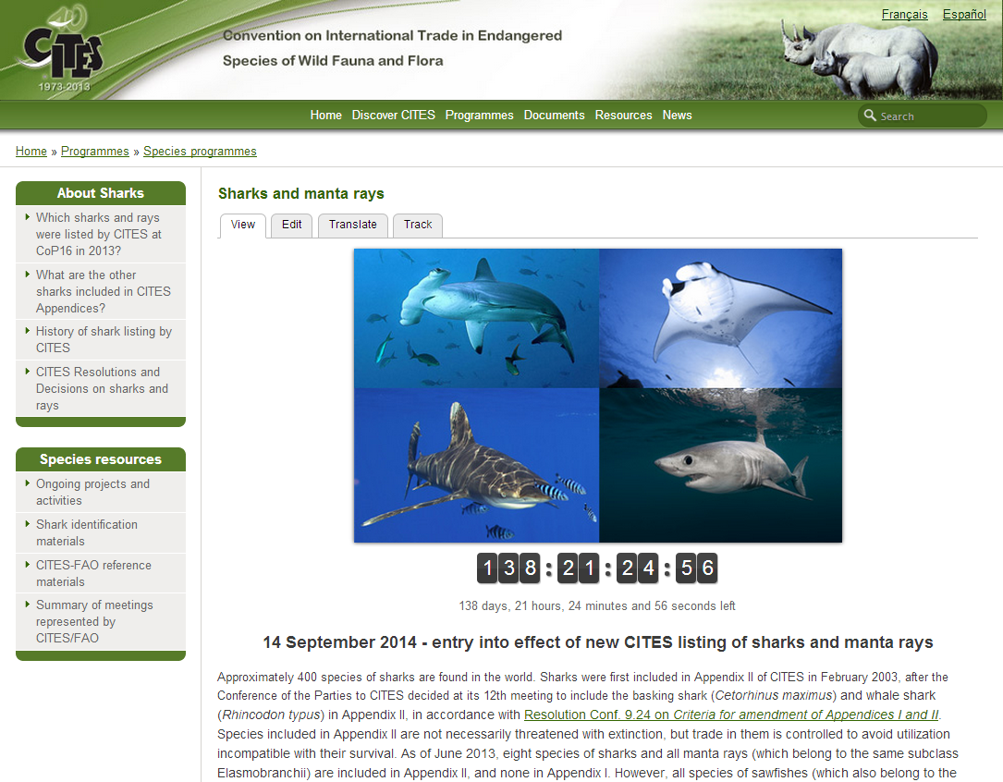
EU-CITES project: Accomplishments
  CITES sharks web portal cites.org/eng/prog/shark
  Species information
  History, Resolutions & Decisions on shark listings
  Meeting calendar
  RFMO measures
  Ongoing activities
  Identification
  materials
  Other information
  & tools

Slide 12
EU-CITES project: next steps
Summary and analysis from regional workshops and needs assessments
Planning steps for national and subregional targeted support activities
  Focus on NDFs, legal acquisition, IFS
FAO-CITES collaboration on:
  International Plan of Action (IPOA) - Sharks
  National fisheries legislation support
  Identification materials

Slide 13







Thank you for your attention!
CITES and FAO working for legal, sustainable and traceable international trade in sharks and manta rays, supported by the European Union

