Slide 1
Lessons from the CITES-FAO needs assessment workshops and the way forward
65th meeting of the CITES Standing Committee
7 June 2014

Slide 2
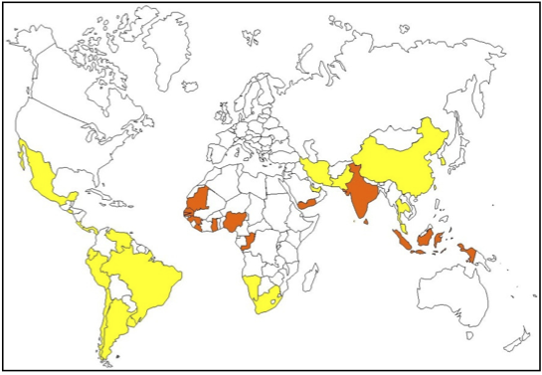
Target countries – FAO report
Range states of the species
Significant shark catches and/or trade
Developing countries
Orange: high priority countries
Yellow: priority countries

Slide 3
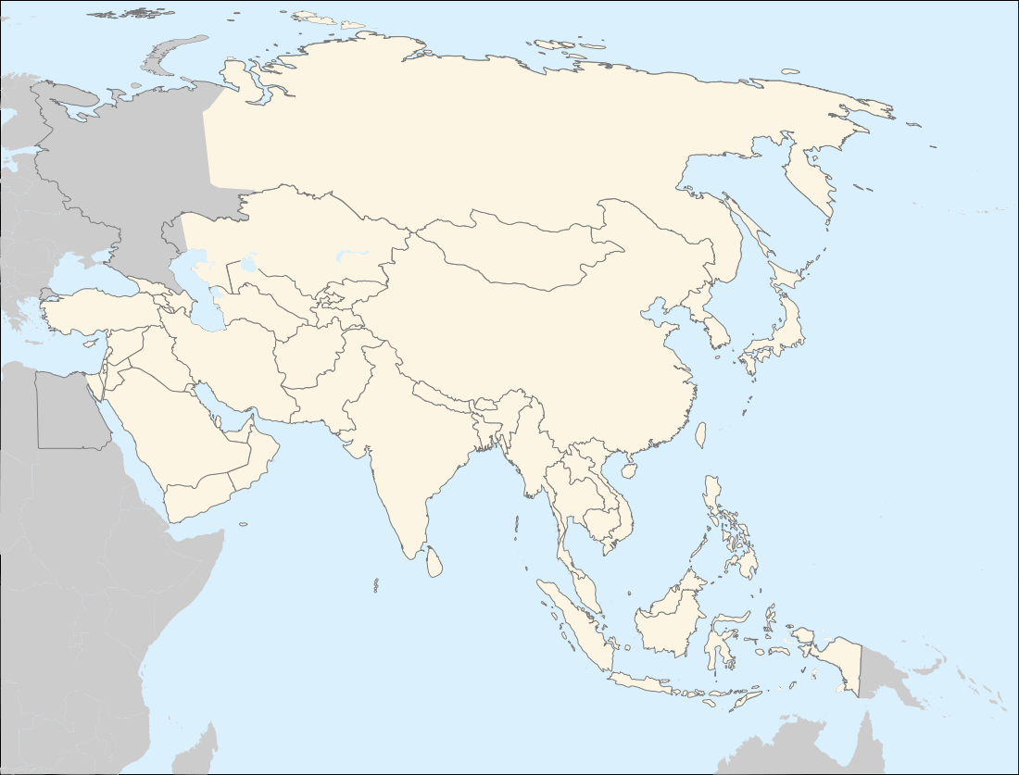
Catches
Oceanic whitetip
Mobulidae
Sphyrnidae
Rajiformes
Elasmobranchii
Other species in other colours

Slide 4
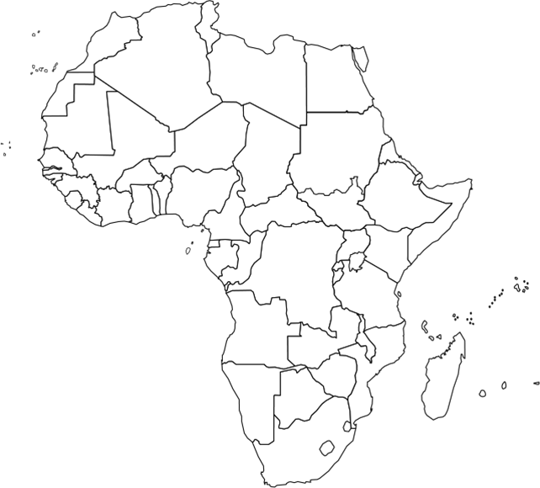
Catches
Mauritania
Senegal
Gambia
Guinea
Liberia
Ghana
Nigeria
DRC
Mobulidae
Sphyrnidae
Namibia
Rajiformes
South Africa
Elasmobranchii

Slide 5
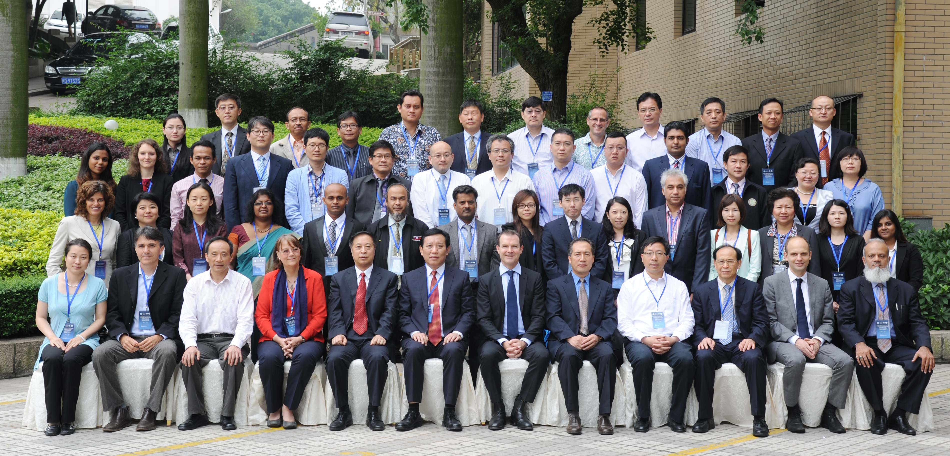
FAO/CITES Regional consultative workshop on sharks for Africa
Casablanca, Morocco. 11-13 February
FAO/CITES Regional consultative workshop on sharks for Asia Xiamen, China. 13-15 May

Slide 6
CSA&C Regional Workshop on Sharks Listed in Appendix II of CITES - Preparing for Implementation. Recife, Brazil. 3-4 December 2013.
CITES Oceania Regional Workshop on Implementation of CoP16 sharks and ray Appendix II listings. Wollongong, Australia. 9-11 December 2013.

Slide 7
Consultant appraisal

Slide 8
Results/Common main limitations
Roadmap
Action Plan
Lack of effective shark management measures
Limited knowledge and expertise to identify products in trade
Lack of traceability mechanisms to verify the origin and legality of products in trade
Lack of coordinated networking and collaboration among agencies
Insufficient prolonged and targeted funding for the implementation of CITES requirements

Slide 9
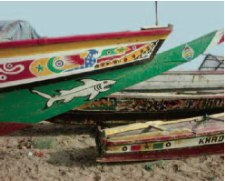
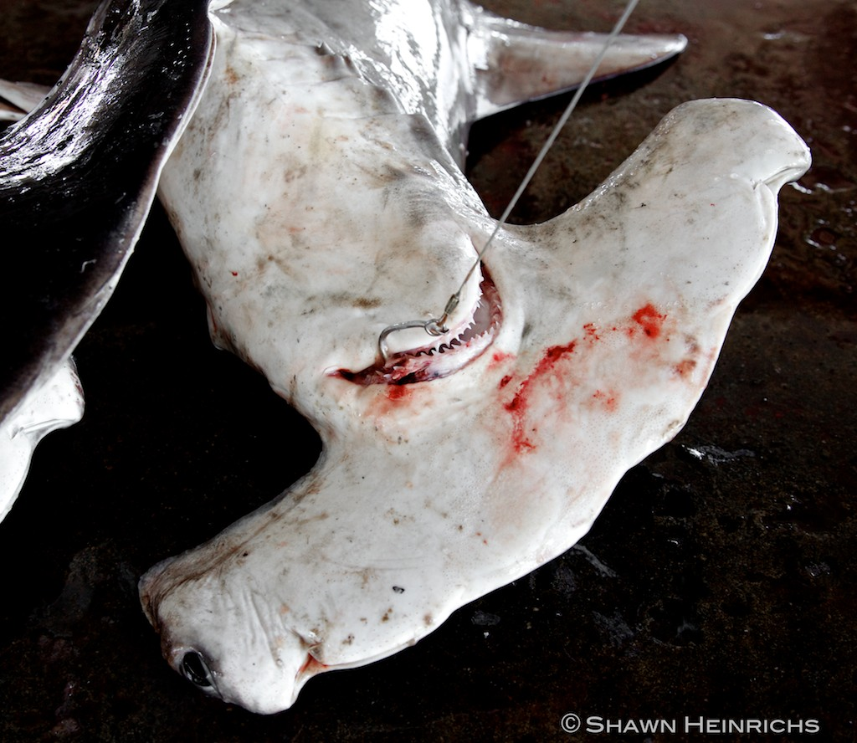
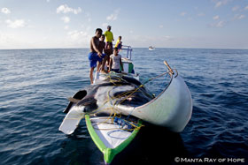
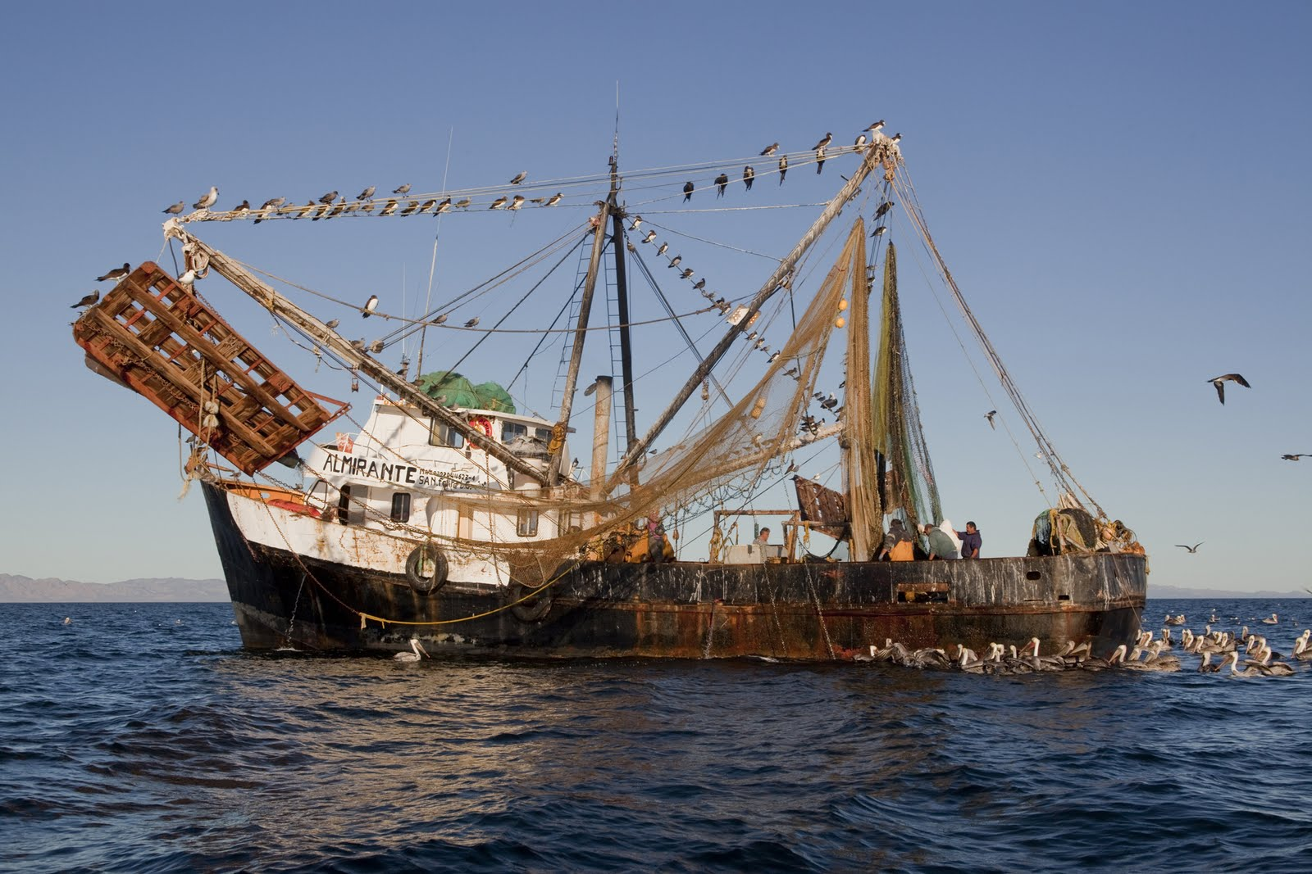
FISHERIES National waters High seas Small scale Industrial Bycatch Target
In general sharks represent less than 5% of the total marine catches
Sharks and rays not reported at species level

Slide 10
Country | DR Congo | Gambia | Ghana | Guinea | Liberia | Mauritania | Namibia | Nigeria | Senegal
NPOA-Sharks
Prod. form |  | * | * | * |  | * | * | * | *
Gear
Access
Spatial
Sps. prohib
Capacity
Size
Temporal
Catch
yes
no
* Norms prohibiting finning: implementation not clear in some cases (e.g. fin-to-body weight, etc.)

Slide 11
Country | China | Indonesia | Iran | Korea | Malaysia | Maldives | Pakistan | Sri Lanka | Thailand | Yemen
NPOA-Sharks |  |  |  |  |  | ** |  | **
Prod. form | * | * | * | * | * | * |  | * |  | *
Gear
Sps. prohib.
Access
Spatial
Temporal
Capacity
Size
Catch
yes
no
* Norms prohibiting finning (e.g. required landing of fins attached to body, 5% fin-body weight)
** NPOA yet to be adopted.

Slide 12
What next?
Direct support to key fishing and trading States – based on self-assessment and consultant’s report.
Key RFMO engagement
Opportunistic follow-up through existing FAO activities.

Slide 13
Thank you for your attention! CITES and FAO working for legal, sustainable and traceable international trade in sharks and manta rays, supported by the European Union

