Slide 2
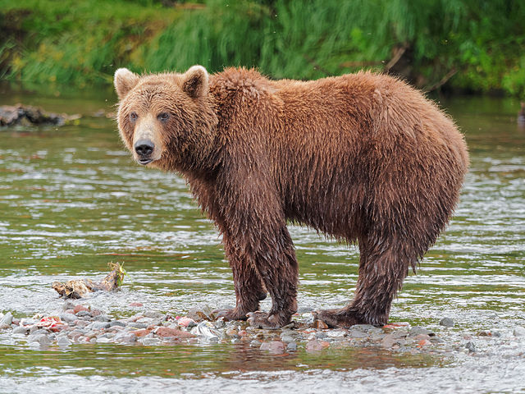
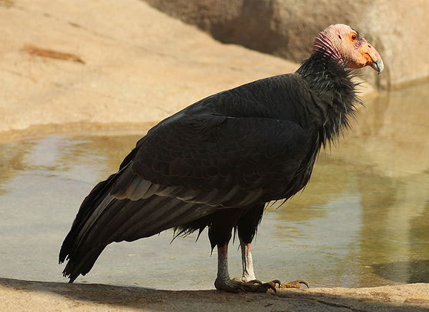
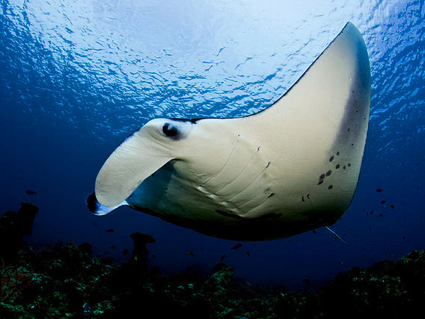
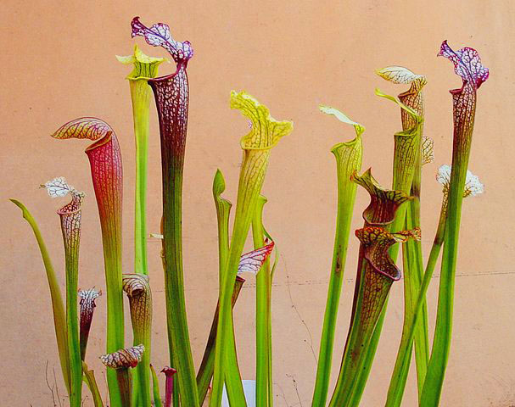
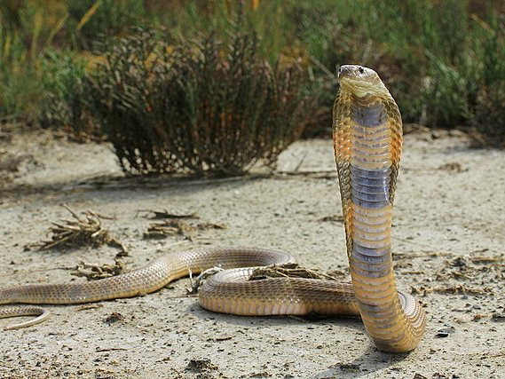
Sustainable use: a powerful tool to ensure the conservation of species of wild fauna and flora
By Ivonne Higuero
Secretary-General, CITES
Reverse the Red Pavilion
IUCN Congress
September 3 - 11, 2021

Slide 3
CITES-IUCN cooperation:
CITES Secretariat - IUCN memorandum of understanding signed in 1999
CITES historically anchored in the IUCN movement
IUCN and SSC data substantial elements of documentation during CITES CoP Meetings
Red List & SSC expertise inform CITES with species not currently listed (i.e., songbirds, amphibians, etc.)
Shared vision on the power of sustainable use & conservation

Slide 4
What is CITES?

Slide 5
What does ‘CITES’ mean?
Convention on International Trade in Endangered Species of Wild Fauna and Flora
CITES is a Multilateral Environmental Agreement (MEA), signed on 3 March 1973, entered into force in 1975

Slide 6
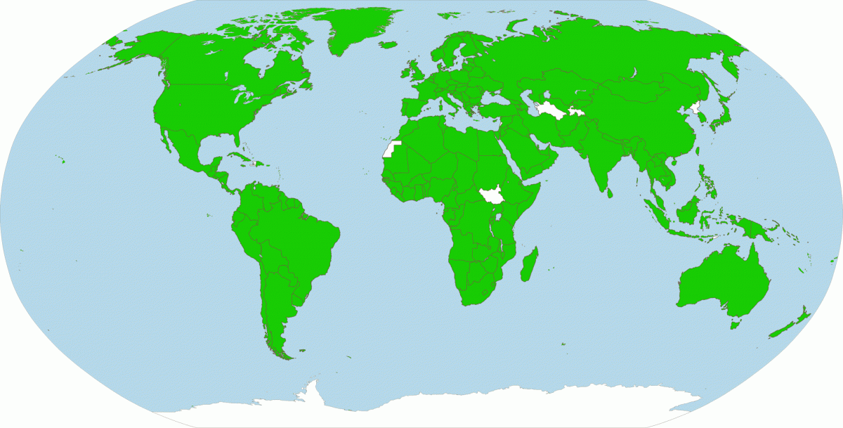
Who is involved in CITES?
CITES has 183 signatory Parties: 182 UN-States and the EU.

Slide 7
The purpose of CITES:
CITES aims to regulate trade in over 38’000 species of wild fauna and flora to ensure it does not threaten their survival
Combines wildlife and trade themes within a legally binding instrument
It is aimed at achieving conservation and sustainable use objectives
The signing of the CITES
Convention. Washington, D.C., 3 March 1973.

Slide 8
What kind of trade is covered by CITES?

Slide 9
CITES regulations:
Apply to all ‘specimens’ of CITES-listed species
Includes whole/live species of plants & animals or derivatives of any form
‘Trade’ is defined as any of the following transactions:
IMPORT & EXPORT:
RE-EXPORT
INTODUCTION FROM THE SEA

Slide 10
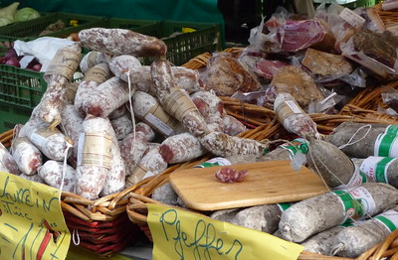
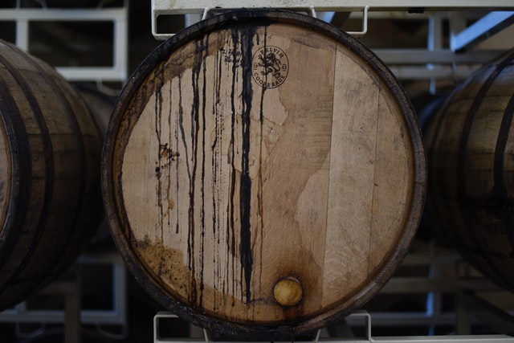
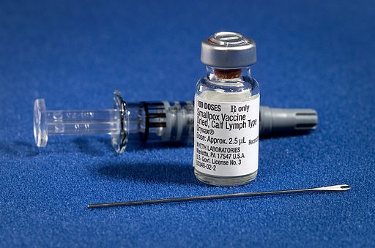
Entire economic sectors rely on wildlife:
Food: Fish, wild meat & plant foods
Housing & Furniture:
Wood, timber & other materials
Health & Beauty:
Pharmaceuticals, cosmetics, fragrances

Slide 11
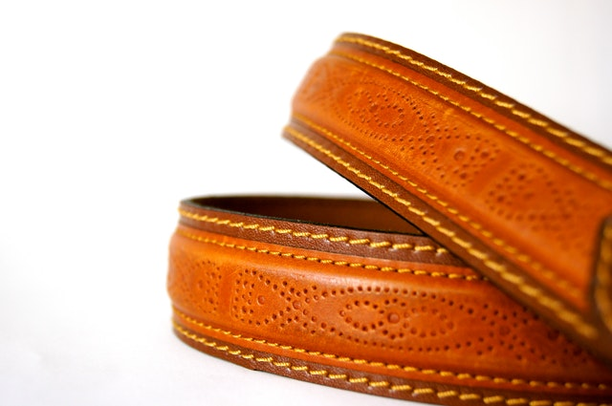
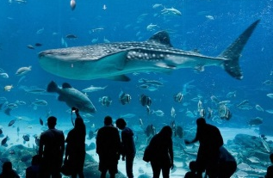
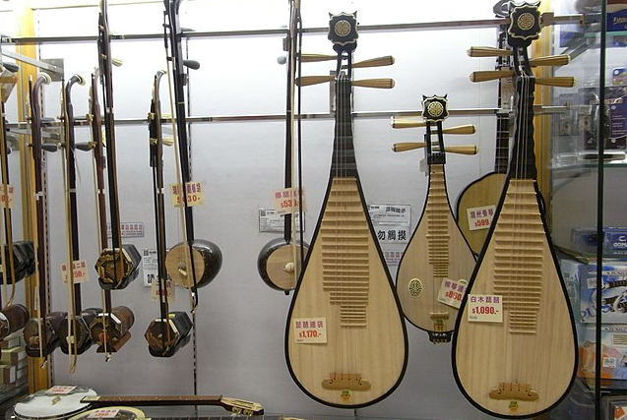
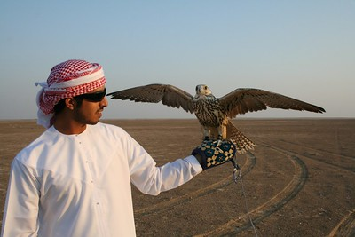
Entire economic sectors rely on wildlife:
Fashion: Leather, furs, fibers, jewelry
Tourism: Museums, souvenirs, botanical gardens
Leisure: Musical instruments, pets, ornamentals

Slide 12
How does CITES work?

Slide 13
How does CITES work?
Nationally appointed authorities deliver certificates and permits…
… for the trade of listed animals and plants
and enforce key requirements, including penalties for breaches
Parties must establish:
Management Authorities (MAs)
Scientific Authorities (SAs) to advise MAs

Slide 14
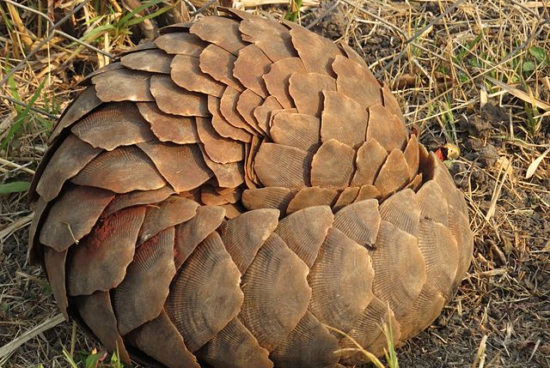
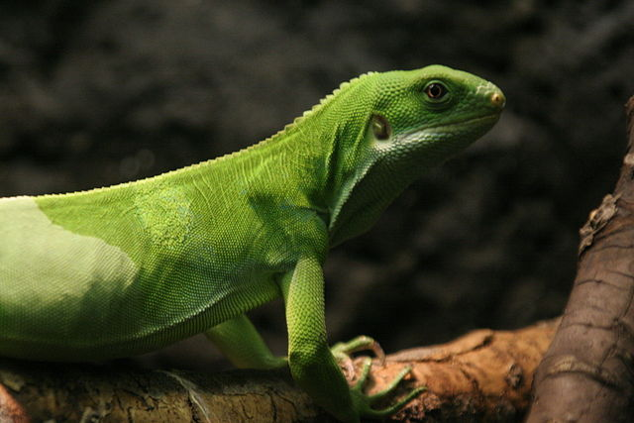
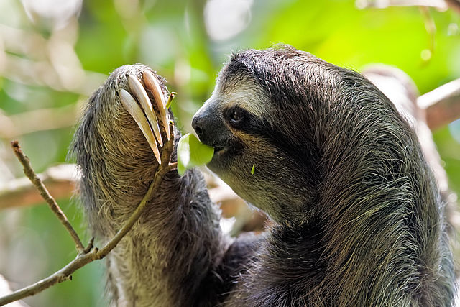
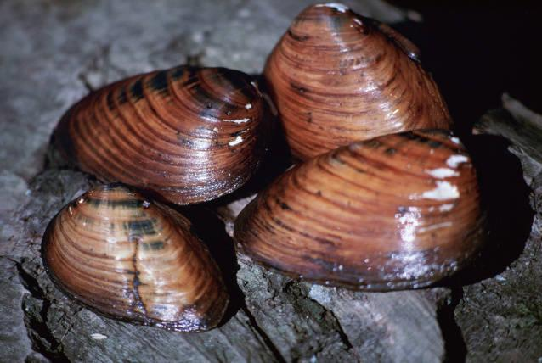
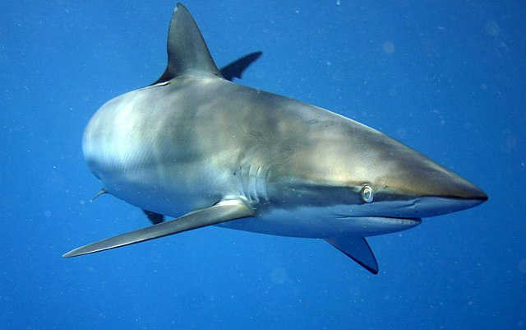
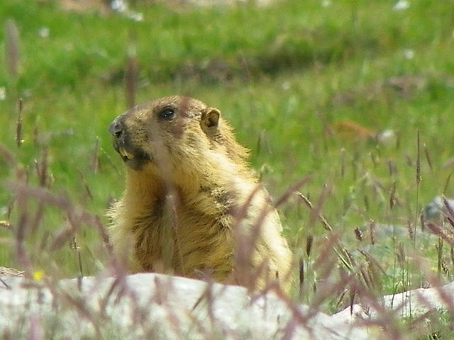
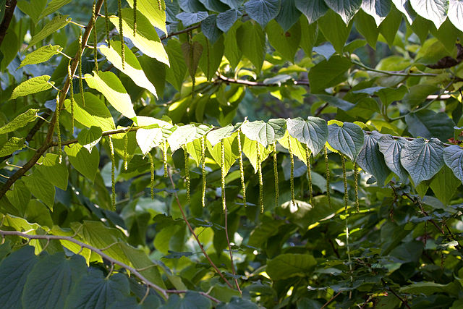
The CITES Appendices:
Species subject to CITES regulations are divided into three Appendices:
Appendix I
Appendix II
Appendix III

Slide 15
CITES Appendices: which species go where?
Appendix I
Species threatened with extinction – some 700 species of fauna and 400 species of flora
Species not necessarily threatened with extinction, but for which trade must be controlled – around 32’000 species of flora and 5’000 species of fauna
Appendix II
Appendix III
Species for which a single country is asking other Parties to help with its protection – some 200 species

Slide 16
Trade rules for CITES Appendices:
Appendix I
Trade is generally prohibited.
Appendix II
Trade is generally permitted but controlled.
Appendix III
Trade is generally permitted but controlled.

Slide 17
Most trade is permitted:
Of the 38’000+ listed species:
3% are listed in Appendix I
96% are listed in Appendix II
Distribution of species in the CITES Appendices
1% are listed in Appendix III
97% of international trade is controlled, but legal.

Slide 18
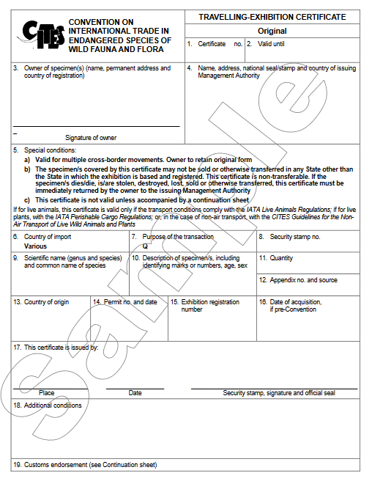
CITES requirements for trade:
Solid proof of the following:
Legality
Mandatory Legal Acquisition finding (LAFs)
Sustainability
Non-Detriment Findings (NDFs)
Traceability
Valid CITES Permits must be issued

Slide 19
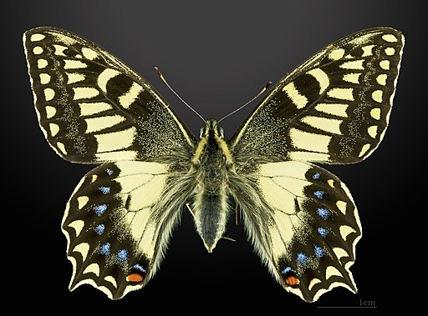
Changes to the Appendices:
Originally included in App. I in 1987
Listed as “Endangered”, then reclassified as “Least Concern” in the Red List in 2010
CITES Animals Committee review in light of new status, and down-listing to App II in 2013.
(Papilio hospiton; CITES App-II)

Slide 20
CITES trade: facts and figures

Slide 21
Scope, scale and reporting:
Trade in listed species likely valued in the billions of US dollars
Basis for the jobs and livelihoods of millions of people globally
Parties must compile annual reports of CITES trade
Data on over 20 million trade transactions reported by Parties is publicly available

Slide 22
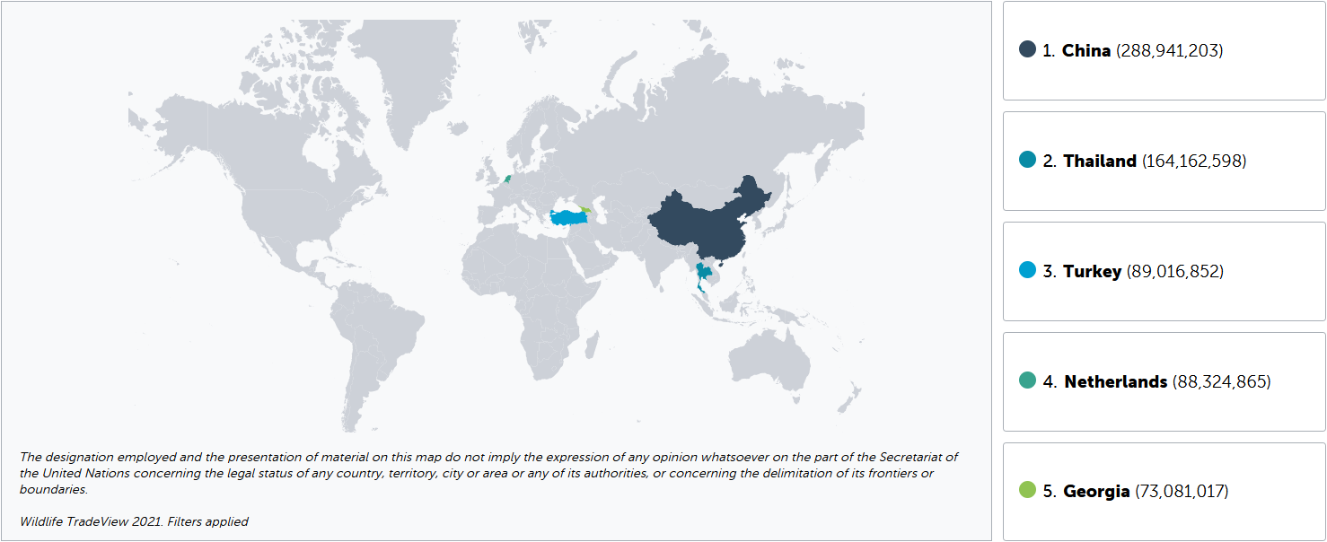
Top exporters (2015-2020):

Slide 23
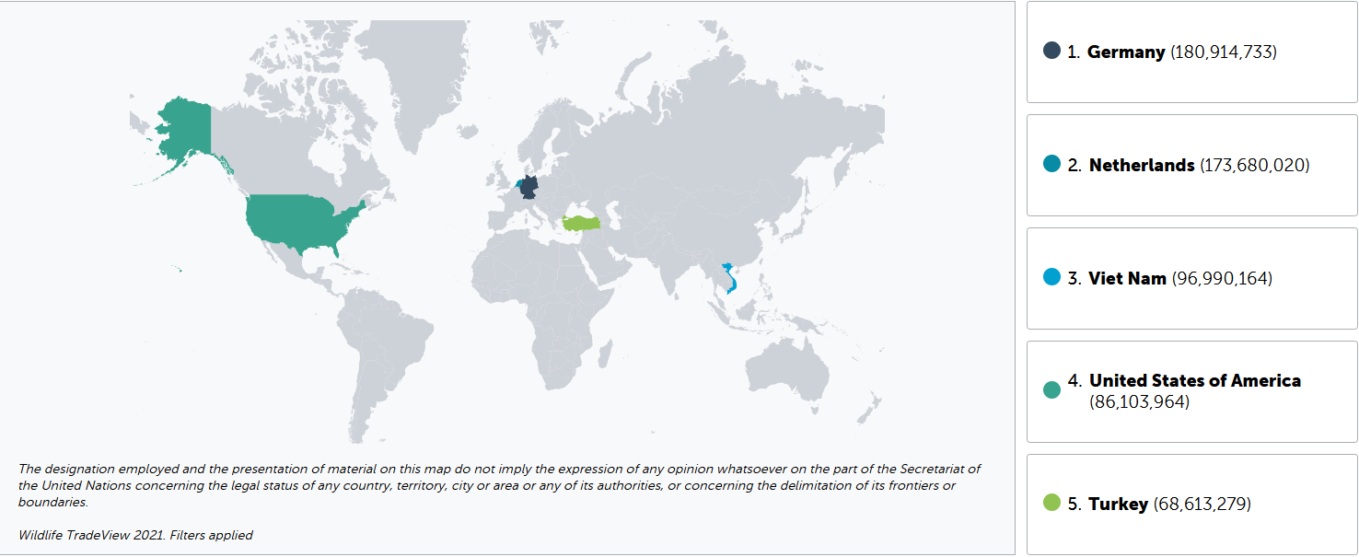
Top importers (2015-2020):

Slide 24
Top taxa in trade by class (2015-2020):
Top 10: Holothuroidea (6); Mammalia (7); Hirudinoidea (8);
Gastropoda (9); and Insecta (10).

Slide 25
CITES and sustainable use

Slide 26
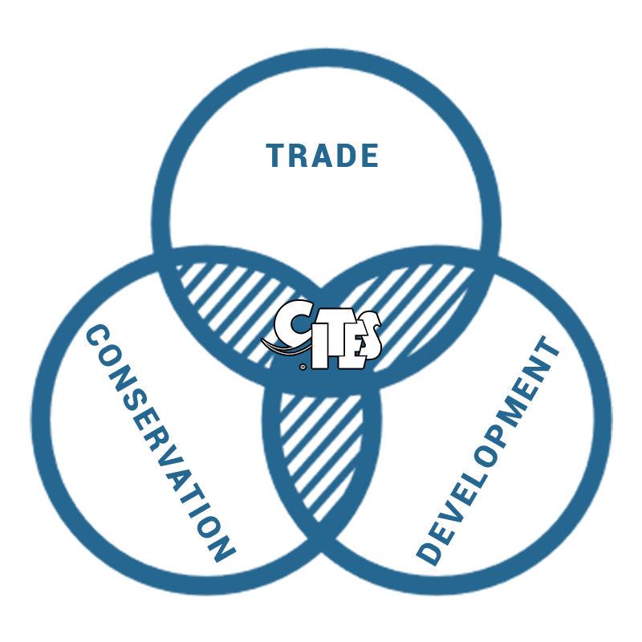
The CITES Mandate:
Parties have recognized that legal, sustainable and traceable trade can support both conservation and livelihoods

Slide 27
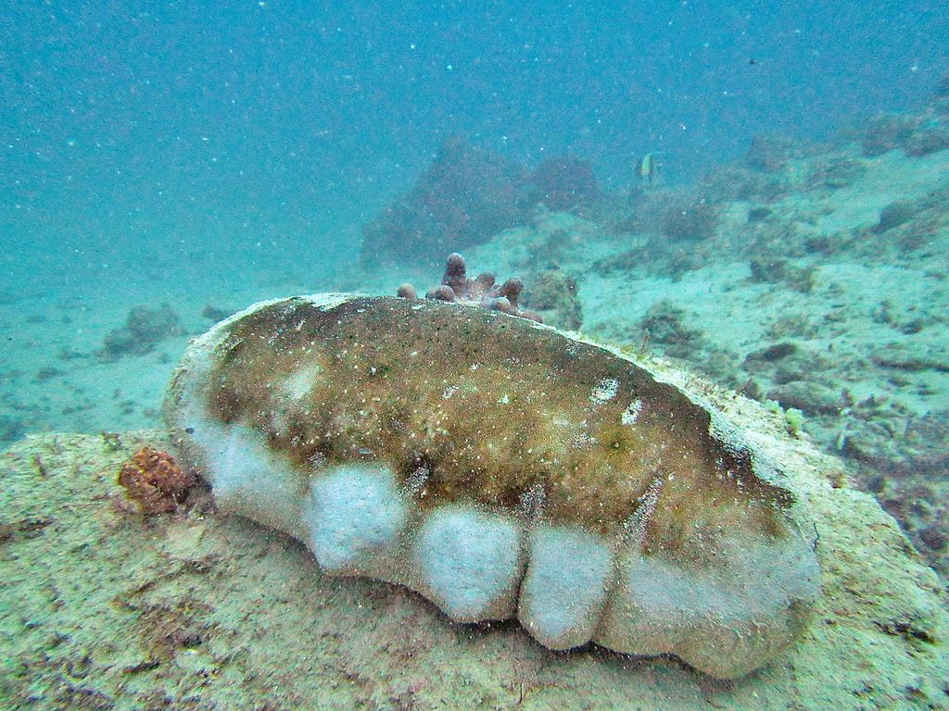
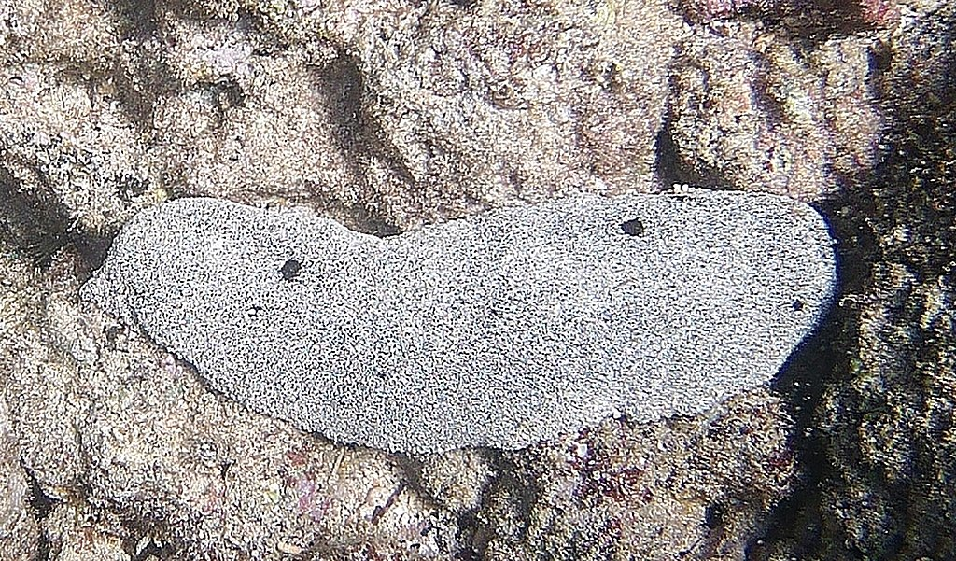
Teatfish: barely known, hugely valuable:
Holothuria nobilis
Holothuria fuscogilva
Holothuria whitmaei
Listed in Appendix II after CoP18 (entered in to force in 2020)
Can be processed into edible beche-de-mer, an Indo-Pacific delicacy
Basis for a fishing industry that employs 3 million small-scale fishers

Slide 28
Assigning economic value to wildlife:
CITES Parties have different approaches
One of them is the strictly regulated trade in hunting trophies (see CITES Resolution Conf. 17.9)
South Africa: hunting reportedly generates $341m annually & supports 17,000 jobs

Slide 29
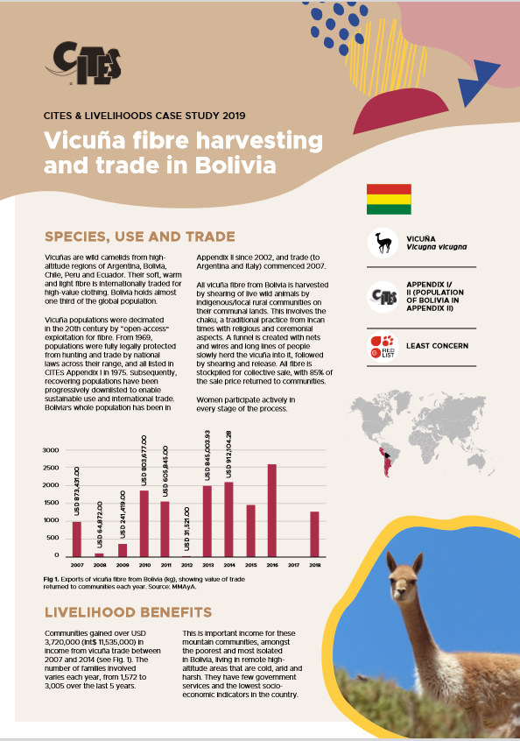
Case-studies: conservation & sustainable use
Historically prized for their silk-like wool
Nearly hunted to extinction in the 20th century
Included in Appendix I in 1975
Sustained recovery alongside the rise of a sustainable, locally-owned wool industry
Vicuñas, CITES App-II

Slide 30
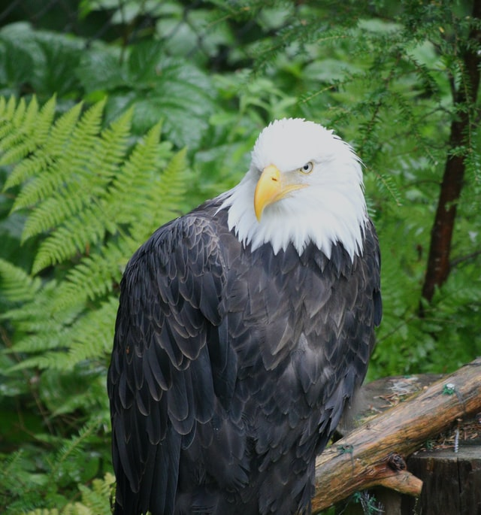
Conservation & sustainable use:
Bald eagles (Haliaeetus leucocephalus):
Intense hunting, habitat destruction and other factors decimated populations, down from 250,000 in the late 18th century to 417 pairs in 1963.
Species included in CITES Appendix I in 1977
Conservation, legal protection led to dramatic rebound in populations
Down-listed to Appendix II in 2005

Slide 31
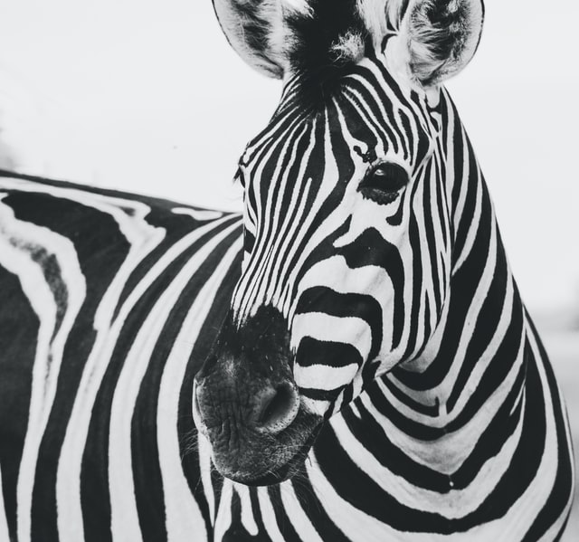
Conservation & sustainable use:
Cape mountain zebra (Equus Zebra Zebra):
Species included in CITES Appendix I in 1975
State South Africa implemented a sustainable hunting quota in 2015
Private ranchers were incentivized to conserve the species, playing a key role in its recovery
Down-listed to Appendix II in 2017

Slide 32
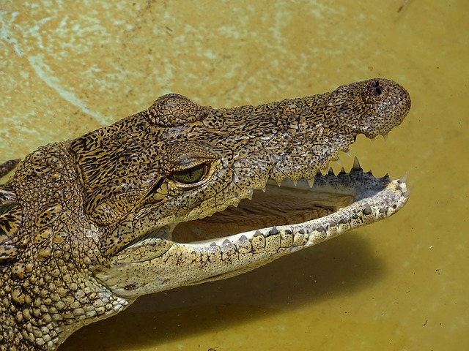
Conservation & sustainable use:
Morelet’s crocodile (Crocodylus moreletii):
Listed in CITES Appendix I
85% of species’ population is in Mexico
Export of wild specimens banned
Knowledge-sharing, conservation & captive breeding initiatives contributed to species recovery in the wild

Slide 33
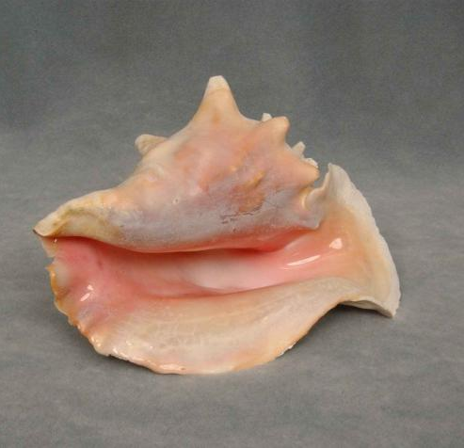
Conservation & sustainable use:
Queen Conch (Strombus gigas):
Listed in CITES Appendix II in 1992 in response to uncontrolled harvesting
CITES Parties proposed series of actions to improve sustainability of trade
Actions included quotas, temporary suspensions, controls, which led to improvements in the conservation of the species

Slide 34
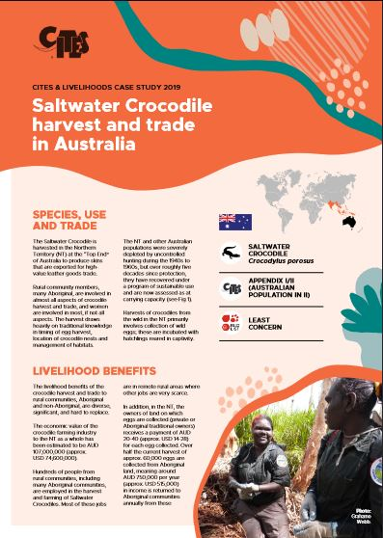
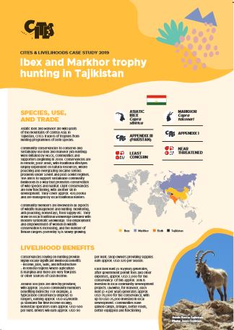
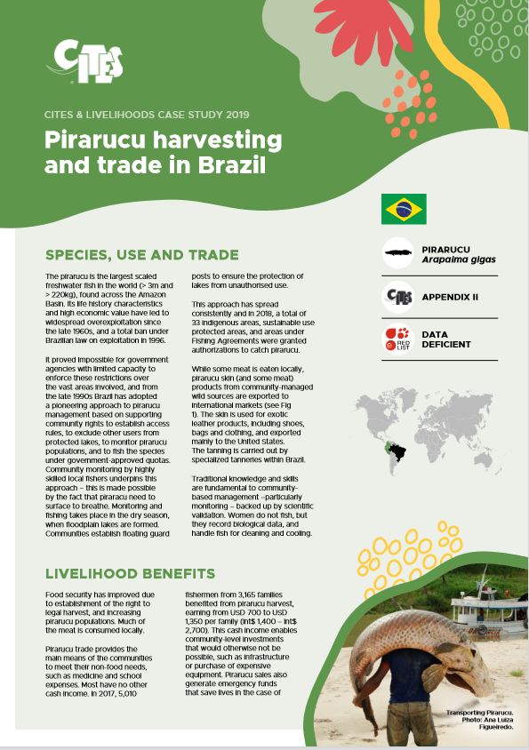
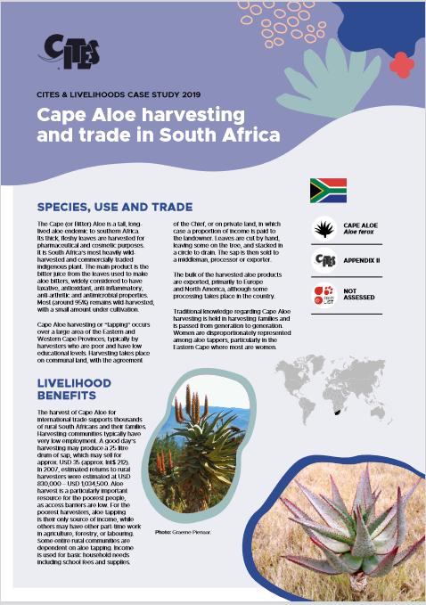
Other case-studies:
Saltwater crocodile; App-I/II
Ibex & Markhor; App-III/I
Pirarucu; App-II
Cape Aloe; App-II

Slide 35
Reverse the Red and the
Post-2020 Biodiversity Framework

Slide 36
Decisions 18.28 & 18.29:
Secretariat & Committees must identify species in Appendix I that could benefit from further action
Aimed at “Endangered” & “Critically Endangered” species listed in App. I
Secretariat to produce assessments on species and Committees to formulate recommendations for CoP19
CoP18, Geneva, Switzerland, 2019

Slide 37
Thank you for your attention!
www.cites.org

Slide 38
